Slide 1
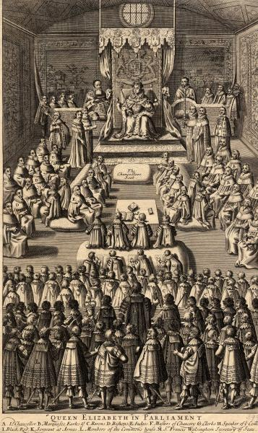
Parliaments revision – 14th November 2019

Slide 2
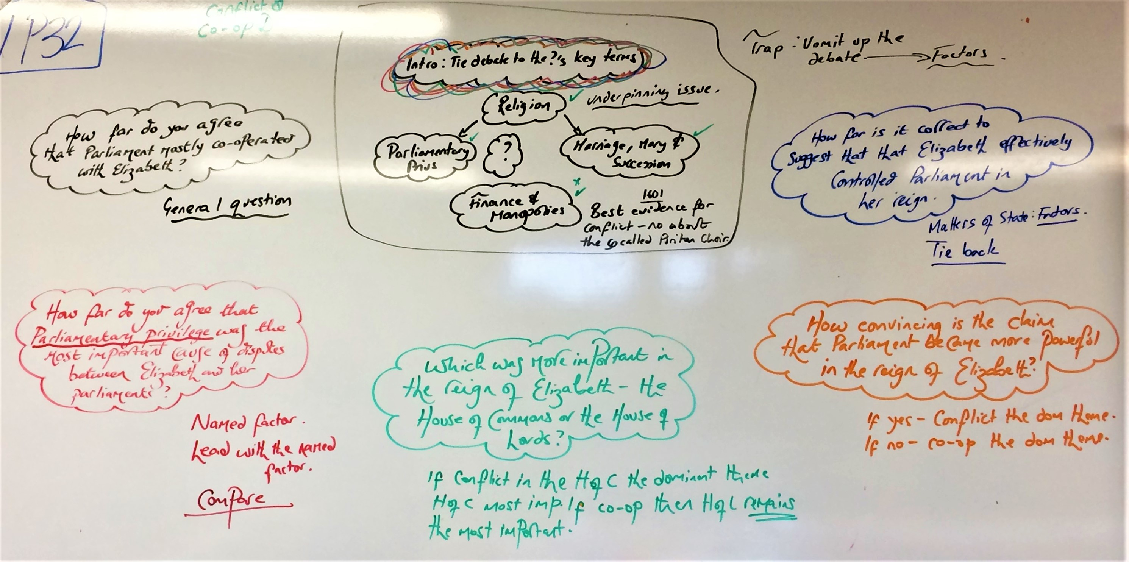

Slide 3
