Slide 1
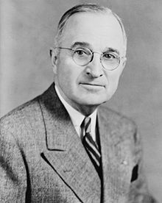
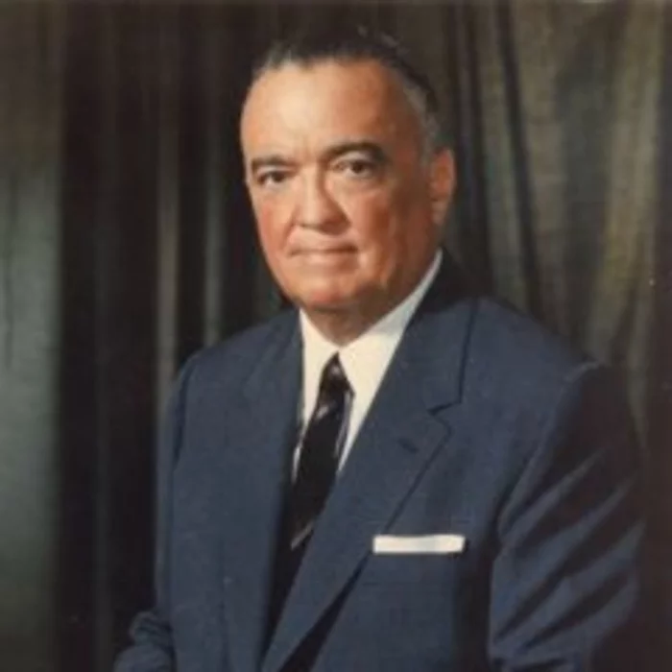
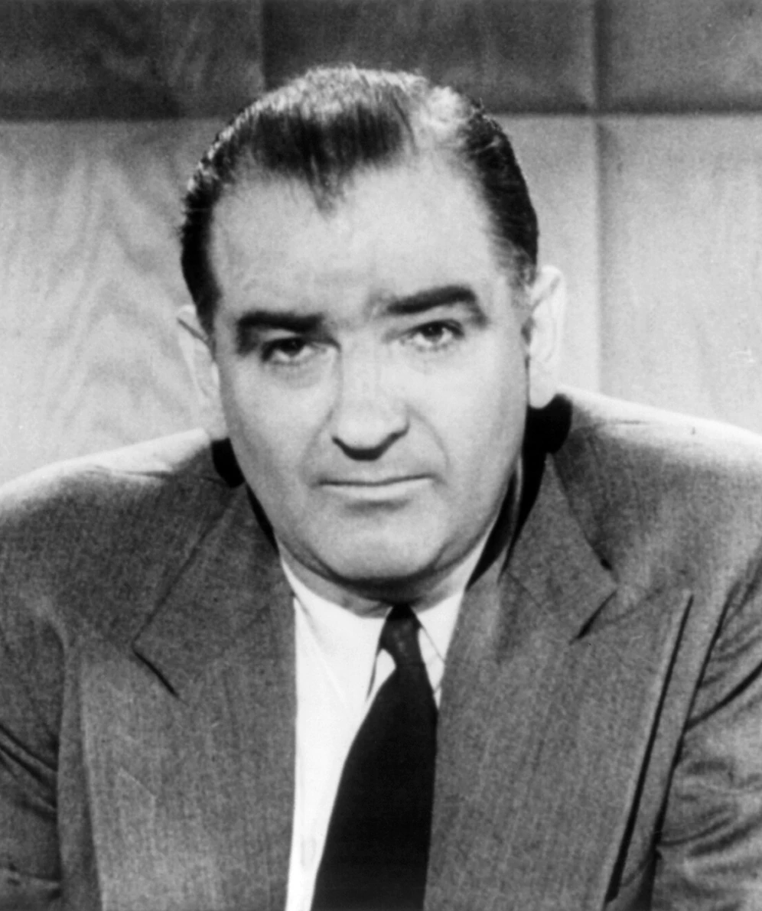
IGCSE Knowledge Organiser: Civil Rights 1945-74
The Red Scare and McCarthyism
Key Events
1 | 1945 | Second World War ends, start of the Cold War
2 | March 1947 | Truman Doctrine – promised to support any country threatened by communist takeover
3 | March 1947 | Truman order – Allowed government employees to be removed from their posts if showed on “reasonable grounds” they were disloyal to USA.
4 | Oct 1947 | Hollywood 10
5 | 1949 | Trial of Alger Hiss
6 | Feb 1950 | Start of McCarthyism in America – had a list of 205 members of the Communist Party who worked in the State Department
7 | Dec 1954 | Senate formally condemns Joseph McCarthy
Key Words
8 | Congress | Group of people chosen or elected to make laws in the USA.
9 | Capitalism | An economic and political system in which businesses belong mostly to private owners.
10 | Communism | A political system in which the government controls the production of food and goods and there is no privately owned property.
11 | Red Scare | Fear of communists in the USA
12 | Federal Bureau of Investigation (FBI) | The USA’s domestic intelligence and security service
13 | Federal Loyalty Boards | Investigated government employees to find out if they were Communists or had links to Communism.
14 | Hearings | Where evidence is presented and people testify to a court or government body; not the same as a criminal trial.
15 | HUAC | House Committee on Un-American Activities – monitored extremist groups suspected of “Un-American” activities.
16 | Propaganda | Information which is often false or exaggerated, to make people think or believe certain things.
17 | First Amendment | The right of everyone to their own views and free speech.
18 | Blacklisted | Marked as unacceptable and therefore not used.
19 | Hollywood Ten | Ten writers, producers and directors who were questioned and refused to answer.
20 | Alger Hiss | Member of State Department who was put on trial and sentenced to 5 years in prison for lying to the court.
21 | Left-Wing | Liberal, progressive views that believe in equality and government intervention to help enforce this.
22 | Radical | Radical ideas are very new and different, and are against what most people think and believe.
23 | Socialism | An economic and political system in which large industries are owned by the government and taxes are used to redistribute wealth.
Key People
Truman | J. Edgar Hoover | Joseph McCarthy
President Harry S. Truman was the 33rd President of the USA. Took on the role in 1945 after death of Roosevelt. Famously anti-Communist, took tough stance with Russia. Responsible for Truman Doctrine. | Was director of the FBI from 1924 until 1972. Strong anti-Communist and played a major role in arresting suspected Communists during the first Red Scare (1919-20). Was concerned that communist spies had infiltrated the Federal government. | Republican senator for Wisconsin in 1946. Feb 1950, made a speech claiming to have list of 205 Communists in government roles. Led investigations into various departments and individuals such as Charlie Chaplin.

Slide 2
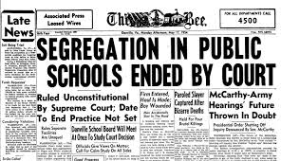
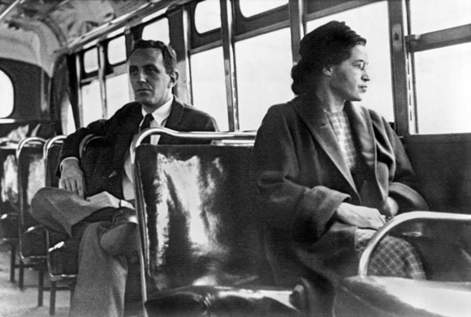
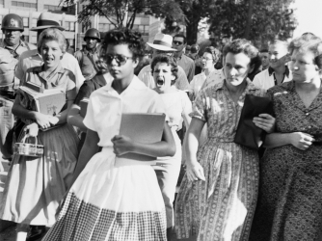
IGCSE Knowledge Organiser: Civil Rights 1945-74
Civil Rights in the 1950s
Key Events
1 | May 1954 | Brown vs Board of Education of Topeka – found illegal for schools to be segregated
2 | 1955 | Supreme court ruling that said schools should be desegregated
3 | Aug 1955 | Murder of Emmett Till – Bryant and Milam found “not guilty”
4 | Dec 1955 | Rosa Parks arrested - start of the Montgomery Bus Boycott
5 | Dec 1956 | Supreme Court ruling that buses should be desegregated – Montgomery Bus Boycott came to an end.
6 | Sept 1957 | 1957 Civil Rights Act passed – aimed to improve black voting in elections.
7 | Sept 1957 | Little Rock Nine – testing of the desegregation of schools.
Key Words
8 | Segregation | Keeping different groups apart
9 | Jim Crow Laws | Segregation laws in the USA
10 | discrimination | the unjust or prejudicial treatment of different categories of people, especially on the grounds of race, age, or sex.
11 | lynching's | Killings, usually hangings, done by a group, where the victim is suspected of a crime but has not been tried
12 | Precedent | (legal) a ruling in a law case that is used by other courts when deciding similar cases
13 | Integrate | Become part of a group or society, or help someone to do this
14 | White supremacist | Someone who believes that white people are better than people of other races
15 | Ku Klux Klan | A racist organisation that believes in the superiority of white Protestant Christians.
16 | Boycott | Refuse to buy or use particular goods or services as a way of protesting
17 | Defendants | an individual, company, or institution sued or accused in a court of law
18 | Activists | An activist is a person who campaigns for some kind of social change.
19 | Dixiecrats | A separate pro-segregation political party formed by the Southern Democrats in 1948
20 | Filibuster | A tactic used in Congress to stop a vote on a bill; the most common filibuster is to talk until the time limit for the debate is reached.
21 | NAACP | Black protest group – National Association for the Advancement of Colored People.
22 | Elizabeth Eckford | Student who tried to go to Little Rock she became the face of the Little Rock 9 after a famous photo.
23 | Governor Faubus | Governor of Little Rock, denied entry to black students.
24 | Deep South | Five states in the south east USA where segregation covered all aspects of life
Key Events
Brown vs Topeka | Montgomery Bus Boycott | Little Rock Nine
Parents of Linda Brown applied for her to attend local school in town of Topeka. Was denied due to being black, and told to got local black school, which was much further. Took the case to court with support of the NAACP. | Rosa Parks was arrested for refusing to move for a white passenger on a bus. NAACP used her case to lead a protest. For over a year, black people refused to use the town buses in Montgomery (they accounted for most of the passengers). | Nine black students were due to start at Little Rock High School. Governor Faubus ordered state troops to stop the students entering for “their protection” from abuse. Students got in eventually with protection.

Slide 3
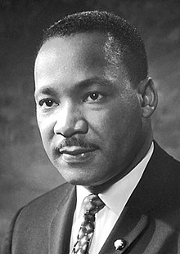
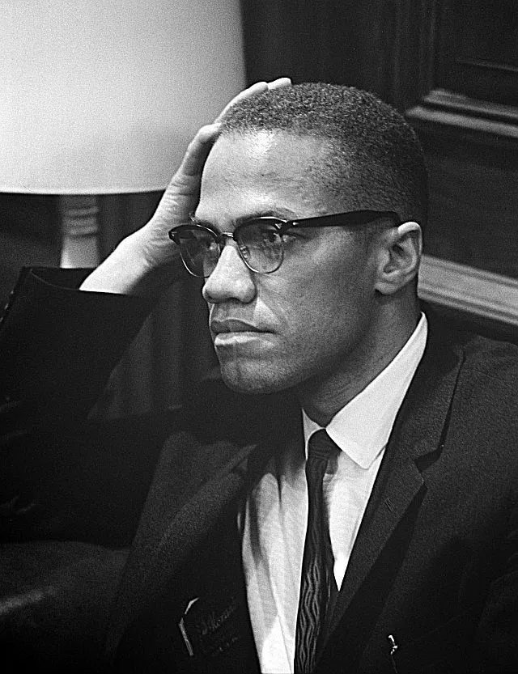
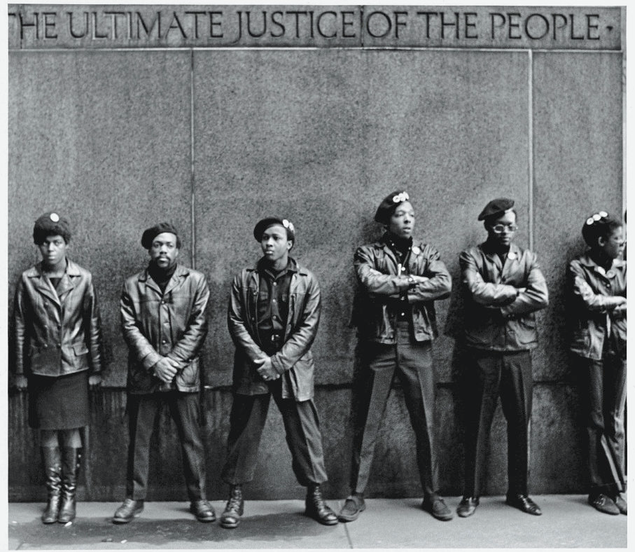
IGCSE Knowledge Organiser: Civil Rights 1945-74
The impact of Civil Rights Protests, 1960-74
Key Events
1 | 1960 | Greensboro Sit-Ins
2 | 1961 | Freedom Rides – testing of desegregation of interstate buses
3 | 1962 | James Meredith successfully registers at Mississippi University.
4 | Aug 1963 | March on Washington and “I have a Dream” speech
5 | 1964 | Civil Rights Act
6 | 1964-1968 | Race Riots – 329 riots across 257 cities
7 | 1968 | Martin Luther King Jr is assassinated.
Key Words
8 | Sit-ins | A type of protest in which people refuse to leave a place until demands are considered or agreed to
9 | CORE | Congress of Racial Equality
10 | SCLC | Southern Christian Leadership Conference
11 | MIA | Montgomery Improvement Association
12 | SNCC | Student Nonviolent Co-ordinating Committee
13 | ACMHR | Alabama Christian Movement for Human Rights
14 | Freedom Riders | Whites and blacks who rode on interstate buses to test the de-segregation
15 | Black Nationalism | The desire by certain African Americans to form an independent country
16 | Bussing | Where buses were used to transport children from mainly black areas to mainly white areas (or the opposite) to go to school.
17 | Affirmative action | Positive discrimination to give African Americans more equal opportunities particularly in education and employment.
18 | Nation of Islam | Muslim civil rights group under the leadership of Elijah Mohammad
19 | Non-violent direct action | An action that does something, without the use of violence e.g. marches and sit-ins.
20 | March | When a large group of people walk together to express their ideas or protest about something
21 | Bill | Proposed law that will be discussed by government – not all bills become laws.
22 | American Dream | The idea that anyone in the USA can become wealthy and successful through hard work because everyone has the same opportunities and freedoms
23 | Ghetto | A part of a city where people of a particular race of class live separately e.g. Harlem in New York
Key People/Groups
Martin Luther King Jr | Malcolm X | Black Panthers | Black Power
Martin Luther King Jr (MLK) became an important leader of the Civil Rights movement through his belief and preaching of non-violent protest. Worked with JFK. | Malcolm X was a member of the Nation of Islam. He believed in the ideas of black pride and violence of self defence and rejection of the civil rights movement and King’s ideas of non-violence. | Huey Newton and Bobby Seale setup the Black Panther Party in 1966. Wore black berets and leather jackets and member carried guns. Not just for violence, had a 10 point plan. | First spoken about by Stokely Carmichael, and was a more radical method compared to King’s methods. It encouraged violent defence and pride in being Black

Slide 4
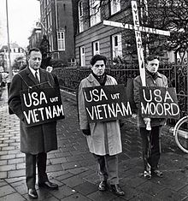
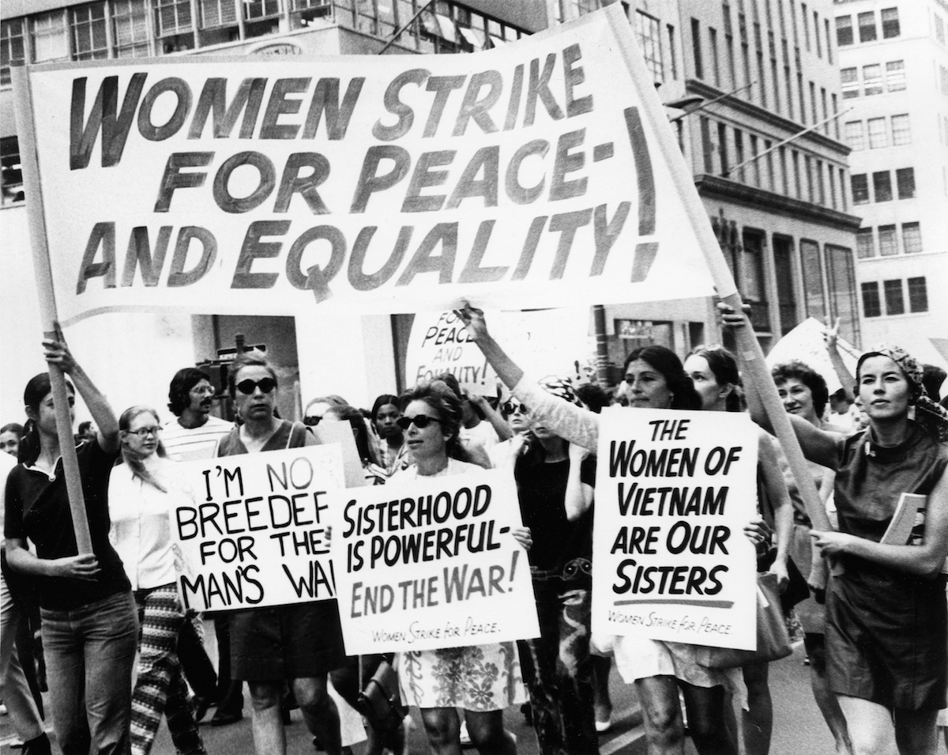
IGCSE Knowledge Organiser: Civil Rights 1945-74
Other Protest Movements
Key Events
1 | 1960 | Students for a Democratic Society established
2 | 1963 | Equal Pay Act
3 | 1964 | Berkeley Free Speech Movement
4 | 1966 | NOW set up by Betty Friedan and other feminists
5 | 1969 | Largest Anti-Vietnam War protest in Washington
6 | Aug 1970 | Women’s Strike of Equality
7 | 1973 | Supreme Court ruled abortions against constitutional right to privacy and freedom
Key Words
8 | Hispanic | a Spanish-speaking person, especially one of Latin American descent, living in the US.
9 | Protestant | a member or follower of any of the Western Christian Churches that are separate from the Roman Catholic Church
10 | Nuclear disarmament | the process of reducing in number or completely eliminating a country's nuclear weapons
11 | Slogan | a short and striking or memorable phrase used in advertising.
12 | Right-wing | Conservative views that value tradition and the freedom of the individual orthe role of government is minimal
13 | Conservative | Not liking changes or new ideas
14 | Berkeley | University where Free Speech Movement started
15 | Draft | A system in which people are ordered to join the army, navy etc. especially during a war.
16 | Anti-war | Against war
17 | Vietnamization | Nixon’s policy from mid-1969 to help South Vietnams’ government take more responsibility for the war and use more Vietnamese troops rather than Americans.
18 | Commune | A group of people who live together and share the world and their possessions.
19 | Hippy | a person of unconventional appearance, typically having long hair and wearing beads, associated with a subculture involving a rejection of conventional values and the taking of hallucinogenic drugs.
20 | Feminist | Someone who believes that men and women should have equal rights and opportunities
21 | Lobby | Attempt to persuade a government to change or make a law.
22 | Patriarchal | Where men hold the power and authority
Key Groups
Student Protest | Anti-Vietnam Protest | Women’s Movement
By 1970, nearly 40% of all young people went on to higher education, with the majority being white, middle-class backgrounds. During the 1960’s the Students Democratic Society gained momentum, with over 150 colleges or universities having groups with a total of 100,000 members. | Protestors objected to many aspects of the war including: Huge cost Rising number of deaths and injuries US support of corrupt government Enforcing its will upon another country US tactics The draft system | Started by Eleanor Roosevelt in the 1930s, it was the 1960’s that Women’s Movement started to gain traction. Following people such as Betty Friedan, the Women’s Movement wanted discrimination against women to end. Various Acts were passed which made some changes.

