Slide 1
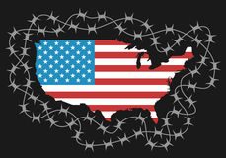
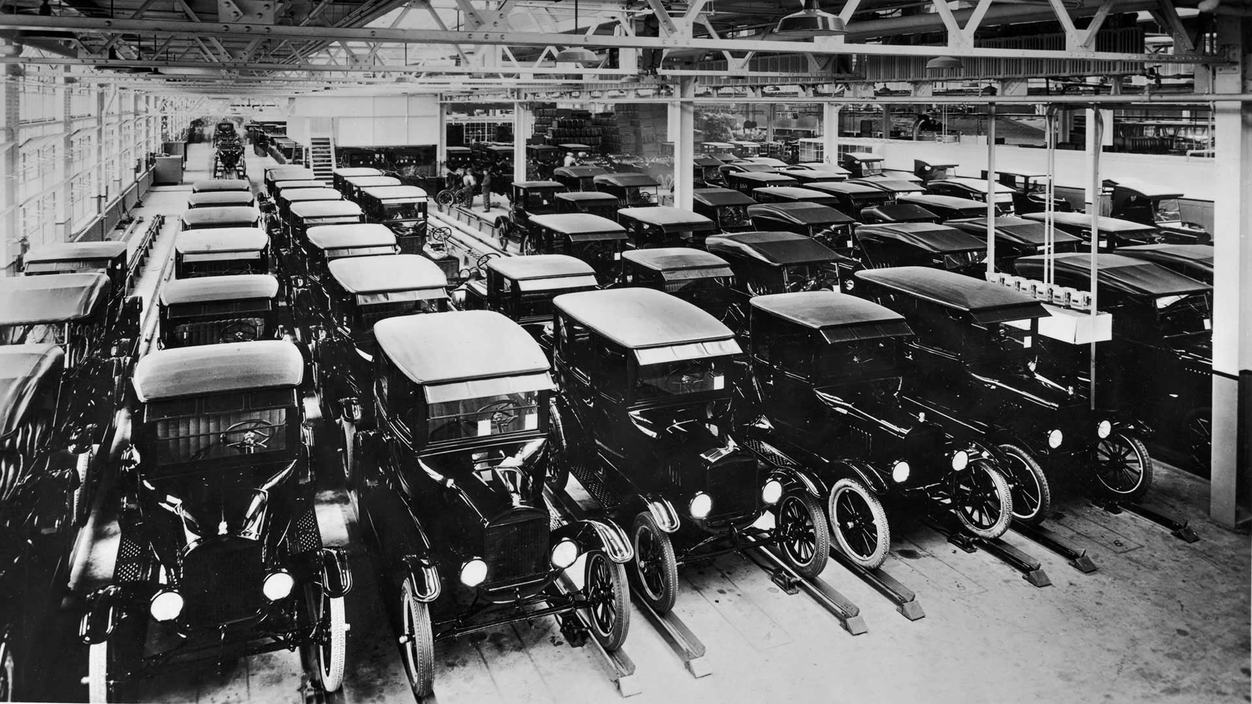
IGCSE Knowledge Organiser: USA 1918-41
The Roaring Twenties
Key Events
1 | 1918 | End of the First World War
2 | 1920 | The League of Nations is formed
3 | 1920 | The 19th Amendment was passed
4 | 1921 | Emergency Tariff Act - see below
5 | 1925 | Ford Model T was being produced one every 10 seconds
6 | 1926 | National Broadcasting Corporation (NBC) is set up
7 | 1927 | First talkie “The Jazz Singer”
Key Words
8 | Diversity | Word describing mixture of different cultures within a country
9 | President | The elected leader of America
10 | Congress | Elected body that makes laws
11 | Supreme Court | Checks laws are in line with the constitution
12 | Agriculture | Farming - crops and livestock
13 | Model T | First mass-produced car
14 | “Buying on the margin” | Taking out loans to buy shares - when sold shares, could pay back loan
15 | Steamboat Willy | First Mickey Mouse “movie” from Walt Disney
16 | Suburb | Residential or mixed-use (residential and commercial) area
17 | Chaperone | Male family member - would accompany women on dates
18 | Amendment | An addition or alteration of the US Constitution (US law)
19 | Flappers | Women who broke with traditional views of women e.g. short hair and skirts.
20 | bushel | A measurement used for crops including wheat and corn
21 | tariffs | Taxes on imported good, often introduced to encourage people to buy produce from their own country.
22 | Mechanisation | Replacing of old methods with machines .e.g tractors for horses
23 | Ethnic | An ethnic group or ethnicity is a group of people who are based on similarities e.g. language, common ancestry
Key Ideas
Isolationism | League of Nations | Mass Production | Tariffs
During the first part of the 20th Century, America adopted an isolationist stance. They would not get involved in international disputes and affairs i.e. during World War 1. | The League of Nations was an international organization created to provide a forum for resolving international disputes. Though first proposed by President Wilson, America never became a member. | The manufacture of goods on a mass scale. Henry Ford introduced a conveyor belt to speed things up. Workers focused on one job. All cars were built the same. | Tariffs – a charge place on foreign goods to encourage Americans to buy “local” goods. There were 3 tariffs – Emergency (1921), Fordney-McCumber (1922) and Smoot-Hawley (1930).

Slide 2
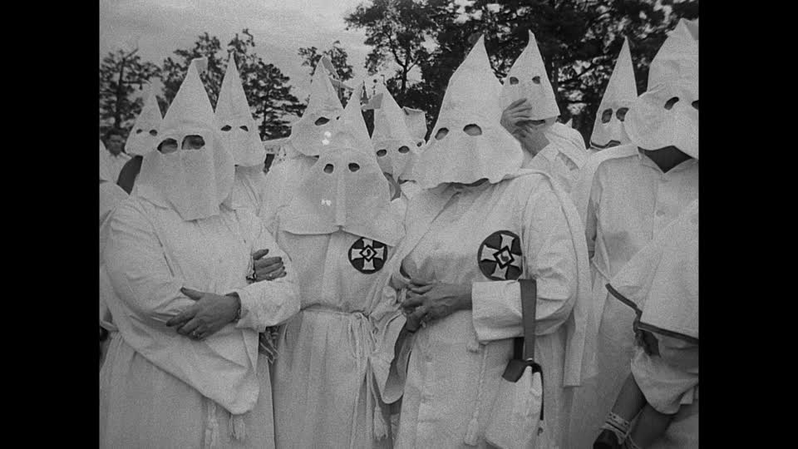
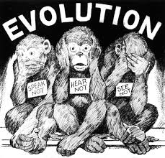
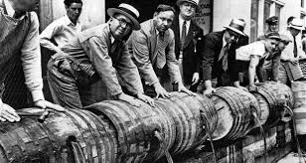
IGCSE Knowledge Organiser: USA 1918-41
Increased Social Tensions in the 1920
Key Events
1 | 1917 | Communist Revolution in Russia
2 | 1919-20 | Palmer Raids
3 | 1919 | Eighteenth Amendment is passed
4 | 1920 | Volstead Act
5 | 1921 | Sacco and Vanzetti case
6 | 1921 | Emergency Quota Act
7 | 1923 | Ku Klux Klan has 5,000 members
8 | 1924 | National Origins Act (see Emergency Quota Act)
9 | 1925 | Scope’s “Monkey Trial”
10 | 1929 | St Valentine’s Day Massacre
11 | 1933 | Prohibition ends
Key Words
12 | radicalism | The desire for dramatic social change
13 | labour | Manual work e.g. farming
14 | legislation | law
15 | immigration | Moving to another country to live
16 | communism | A way of organising society in which there is no private property and everything is shared.
17 | Soviet Union | The name that Russia was known as from 1922
18 | anarchist | A person who rejects the idea of organised government
19 | deported | To expel out of a country
20 | Jim Crow Laws | The name given to the laws that segregated facilities and institutions for white and black people.
21 | segregation | Keeping different racial groups apart e.g. whites and blacks.
22 | moonshine | Illegally made alcohol - often very strong
23 | bootleggers | Someone who smuggle alcohol
24 | White supremacy | Belief that white is best
25 | Speakeasies | Illegal drinking establishments - people were asked to “speak easy” (keep the noise down)
26 | Bible Belt | Southern and mid-western states - many people hold fundamentalist Christian Beliefs.
27 | Darwinism | The theory of evolution by natural selection as developed by Charles Darwin.
28 | temperance | Refusal to drink alcohol
29 | racketeering | Way of raising money, either illegally or through extortion of businesses.
Key Ideas
Red Scare | Ku Klux Klan | Scope’s Monkey Trial | Prohibition
Fear of communism in USA. Made worse by strikes and unrest in 1919. Led to Palmer Raids on radicals in USA. | Southern White Supremacy group - against Black’s using violence and intimidation. Members had to be a WASP (White Anglo Saxon Protestant) | Criminal trial of John Scopes, a school science teacher who had taught theory of evolution in Tennessee, which had made it illegal. | Due to pressure from temperance groups, USA made production, transporting and selling of alcohol illegal.

Slide 3
IGCSE Knowledge Organiser: USA 1918-41
The USA in Depression, 1929-33
Timeline of Wall Street Crash
Key Words
1 | Bull pool | A group of traders who set out to artificially increase the price of a share by buying and selling it to each other repeatedly over a short period, in order to sell that share to less experienced investors at a profit.
2 | Speculate | Buying goods or shares on the expectation that their price will rise in the short term, with a view to selling them on to make a profit
3 | Federal Reserve | A system of central banking in the USA, with a range of functions, including lending money to member banks.
7 | Great Plains | An area of grassland over 1.3. million square kilometres in size, covering much of central North America
 | Dust Bowl | Period in the 1930’s when many dust storms struck the American Prairies making the land impossible to grow crops on.
8 | Black blizzard | A powerful dust storm, lifting dark-coloured bits of soil up to 2.5 km in the air and rolling across the landscape
9 | Great Depression | Period of high unemployment in USA after the Wall Street Crash – affected many countries around the world.
10 | Unemployment | Losing one’s job
11 | Relief | Help from the local or state government for the poor or other groups in need.
12 | homelessness | Having no where to live
13 | Hooverville | A shanty town or settlement made of simple shacks that sprung up over America
14 | Bonus Marcher | Ex-WW1 soldiers who were promised a bonus from the government, but wouldn’t receive until 1945
15 | Herbert Hoover | President of the USA during Wall Street Crash and beginning of the Great Depression
 | Laissez-Faire | The belief that government should not interfere in a country’s economy.
Causes of the Great Depression

Slide 4
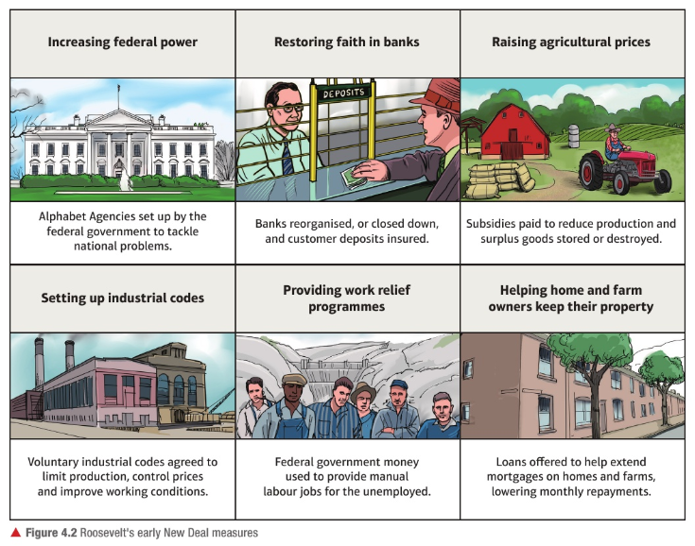
IGCSE Knowledge Organiser: USA 1918-41
Roosevelt and the New Deal, 1933-41
Key Events
1 | 1932 | Presidential election – Roosevelt campaigning by promising to solve problems of Great Depression.
2 | 1933 | Roosevelt takes office – 3 aims “Recovery, Relief and Reform”
3 | 1933 | First “Hundred Days” – set up lots of Alphabet Agencies
4 | 1935 | Start of the 2nd New Deal
New Deal
4 | Fireside Chats | Weekly radio programme with Roosevelt talking to American public about his plans
5 | Emergency Banking Act | Closed all banks for 4 days – government then checked and only “financially sound” banks reopened.
6 | Agricultural Adjustment Administration (AAA) | Alphabet Agency to help farmers – to raise price of agricultural goods government offered subsidies to farmers to limit production.
7 | National Recovery Administration (NRA) | Created industry wide codes - set quotas, controlled prices, set wages, limited working hours and banned child labour.
8 | Federal Emergency Relief Administration (FERA) | Provided $500 million for states to spend on relief, main use as providing food for unemployed.
9 | Home Owners Refinancing Act (HORA) | Act introduced to extend mortgage payments – 5 years was extended to 20 years and monthly payments reduced.
10 | Economy Act | Reduced government running costs by 25%.
11 | Civilian Conservative Corps (CCC) | Took unemployed young men into the countryside and gave them tough outdoor jobs and paid them – most of the money had to be sent home.
12 | Public Works Administration (PWA) | Used $3.3 billion of federal money to spend on big construction projects like Grand River Dam.
13 | Civil Works Administration (CWA) | Budget of $400 million, provided short-term projects such as refurbishing schools and road building.
14 | Tennessee Valley Authority (TVA) | Covered seven states – provided work for southerners, generated and extended electricity to remote farms and control flooding and improve productivity of land.
Roosevelt’s Early New Deal measures

