Slide 1

A CAREER IN
LAW
Louise Musgrave
Student Recruitment Officer
Notes:
PLEASE NOTE
Some of the notes contained within the notes pages are for reference only to provide you with additional background.
Introduction
Introduce self with a swift comment about your role at ULaw and some information about your days in practice.

Slide 2














WHY STUDY AT
THE UNIVERSITY OF LAW
AN ESTABLISHED HISTORY IN LEGAL EDUCATION
7 LOCATIONS
TAUGHT BY QUALIFIED LAWYERS
91% SECURED EMPLOYMENT OR FURTHER STUDY
TEF GOLD STANDARD
OVER 64,000 ALUMNI
91%
Notes:
Chat through the points fairly swiftly:
One of the UK’s leading law schools –Gold in the Teaching Excellent Framework, putting us in the top 45 participating universities
Employability – this is a key focus for ULaw and we will go into more detail shortly.
Connections – we work with over 90 of the top 100 UK law firms.
Courses and locations – choice of study (full time, part-time, online) at 7 ULaw centres – Birmingham, Bristol, Chester, Guildford, London B, Manchester, Leeds. Qualified lawyers – this means all our tutors actually know what practice is like, and what knowledge and skills you need to succeed.
Personal tutors – every student has a personal tutor allocated to them, who is available for one-to-one discussions to check progress and help with any problems.

Slide 3

TEF GOLD
WHAT DOES THE AWARD REFLECT?
Progression to employment or further education
Personal development opportunities
Teaching excellence
Student satisfaction
Course design
Strong link to employers

Slide 4
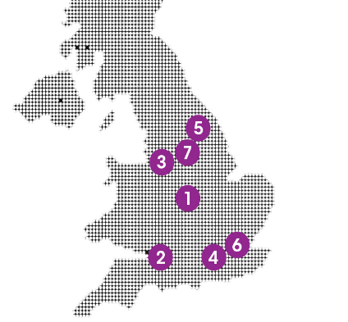
WHERE ARE WE?
7 LOCATIONS IN MAJOR CITIES
Our Campuses
Birmingham
Bristol
Chester
Guildford
Leeds
London Bloomsbury
Manchester

Slide 5












A CAREER IN LAW
LAW IS EVERYWHERE
Notes:
Lawyers can get a bad press, but they are the cogs that make most things work. Considering the amounts of areas that they work in, they are there to do an awful lot of different roles. They may work in businesses, in their own law firms (in offices), in court, etc.
Here are a few examples of (more) areas that they work in and what a lawyer is and does in those circumstances.
Just a few examples:
Conveyancing – helping people buy houses – work for either party
Family law – dealing with divorce or disputes over responsibility for children
Criminal Law – all manner of cases, from minor motoring misdemeanour, murder, rape, theft, etc – they advise their clients and represent them in court.
Tort – personal injury, negligence, they are there to represent people who have suffered an ‘injury’ or ‘loss’, to work out who is at fault and what the compensation should be
Trade law (can say specifically shipping, etc) – dealing with
Contract law
Medical Law
EU Law
Environmental Law
Tax / financial law
Human rights law – very varied it could encompass everything from immigration and asylum issues and prisoner cases, through to privacy cases for celebrities
Also:
Commercial law – advise on complex transactions (do contract work) but work for businesses of all sizes.
Employment law – where someone may have been unfairly dismissed or want to raise grievances against an employer, you may have to represent one side or another
Intellectual property – ensuring that intellectual property and ideas are protecting through copyright, trademarking and patents, along with representing clients when copyrights are infringed – from music through to scientific endeavour.

Slide 6







A CAREER IN LAW
ROLES AND TASKS
Legal Drafting
Legal Research
Negotiating
& Questioning
Conferencing
& Meeting
Clients
Advising clients
on Law
£
i
Representation
& Advocacy
Meeting and
Problem solving
For Clients
Notes:
Click the corresponding image to reveal the wording
Negotiating and Questioning
Drafting legal letters, contracts and Documents
Representing clients in court
Holding Conferences and meetings with clients
Researching he law and deciding a course of action
Meeting clients and finding out how to help
Advising clients on the law and their case

Slide 7








A CAREER IN LAW
WHY BE A LAWYER?
Notes:
It's intellectually challenging – you’re always learning
You work closely with clients and help them achieve their goals
No two days in the office will ever be the same
Opportunities to work abroad
Your earning potential can be very high
Solid career progression
Your work might even make the news…

Slide 8
A CAREER IN LAW
WHAT TYPE OF LAWYER ARE YOU?
I would enjoy travelling around the country and working in different locations
I want to become an expert in a particular field of law and undertake specialist research
I want to work in a small and close knit profession where a lot of the contact would be with other lawyers rather than members of the public
I would like to work as part of a wider team
I want to establish long term relationships with clients
I would like to work on a case from start to finish, from taking initial instructions from a client through to (if necessary) attending court with them at the end of the case
I would enjoy the freedom of self-employment and managing my own financial affairs
I want to spend a lot of my time speaking in public and presenting arguments
Lots of contact with clients is important to me
I want my career progression and income to be based solely on my own work
I would be comfortable familiarising myself with a client’s case on short notice and often having to work in the evenings and weekends
Stability and job security are important to me
On a day-to-day basis I would rather spend most of my time in the same office
I would enjoy drawing up contracts and working on deals
I can cope financially if my income isn’t regular
I want a regular monthly salary
Notes:
If you have time, the following is a quick quiz. If not just click anywhere but the play button to move to next slide
press the play button (bottom right of screen)
Ask the students to write down a “P” for Purple and a “B” for Blue, for every statement they agree with.
Do first 8 then click arrow for next 8.
At the end add up how many of each. More P = Barrister, B = Solicitor

Slide 9


A CAREER IN LAW
WHAT TYPE OF LAWYER ARE YOU?
VS
SOLICITOR
BARRISTER
Notes:
Ask them to explain barrister v solicitor first
Use appropriate examples based on your own personal experience – a good way of comparing solicitors and barristers is using the GP/hospital consultant analogy – ie GPs refer their patients to a hospital consultant when their symptoms are very serious or unusual so they can get expert advice or a second opinion
Explain that students still have a number of years to decide which route to go down as they won’t need to do this until they start their degrees

Slide 10
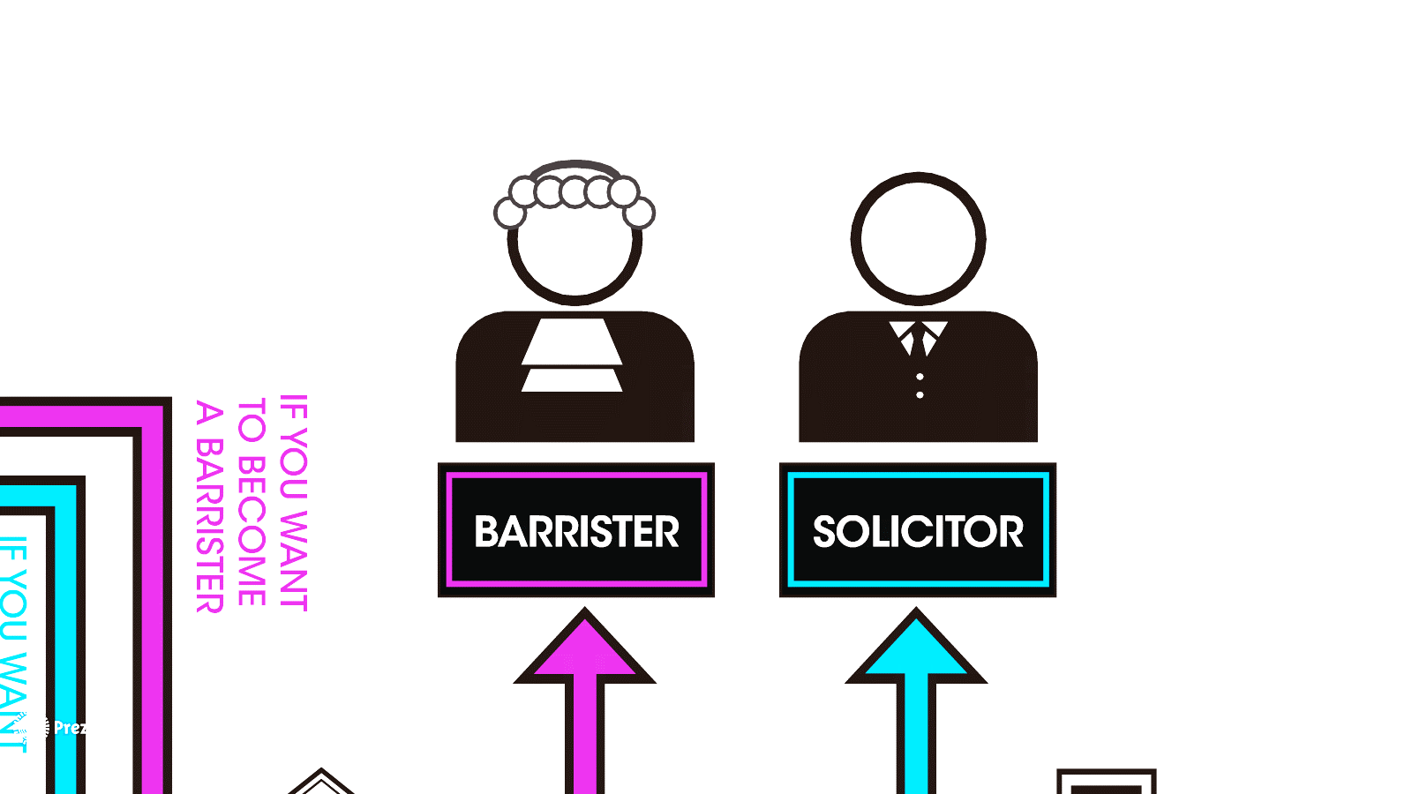
A CAREER IN LAW
WHAT TYPE OF LAWYER ARE YOU?
SOLICITOR
BARRISTER
160,000
16,000

Slide 11

A CAREER IN LAW
WHY BE A SOLICITOR?
I enjoy being based mostly in the office
I get to work with lots of people and clients.
I tend to work on a case from start to finish
I get paid a salary by my firm
There are lots of career opportunities
I’m given a variety of tasks and jobs by my firm

Slide 12

A CAREER IN LAW
WHY BE A SOLICITOR?
11,000 solicitors in ‘Public Sector’
38,000 solicitors work “In-house”
91,000 solicitors in
‘Private Practice’

Slide 13



A CAREER IN LAW
WHY BE A SOLICITOR?
78%
work in London
22%
work elsewhere

Slide 14

I get to travel around the UK and work in different places
A CAREER IN LAW
WHY BE A BARRISTER?
I work in a small, close-knit community, mostly in contact with other lawyers.
I like talking in public and presenting arguments
I’m self-employed, and have to manage my own finances
I have to work hard to get my cases and my career is based on my work
I have to work hard to get my cases and my career is based on my work
I have to work hard to get my cases and my career is based on my work

Slide 15


A CAREER IN LAW
BARRISTER STATS
35%
Get a 1st at University
28%
Get pupillage
(Nationally)
55%
Get a 2:2 at University
71%
ULAW BPTC Students
get Pupillage
Notes:
35% get 1st, 55% get a 2:1
National Pupillage rate (16/17) – 28%.
ULAW Pupillage 71%

Slide 16
A CAREER IN LAW
WHAT SKILLS DO YOU NEED?
Ability to organise & prioritise
Attention to detail
Commercial awareness
Communication
Interpersonal Skills
Problem Solving
Research and Analysis
Self-motivation and drive
Team work

Slide 17



QUALIFYING AS A LAWYER
CURRENT TRAINING ROUTES
QUALIFYING LAW DEGREE
SOLICITOR ROUTE
LEGAL PRACTICE COURSE
TWO YEAR TRAINING CONTRACT
ADMISSION AS A SOLICITOR
OR
NON-LAW
DEGREE
BARRISTER ROUTE
LAW CONVERSION COURSE
BAR PROFESSIONAL TRAINING COURSE
CALL TO
BAR
TWO SIX MONTH PUPILLAGES
Notes:
Training contract offers - Many firms (especially larger/commercial firms) fill training places two years in advance. Law students should start applying during the final term of the second year of their law degree. Non-law students should start applying before starting the Graduate Diploma in Law.
During your training you should be given experience in at least three distinctive substantive areas of English law, including both contentious and non-contentious work.
For aspiring barristers:
The BTPC itself lasts one year and is a highly vocational course
Following this you are ‘called to the bar’ and complete a pupillage (which is a year working within a chambers) to obtain the skills and experience necessary for tenancy. Note that often pupils choose to undertake a further 6months to gain more experience. Many chambers will also assess a candidates suitability for tenancy during this stage.
The final stage is tenancy where you become a ‘tenant’ of a chambers and will generally work on your own cases.
Mention New Regime in passing not in detail
The Solicitors Regulation Authority (SRA) is changing the way people can qualify as solicitors. They call this their “Training for Tomorrow” reforms.
On 25 April 2017 the SRA made a major announcement about these reforms, and confirmed some key details. In particular, they are introducing a new assessment system called the Solicitors Qualifying Examination (SQE).
As a result, there has been some media coverage that the GDL and LPC are abolished. This is misleading! It has led to some queries from current and potential students about the changes.
This note sets out some information about the main points, and then has some Q&A to help answer any queries from current and potential students.
Main points
The changes do not come in until 2020 at the earliest.
Even when they do come in, there will be transitional arrangements that will allow students who have already started studying law before 2020 to keep going under the current system until they finish their studies. Current courses may be in place until 2025
There are still many details that the SRA need to finalise (including about the exams themselves, such as assessment methods and the syllabus to be covered), which is why the dates are so far away, and means that anyone taking decisions now on what to study in the next year or so does not need to worry about these reforms.
This means that in relation to the LLB / GDL / LPC:
anyone already studying these courses does not need to worry about these reforms – they can continue to study exactly as they expected to;
anyone who wants to start studying these courses in 2017 or 2018 does not need to worry about these reforms – they can continue under the current system;
anyone who wants to start studying these courses in 2019 or later does not need to worry about these reforms now – when they get closer to the time of applying we can discuss options with them then. They will not be limiting their options in the meantime.
What are the SRA reforms?
The SRA are changing the way that people can qualify as solicitors. The important thing is that these are changes for the future. They will not start to apply until 2020 at the earliest, and even then the current system will keep going for a few more years alongside the proposed new system.
What is Training for Tomorrow / the Solicitors Qualifying Examination / SQE?
Training for Tomorrow is the name the SRA have given to its reform of the rules about becoming a solicitor. They have been consulting on these reforms for quite a few years under that name.
The SQE is the new set of exams the SRA intend to introduce to test if you have reached the standards they expect of solicitors. However they will not start the SQE until 2020 at the earliest, so it does not change anything for the next few years.
Can I choose which route to follow – either the current one or the future one?
The SRA have said that anyone who has started working towards qualifying as a solicitor will have a choice when the reforms do start of staying on the current rules, or switching to the new rules. So by starting your courses now you give yourself more options in the future, if you haven’t already qualified by the time the new rules come in.
Do these reforms mean the LPC is being abolished?
The LPC remains essential to qualifying as a solicitor until at least 2020, and will still be an option for many people for some years at least after that. Eventually the LPC is expected to stop, but not for many years.
Do these reforms mean the GDL is being abolished?
The GDL remains essential for those who don’t have a law degree until at least 2020. After 2020, it might be called something different, but there will still be a similar course for those who don’t have a law degree and need to learn the law required to become a practising lawyer.
What do these reforms mean for the Qualifying Law Degree
When the reforms finally come in (which will not be until 2020 at the earliest), you will have to pass the SQE exams, and the exact format of your law degree will not matter. A qualifying law degree as it is now would be very helpful, but you would probably also need to cover some other areas to be ready for the first SQE exams. We expect that anyone starting a qualifying law degree before 2020 will be able to rely on that degree as you can now – so this isn’t something to worry about at this stage.
Should I take a year or more out because of these reforms and start my course later?
There is no need to delay your plans because of these reforms. They will not start to apply until at least 2020, and even then the existing system will carry on for many people for at least a few years longer. If you do start now, and haven’t already qualified as a solicitor by the time the reforms do some in, you can choose to swap to the new rules if you wish – so starting now gives you more options for the future.
What do these reforms mean for the training contract?
Because these reforms will not start to apply until at least 2020, and there will be transitional provisions for those already started on courses before then, the training contract will continue in its current form for many years.

Slide 18
QUALIFYING AS A LAWYER
FUTURE TRAINING FOR SOLICITORS
SQE STAGE 2
SQE STAGE 1
QUALIFYING WORK EXPERIENCE
SQE
DEGREE OR
EQUIVALENT
SQE
QUALIFICATION
Notes:
Context
The Solicitors Regulation Authority (SRA) is changing the way people can qualify as solicitors. They call this their “Training for Tomorrow” reforms.
On 25 April 2017 the SRA made a major announcement about these reforms, and confirmed some key details. In particular, they are introducing a new assessment system called the Solicitors Qualifying Examination (SQE).
As a result, there has been some media coverage that the GDL and LPC are abolished. This is misleading! It has led to some queries from current and potential students about the changes.
This note sets out some information about the main points, and then has some Q&A to help answer any queries from current and potential students.
Main points
The changes do not come in until 2020 at the earliest.
Even when they do come in, there will be transitional arrangements that will allow students who have already started studying law before 2020 to keep going under the current system until they finish their studies. Current courses may be in place until 2025
There are still many details that the SRA need to finalise (including about the exams themselves, such as assessment methods and the syllabus to be covered), which is why the dates are so far away, and means that anyone taking decisions now on what to study in the next year or so does not need to worry about these reforms.
This means that in relation to the LLB / GDL / LPC:
anyone already studying these courses does not need to worry about these reforms – they can continue to study exactly as they expected to;
anyone who wants to start studying these courses in 2018 does not need to worry about these reforms – they can continue under the current system;
anyone who wants to start studying these courses in 2019 or later does not need to worry about these reforms now – when they get closer to the time of applying we can discuss options with them then. They will not be limiting their options in the meantime.
What are the SRA reforms?
The SRA are changing the way that people can qualify as solicitors. The important thing is that these are changes for the future. They will not start to apply until 2020 at the earliest, and even then the current system will keep going for a few more years alongside the proposed new system.
What is Training for Tomorrow / the Solicitors Qualifying Examination / SQE?
Training for Tomorrow is the name the SRA have given to its reform of the rules about becoming a solicitor. They have been consulting on these reforms for quite a few years under that name.
The SQE is the new set of exams the SRA intend to introduce to test if you have reached the standards they expect of solicitors. However they will not start the SQE until 2020 at the earliest, so it does not change anything for the next few years.
Can I choose which route to follow – either the current one or the future one?
The SRA have said that anyone who has started working towards qualifying as a solicitor will have a choice when the reforms do start of staying on the current rules, or switching to the new rules. So by starting your courses now you give yourself more options in the future, if you haven’t already qualified by the time the new rules come in.
Do these reforms mean the LPC is being abolished?
The LPC remains essential to qualifying as a solicitor until at least 2020, and will still be an option for many people for some years at least after that. Eventually the LPC is expected to stop, but not for many years.
Do these reforms mean the GDL is being abolished?
The GDL remains essential for those who don’t have a law degree until at least 2020. After 2020, it might be called something different, but there will still be a similar course for those who don’t have a law degree and need to learn the law required to become a practising lawyer.
What do these reforms mean for the Qualifying Law Degree
When the reforms finally come in (which will not be until 2020 at the earliest), you will have to pass the SQE exams, and the exact format of your law degree will not matter. A qualifying law degree as it is now would be very helpful, but you would probably also need to cover some other areas to be ready for the first SQE exams. We expect that anyone starting a qualifying law degree before 2020 will be able to rely on that degree as you can now – so this isn’t something to worry about at this stage.
Should I take a year or more out because of these reforms and start my course later?
There is no need to delay your plans because of these reforms. They will not start to apply until at least 2020, and even then the existing system will carry on for many people for at least a few years longer. If you do start now, and haven’t already qualified as a solicitor by the time the reforms do some in, you can choose to swap to the new rules if you wish – so starting now gives you more options for the future.
What do these reforms mean for the training contract?
Because these reforms will not start to apply until at least 2020, and there will be transitional provisions for those already started on courses before then, the training contract will continue in its current form for many years.

Slide 19
OUR LLB DEGREES
DIFFERENT OPTIONS
LLB (Hons)
LAW WITH… LLBs
Our 3 year, Online and 4 year foundations are also available with the following variations
2 Year | Accelerated
Law with Criminology
3 Year | Full time
Law with International Business
4 year with foundation year
Law with Business
Online
Law with Government & Politics
NEW FOR 2019
Law with International Diplomacy
Law with Journalism
Notes:
Mention courses above.
NEW for2018 – BSc Policing and Criminal investigation – Event coming up on 28th june
We also have Dual Degree with IE University in Spain
The online is available as 3,4 and 6 years

Slide 20
LAW DEGREES
COMPULSORY
LAND LAW
EQUITY AND TRUSTS
EUROPEAN UNION
CONTRACT
PUBLIC
TORT
CRIMINAL

Slide 21

A CAREER IN LAW
JAFFA CAKE DEBATE

Slide 22







JAFFA CAKE DEBATE
LUXURY TAX
Notes:
nder UK VAT rules bakery products like bread, biscuits and cakes are essential items and so are zero-rated.
But biscuits that are wholly or partly covered in chocolate are classed as confectionery and therefore deemed as a standard-rated luxury item. Weirdly cakes with a similar make-up aren’t.
Other odd luxury tax items
E-Books yes, Paperbooks no
De-shelled nuts are luxury
Previous issues with Luxury tax – Tampon tax (reduced rate of 5% but still existed), Childrens safety such as car seats etc. (again, reduced to 5%)

Slide 23



JAFFA CAKE DEBATE
LUXURY TAX
“Chocolate topped Biscuits” = Luxury
Notes:
Click – So we have 2 VAT bands
Click – What do we think crisps are
Click - Luxury
Click – “chocolate topped biscuits” = Luxury

Slide 24

JAFFA CAKE DEBATE
PLAN YOUR DEBATE
Brain storm content
Then Identify key messages
Keep your audience in mind
When structuring consider beginning, middle and end
End Strong
Don’t Make it Personal!
Notes:
Foods that you would think are luxury but aren’t luxuries include: cakes and biscuits (as along as not chocolate covered). These would not have to pay tax.

Slide 25


JAFFA CAKE DEBATE
LUXURY TAX
VS
Notes:
Foods that you would think are luxury but aren’t luxuries include: cakes and biscuits (as along as not chocolate covered). These would not have to pay tax.

Slide 26





NEXT STEPS
WHAT CAN I DO NOW?
Aim for good grades in all your exams
Participate in extra-curricular activities
Take on positions of responsibility
Gain commercial awareness
Work experience
Read quality media articles

Slide 27
ENGAGE
WITH US
Join Our Future Lawyers
Access our 10 step employability programme
Connect with us online

Slide 28
THANK YOU
ANY QUESTIONS?

