Slide 1




Apprenticeship Support and Knowledge for Schools and Colleges
Notes:
My name is ‘insert name’ and I’m here on behalf of the National Apprenticeship Service to talk to you about apprenticeships.
It’s really important to remember to keep your options open about your future. So for the next 15-20 minutes, I’m going to explain:
- The range of apprenticeship job roles available
- The different levels
- How you find an apprenticeship and
- What you need to do next
Regardless of qualifications, there are apprenticeships for everyone but not many people realise that apprenticeships are for A* students
Activity idea:
Before I start, hands up who knows what an apprenticeship is?
(typical response is to get around 20% of the audience with their hands raised)
Ok – well hopefully when I ask you that again at the end of this session, everyone’s hands will be up in the air.

Slide 2

What are apprenticeships?
Notes:
Lots of people get confused about apprenticeships. That’s probably because they’ve been around for hundreds of years, but they’ve changed a lot in that time.
It’s important to understand that an apprenticeship is a real job, with a real employer.
There’s a myth that apprenticeships are just like work experience, where you’re given basic tasks or asked to make the tea, but this isn’t the case.
Firstly, you get paid a salary – and it can be a really good salary too! We’ll talk more about money later on.
The employer will invest their time and money in helping you to gain qualifications and valuable new skills and experience.
You will be given real responsibilities and expected to work hard, just like anyone else in the company.
For example, We have seen apprentices *Example – “managing projects for Channel4”.
Because it’s a proper job, you will also have a contract of employment, holiday and sick pay - exactly the same as any other member of staff.
Not only this, but you’ll be working towards qualifications throughout your apprenticeship. You’ll be supported by a training provider, who will help you achieve your qualifications and make sure you complete your apprenticeship.
An apprenticeship typically takes 1 to 4 years to complete, depending on the level and the subject you’re studying.
It’s important to remember that apprenticeships aren’t the ‘easy option’. Holding down a full time job and studying takes a certain skill, and it won’t be right for everyone.

Slide 3
Some of the 1500 possibilities
Notes:
When we talk about apprenticeships, people often assume we’re referring to traditional apprenticeships like construction and engineering. There are many brilliant apprenticeships in these areas, but there are also hundreds of new apprenticeships in exciting areas that you might not know exist.
This slide gives you an idea of the huge range of apprenticeships available. If you have got a job or career in mind, it’s really worth doing your research as there is a high chance you could get there through an apprenticeship.
Apprenticeships are available in a wide range of industry sectors with employers from large national companies such as the BBC, Barclays Bank, IBM, Airbus, ASOS, ITV and Royal Mail to smaller, local companies.
Activity idea: Pick out a few of the job roles to discuss – will depend on the audience.
Activity idea: Can anyone spot an apprenticeship on the screen that has surprised them?
Activity idea: Does anyone know someone who is doing an interesting apprenticeship?

Slide 4


Slide 5
LEVELS OF APPRENTICESHIP
TRAINEESHIPS
INTERMEDIATE APPRENTICESHIP
LEVEL 2
12 – 18 MONTHS
ADVANCED APPRENTICESHIP
LEVEL 3
12 – 36 MONTHS
HIGHER/DEGREE APPRENTICESHIP
LEVELS 4, 5, 6 & 7
12 – 48 MONTHS
SKILLS, KNOWLEDGE AND COMPETENCIES

Slide 6


You get paid and you have a career
National Minimum Wage £3.50 per hour
Average wage £170 per week
Wage depends on the employer – many pay more than Minimum Wage
Notes:
On top of all of the benefits I’ve mentioned, if you didn’t hear it the first or second time… as an apprentice, you get paid a salary!
Many people think that apprentices are low-paid, and this can be true, depending on the employer. Legally, an employer must pay an apprentice the National Minimum Wage for apprentices which is currently £3.40 per hour. This is lower than the normal National Minimum Wage, but it recognises that some people will be going into their first job with no experience at all. The good news is that lots of employers pay a lot more than the National Minimum Wage for apprentices.
The average wage for apprentices is £170 per week which is a great starting salary for someone just leaving school.
Some apprenticeship schemes in big organisations have a starting salary of £18-20k.
Local info: Partners might want to display local opportunity pay rates or adjust this message depending on the local area.
It’s important to remember that if you see an apprenticeship you’re interested in, don’t be put off by the pay if it’s low: there’s room for progression and working your way to the top of an organisation.
Another common myth is that once you’ve completed your apprenticeship, your employer will let you go. This isn’t true. The majority of apprentices (around 90%) stay in employment. If they do change companies, it’s usually because they’re able to compete for a better job, perhaps with more pay or more responsibility.

Slide 7
Are there any jobs?
Find An Apprenticeship website
5 miles = 89 apprenticeships
10 miles = 212 apprenticeships
20 miles = 786 apprenticeships
Over 28,000 apprenticeship vacancies advertised at any given time
267
Notes:
Guidance notes:
We would expect this slide to be updated by the delivery partner to reflect local opportunities by searching through Find an Apprenticeship
I had a look on the Find an apprenticeship website before coming along today.
If you notice, within 5 miles of this school/college today, there are xx vacancies.
You can see how this number grows the more you increase the distance.
You will need to think about how far you are prepared to travel for work each day.
If you want to think about working in the (insert name of an appropriate location) City, then you could be looking for vacancies there.
The one rule is that you will need to be able to get there, on time, every day.
Don’t worry if you don’t know too much about travelling to work. On the new Find an apprenticeship website, there is a journey planner so this will help you when you are applying for vacancies to work out which vacancies are going to be realistic, and which are not in terms of distance.
It is important not to restrict your searches for vacancies to just look at large companies as many small employers offer some excellent vacancies with great packages and career progression opportunities.

Slide 8
Apprenticeship jobs in this area:
Job opportunity | LEVEL | DURATION | Closing date | Weekly salary | Annual salary
Higher Apprenticeship Data Analyst – Level 4 Virgin Media | Higher (Level 4) | 18 months | 17th July 2017 (to start September 2017) | £336.53 | £17,500
Business Administration Apprentice Highways England | Higher (Level 4) | 18 months | 24th July 2017 (to start September 2017) | £270.94 | £14,088
Degree Apprenticeship - Digital & Technology Solutions Apprentice - 11766 Visa Europe Services Inc | Degree (Level 6) | 37 months | 31st August 2017 (to start September 2017) | £355.76 | £18,500
Apprentice Building Surveyor Hampshire County Council | Degree (Level 6) | 60 months | 31st July 2017 (to start September 2017) | £311.71 - £346.05 | £16,209.00 - £17,955.00
Notes:
We would expect this slide to be updated by the delivery partner15 mnth
Guidance notes:
Search through Find an apprenticeship using the establishment postcode and find some interesting jobs.
Try to find a selection of closing dates so that you can reinforce the need to be using Find an apprenticeship regularly
Try to find a range of salaries so that you can show that there are employers who are prepared to pay more
Try to find a job title that might sound a bit confusing and then explain what that role really is – make it sound exciting and explain that they should not be put off by the titles of some jobs, it’s important they read the job advert attached to it.

Slide 9

There’s never been a better time…
The world of work and career opportunities just got a whole lot more exciting …really!
Notes:
No matter what kind of career you want to follow, you need to do your research and find out if there’s a way to get to the role you want through an apprenticeship. That way, you can decide if you would prefer to study full time at college or university, or if you would prefer to go into work as an apprentice and gain qualifications and experience on the job from day 1.
Until recently, school leavers had a straight decision to make: stay on, go to Uni, or take your chances in the job market. All of that has now changed.
With more and more new apprenticeships being introduced, especially higher and degree apprenticeships, there really is something for everyone.
Influencers notes:
Hundreds of employers are developing a whole range of new opportunities in some of the more prestigious career sectors, such as Aeronautics, Human Resources and allied professions, Civil engineering
Influencers slide info-Protected term ‘apprentice’ to guarantee that only quality
Measures proposed in the Enterprise Act will also protect the term ‘apprenticeship’ to prevent misuse by providers in England. Government Response.

Slide 10
Higher and Degree apprenticeships
Now its possible to get a degree without going to uni…
Notes:
Higher and degree apprenticeships are a real alternative to following the traditional route of going to University as a full time student.
They offer all the benefits of higher education with none of the cost. You will not only be learning, but earning a salary, from day one.
So with a degree apprenticeship, you’re much less likely to build up any debt. Your tuition fees are paid for by your employer and the Government, so you will not be expected to pay £9000 a year. Universities offer their degree apprentices exactly the same student experience as other students, so you will still have access to the student union, sports facilities, student discounts etc.
In the past, going to university was seen as the best way to advance your career to a higher level. But with the current level of competition for jobs amongst graduates, it might not be the best route for you. With an apprenticeship, you gain the competitive advantage of gaining at least 3 years’ work experience whilst completing your degree.
But remember – it’s hard work as a degree apprentice. You’ll be working full time and fitting in the equivalent of a full time degree alongside it.
It might take a bit longer, 4 years instead of 3, but you’ll achieve exactly the same degree.
Entry requirements vary programme to programme and depend on the learner's existing skills, grades, work experience, and performance at interview. Tuition fees are paid by the employer and the government so there is no need to take out a university loan.

Slide 11
Early recruitment of Higher and Degree apprenticeship vacancies for 2017 (August onwards for 2018)
All vacancies are advertised on the Faa site
The following employers were involved with 1072 positions advertised nationally:
BAE Systems
Balfour Beatty
Wessex Water
BBC
Civil Service Fast Track Apprenticeship Programme
Royal Mail
Siemens
Skanska
North Bristol NHS Trust
Wates Group Plc
Airbus
Virgin Money
Atkins Global Ltd
ISG Plc
Atkins
Laing O'Rourke
Lloyds Banking Group
Nestle UK Ltd
Ministry of Defence
More information can be found at: https://www.gov.uk/government/publications/early-recruitment-of-higher-and-degree-apprenticeship-vacancies-for-2017
Notes:
Mainly higher and degree vacancies
Full list can be downloaded here https://www.gov.uk/government/publications/early-recruitment-of-higher-and-degree-apprenticeship-vacancies-for-2017

Slide 12
Degree apprenticeships – a genuine game changer
Degree apprenticeships are a genuine game changer and should not be viewed as the poor relation of academic education, writes Pearson College London's Ben Hughes, vice-principal for academic delivery.
In this country, technical and vocational training has long been unfairly viewed as the poor relation of an academic education – at least by those who have had an academic education.
It could create an alternative corporate Russell Group. For example, a Rolls-Royce apprenticeship has long been held in similar esteem to an undergraduate degree course. Thanks to the levy, there will now be a whole host of such apprenticeships with leading companies, which also lead to a degree.
In time, school leavers will see your Oxford or Cambridge degree and raise you an IBM or a BBC degree apprenticeship. At the discussion, apprentice Chris Achiampong noted that many who doubted his initial decision to start a degree apprenticeship have had their reservations assuaged through an understanding of the programme and its benefits.
For the first time there is now an alternative HE route, with professional associations and blue chip endorsements which will ultimately lend it equal credibility to that traditional path. For the first time, students can genuinely have their cake and eat it. Food for thought in these revolutionary times.

Slide 13

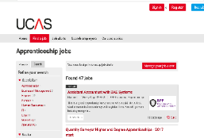
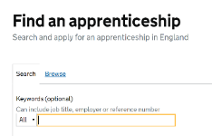
How do you find an apprenticeship?
Register on Find an apprenticeship website
(Ideally create an account & respond to your email to activate it)
Do your research and search for jobs
Manage your alerts
Start applying
Make contact with the companies
Notes:
1. It’s really important to register with Find an Apprenticeship. Search the internet for ‘Find an apprenticeship’ and it will come up as the first link
Once you register you’ll receive an account activation code by email. After activating your account, you’re ready to start applying for apprenticeship vacancies.
2. Have a look at the different jobs that are being advertised. Remember, this is a live jobs site so it may be that you need to try and few different searches or to broaden how far you are looking to find jobs that you are interested in.
3. Start applying for jobs that interest you. You need to remember that some of the bigger companies will advertise quite early in the year (e.g. Autumn) for apprentices to start the following September so please don’t leave it until the last minute or you might be disappointed to have missed a great opportunity.
4. Set up your alerts. A great feature of this system is that you can get it to do all the hard work for you. You can manage your alert settings so that you receive text messages and emails when jobs come up that you might be interested in
5. Employers are always telling us that the applicants that really stand out to them, are those that have made a bit of extra effort. You could consider contacting the company and asking them if you could spend a few hours shadowing a member of staff or if they have any open days coming up. That will look really impressive on your application and can give you an advantage over other applicants.

Slide 14
Activate your account:
You complete the Information card and hand it to me as you leave.
I register you on the Find An Apprenticeship database.
I will email you with confirmation of your registration, your password and the web address.
You will receive an email from Find An Apprenticeship with an activation code. Type this in to the Code box on the website and your account will be live.
You can log in and search for Apprenticeships.
Set up Alerts to your phone and/or email. You will then receive texts and/or email alerts that you set up for your searches
Save Apprenticeships to look at later.
You can Apply for Apprenticeships

Slide 15
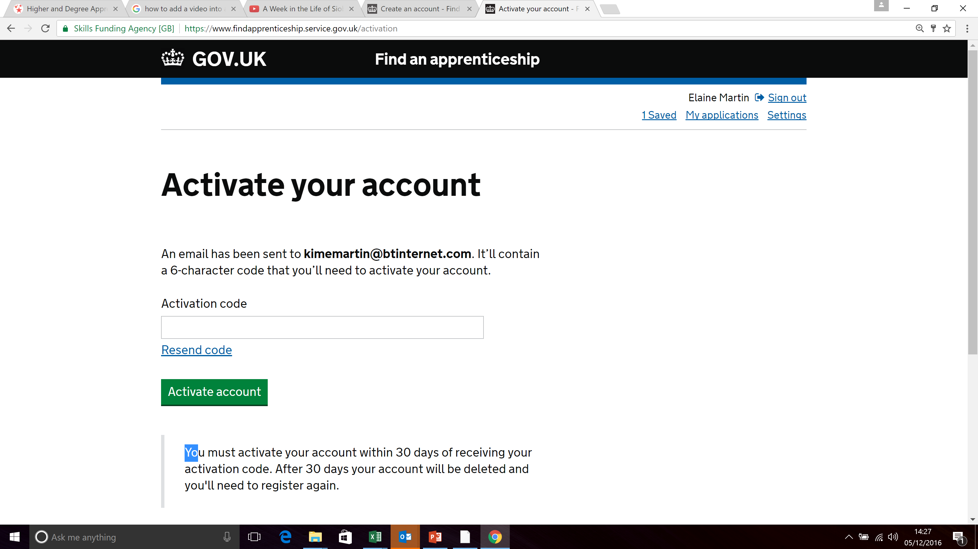
NAME
Email address

Slide 16
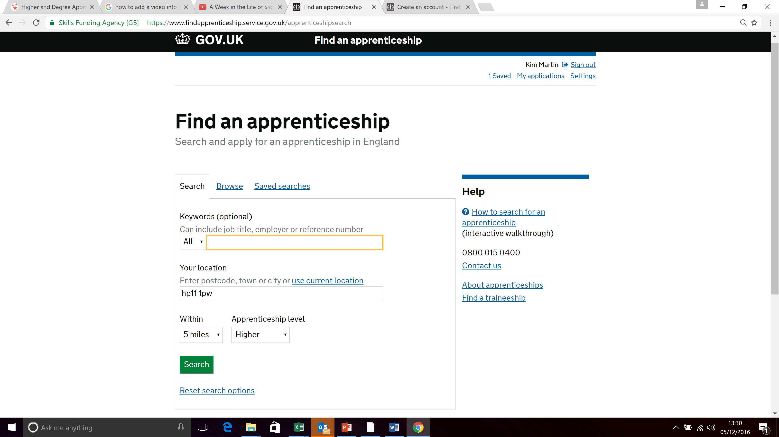
Enter any keywords, your home postcode, how far you can travel and level of apprenticeship

Slide 17
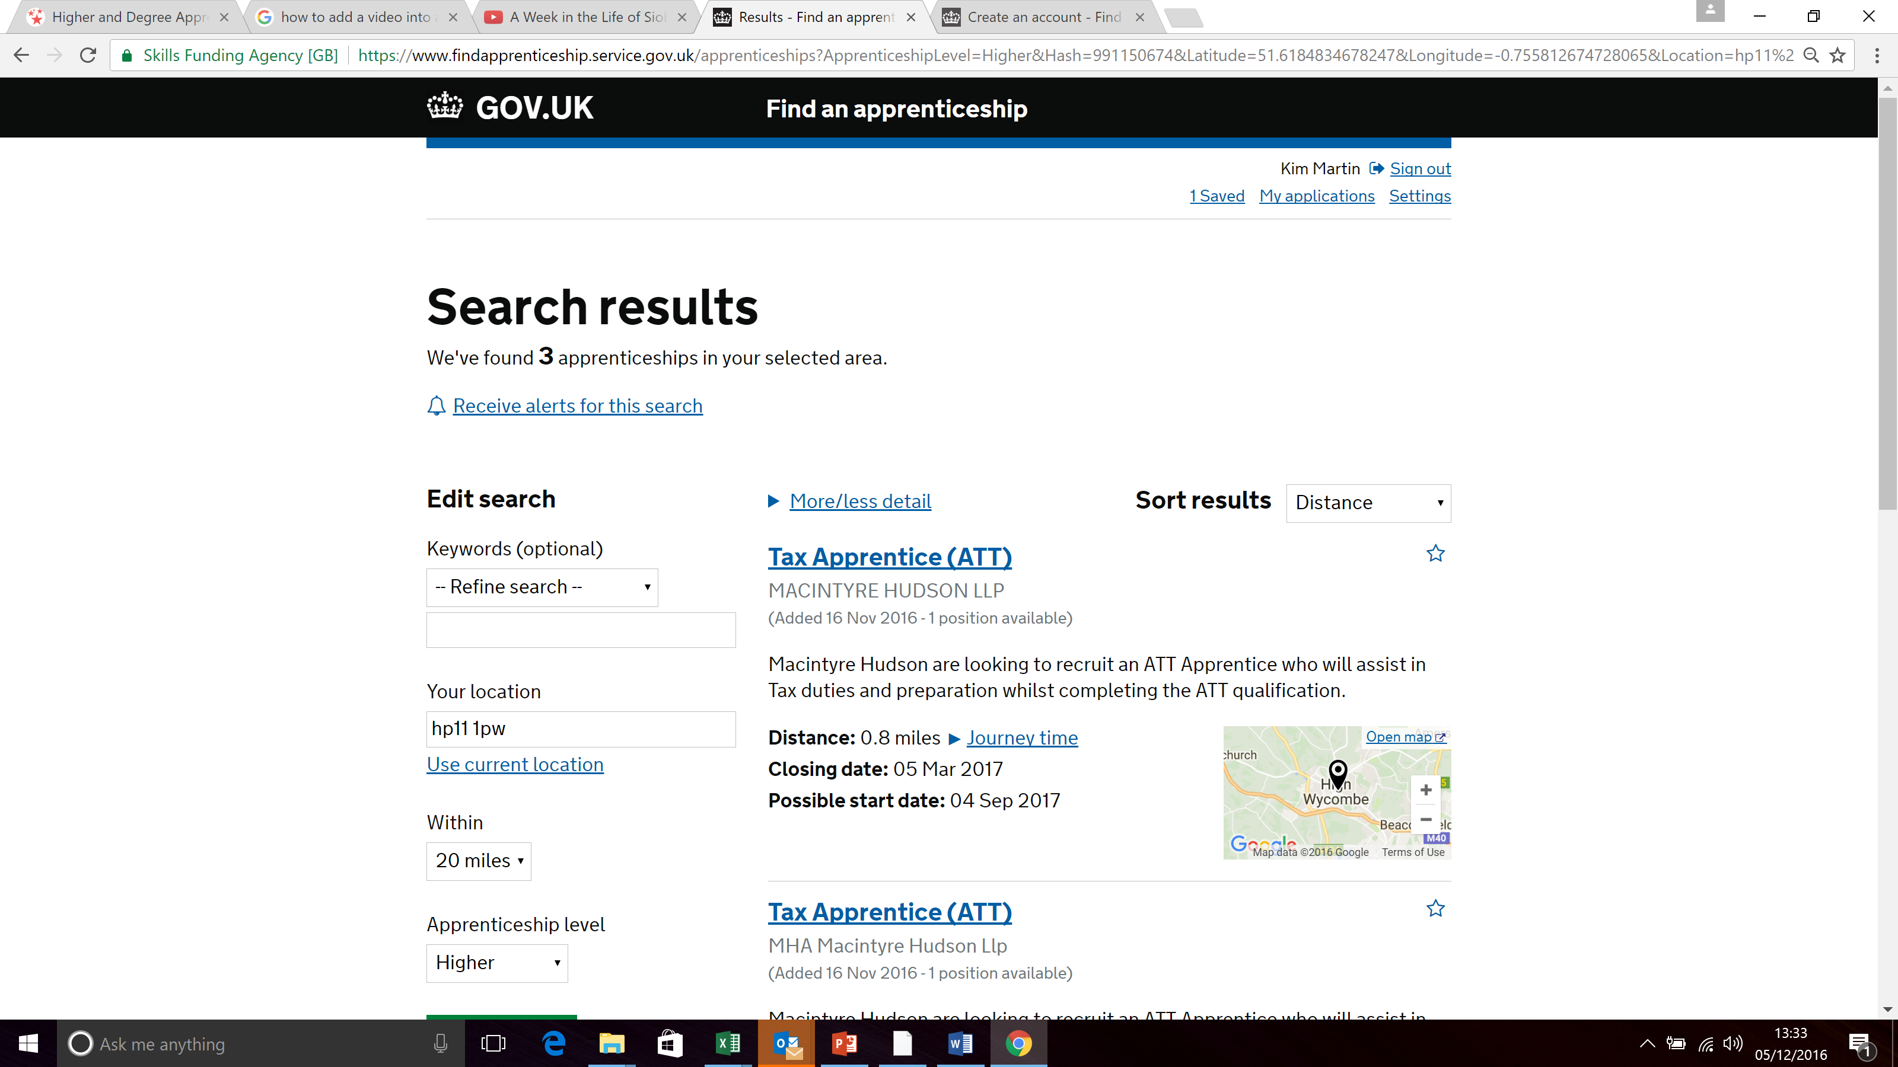
Click ‘Receive alerts for this search’ to have new vacancies sent to your mobile phone and /or email.
Click on the Job title to see further details of the role and the training.

Slide 18
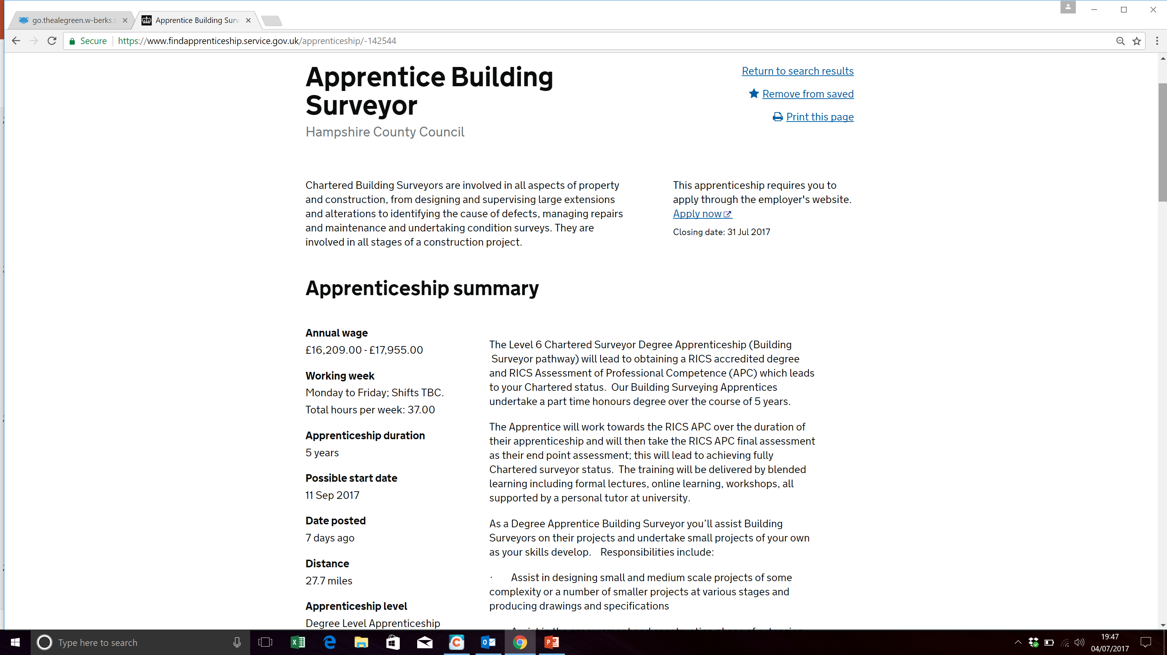
Look at the details.
You can Save the job to refer to later or Print the page

Slide 19
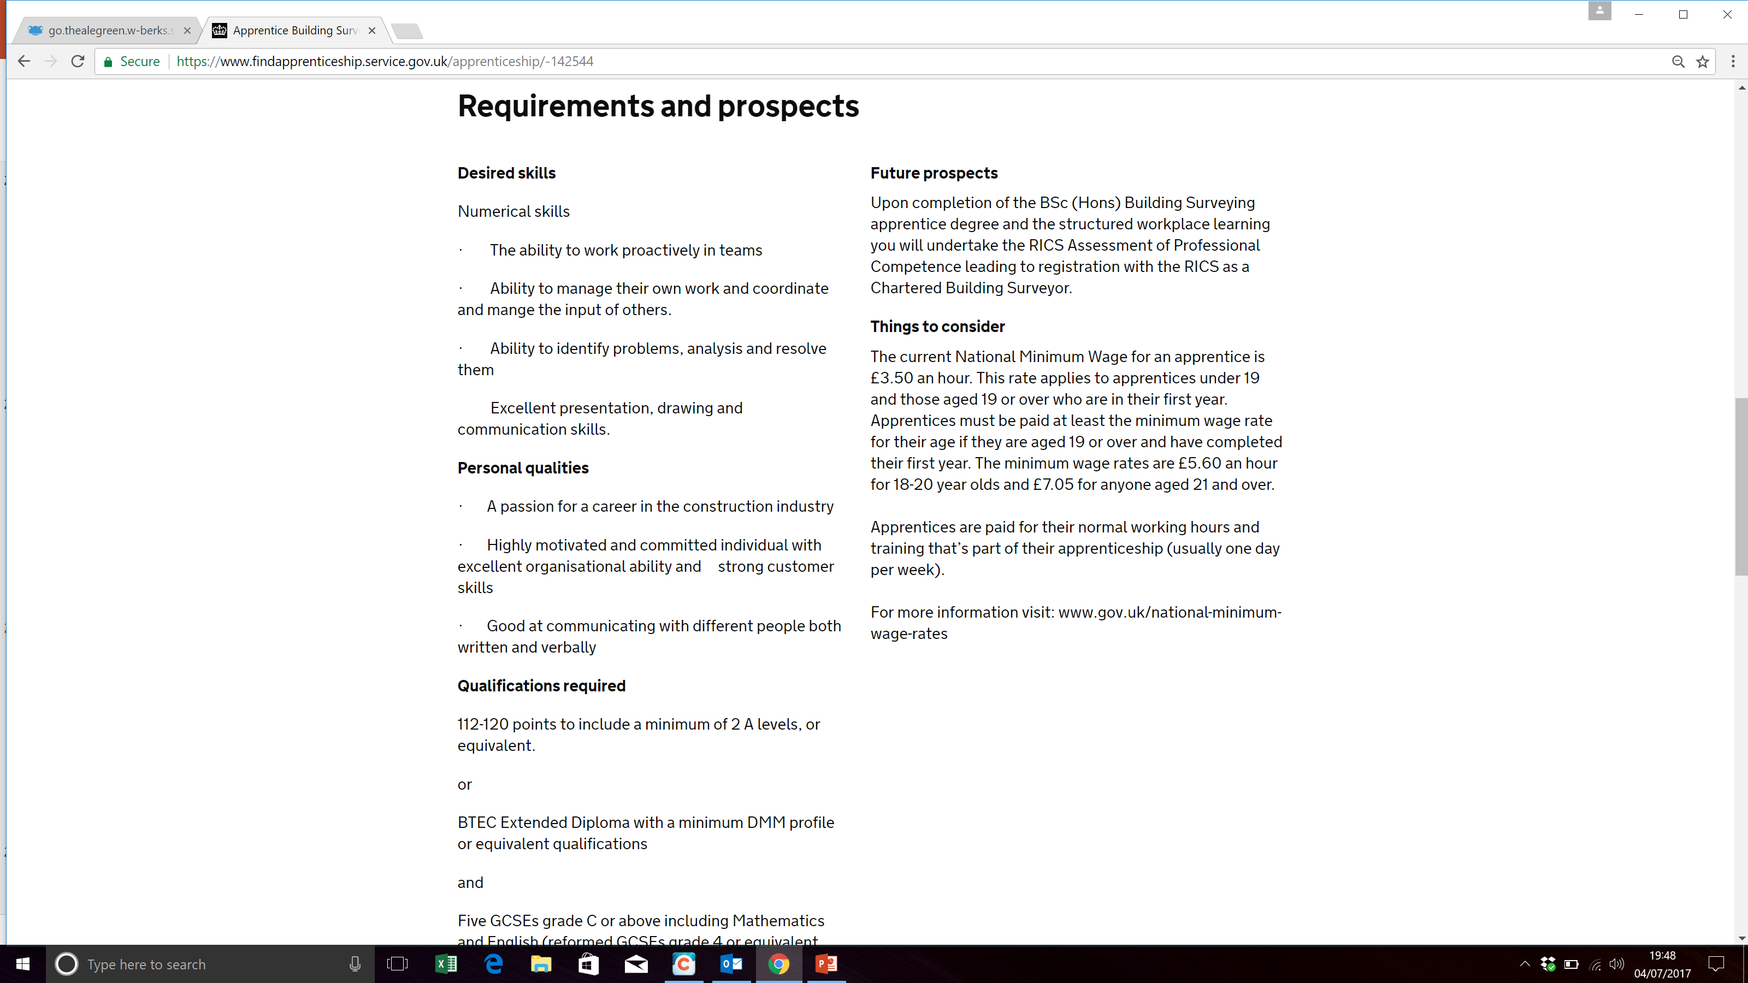

Slide 20
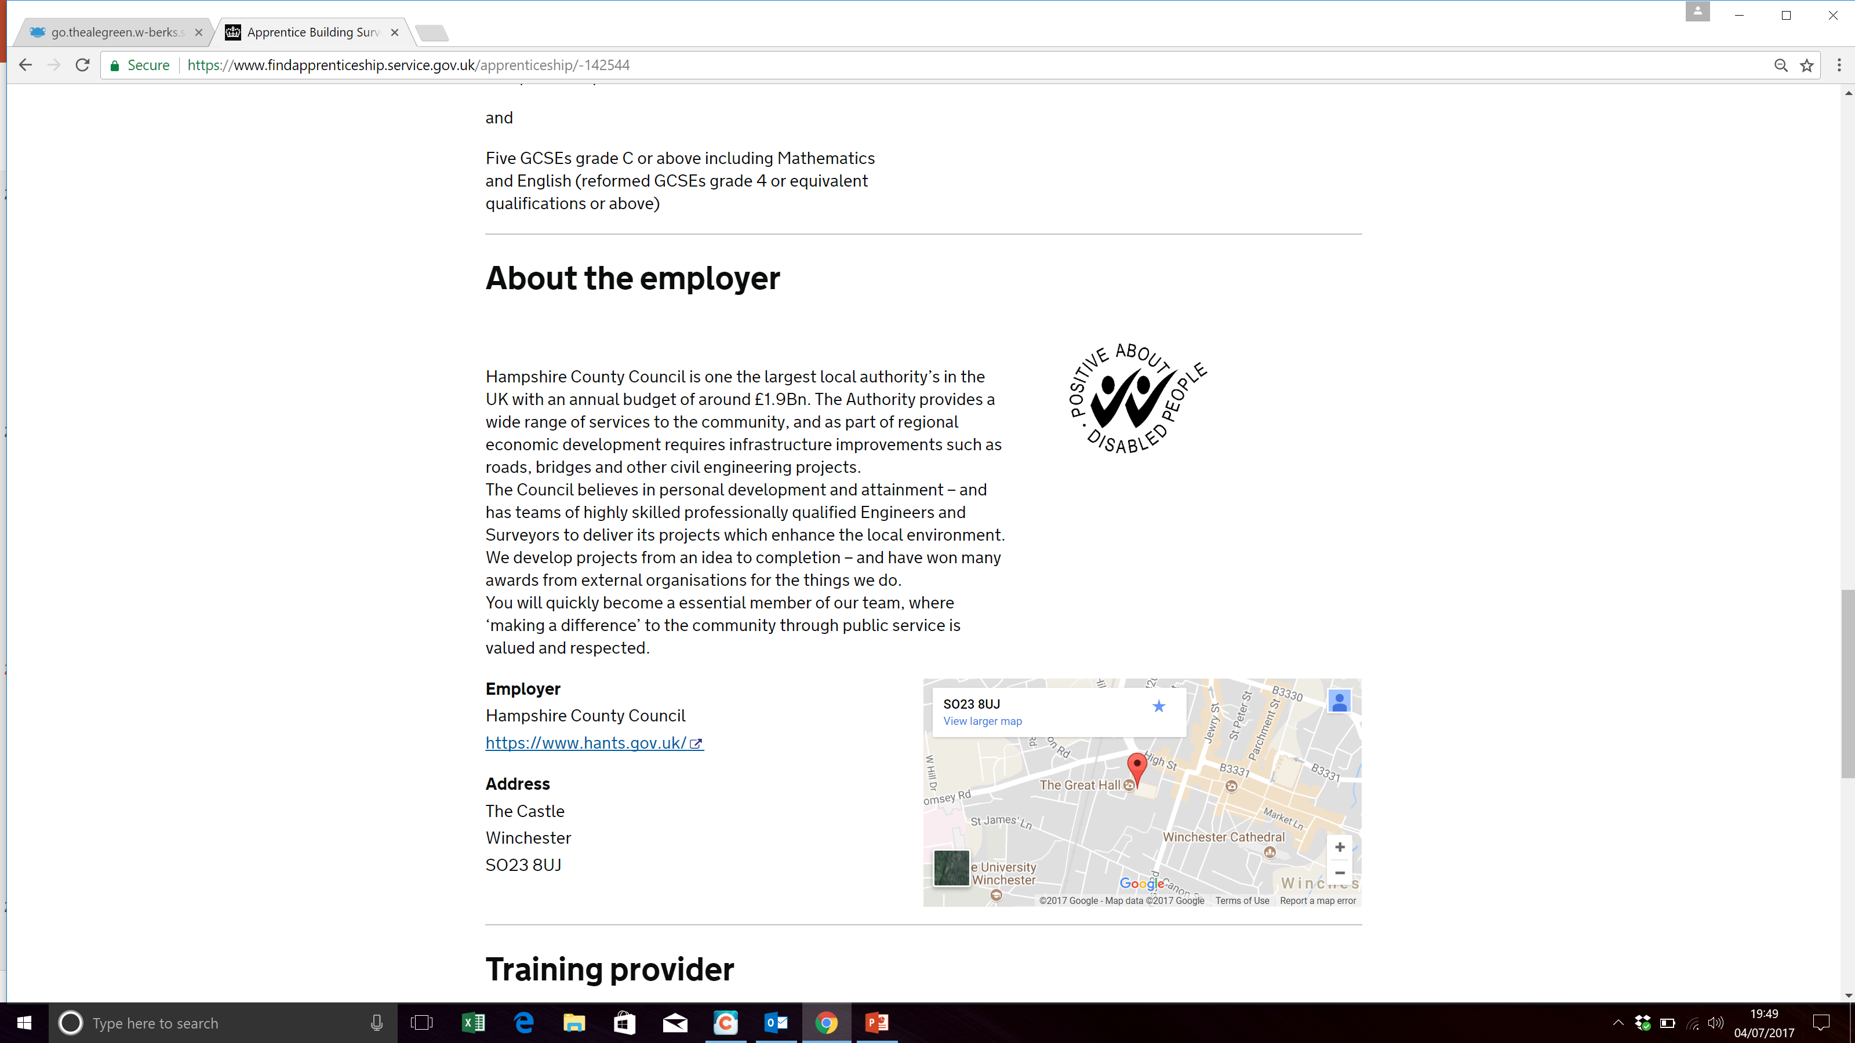

Slide 21
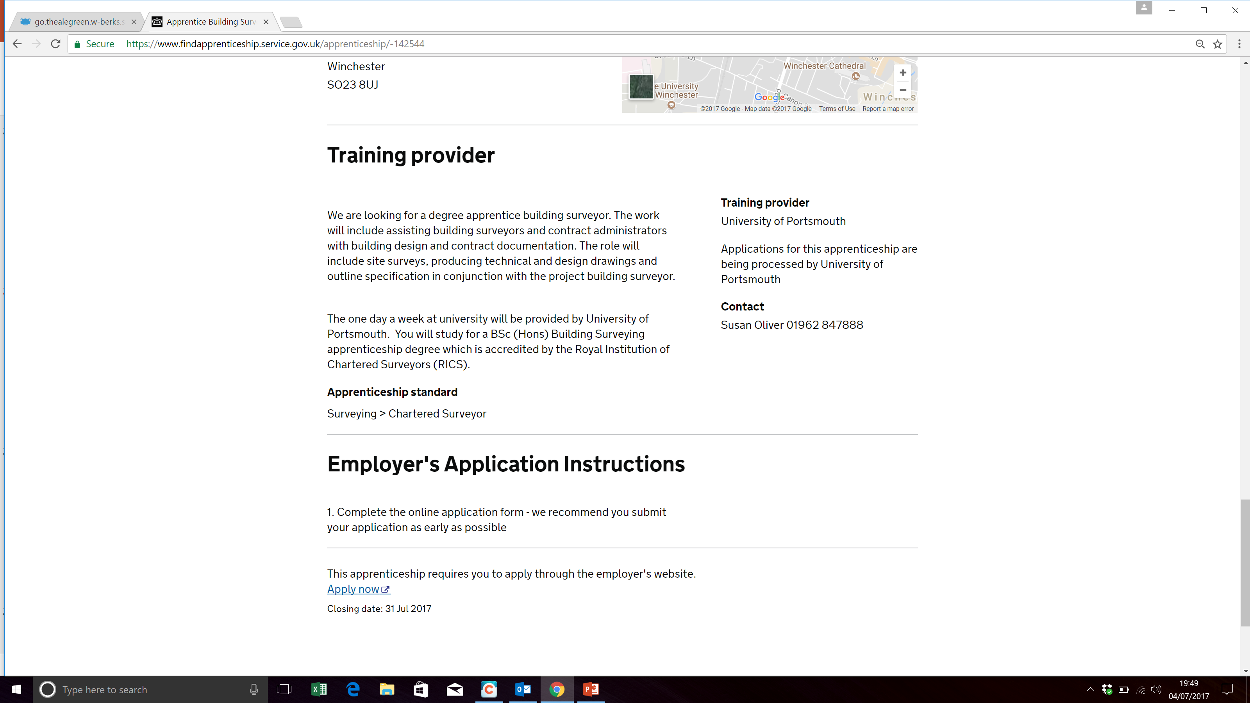

Slide 22
An apprenticeship is:
learn
Work
+ = apprenticeships
How many different types of apprenticeships job roles are there?
1500 job roles
How many apprenticeships are advertised on a daily basis?
28,000
What % of apprentices stay in employment at the end of their apprenticeship?
90%
What year at school must your complete before you can start an apprenticeship?
Year 11
What is the on-line system called where you can search and apply for apprenticeship jobs?
Find an apprenticeship
What must you do once you have been registered on ‘Find an apprenticeship’?
Activate the account
Nothing, it is free of charge
How much does it cost to register on Find an apprenticeship?

Slide 23

The Apprenticeship
Guide
Sophie to provide front cover
Find out about the latest apprenticeships available
Build your knowledge of starting salaries and progression opportunities
Read about real apprentices in real jobs
Notes:
Another source of information is The Apprenticeship Guide….you won’t be able to put it down, because it’s packed with useful information.
Your school will have a copy of this. So if you’re not sure if there is an apprenticeship available in a career that you are interested – have a look!

Slide 24

What next?
We can help!
We can run sessions for those who want help to search and apply for apprenticeships.
Tick the box on your info card if you would like help with applications
Notes:
Offering follow up sessions later in the year for those who want help to search and apply for an apprenticeship.

