Slide 1
CGI
School Leaver Programmes
2016/2017

Slide 2
Over the next 20 minutes or so!
What’s next?
Degree
Job
Apprenticeship
School Leaver Programme
Gap Year
Who are CGI?
Our routes in
The Degree Apprenticeship Programme
Questions
Contact details
CGI UK Students |
@CGI_UK_Students
Notes:
Agenda
Introductions to me/us and CGI
Our programme
Contact details
Any questions at the end
Lots of decisions to make on what to do next – this is just another alternative that may suit some people

Slide 3
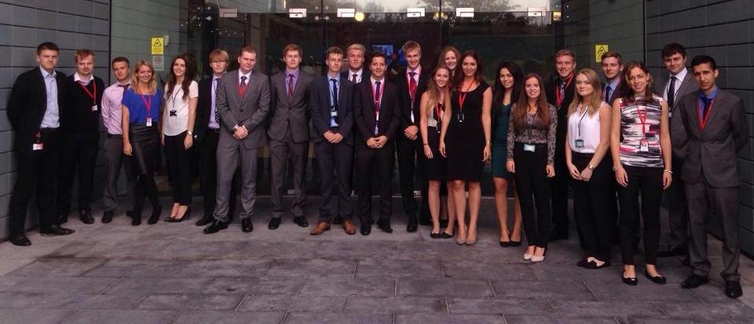
Hi!
Maria Whittingham
3nd Year Degree Apprenticeship Student
Student Recruitment Officer

Slide 4
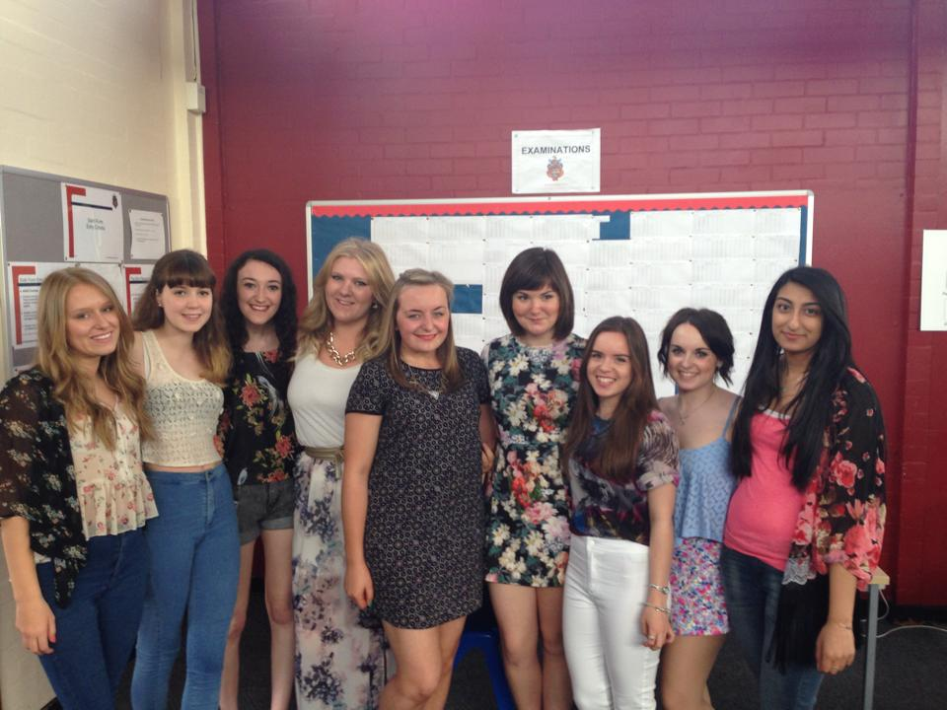
3 years ago…

Slide 5
Who are CGI?
Heard of us?

Slide 6
CGI
Business and Technology Services
70,000 Employees
Countries across the globe
10,000 Clients
400 Local Offices
5th Largest IT Services Provider in the world!

Slide 7
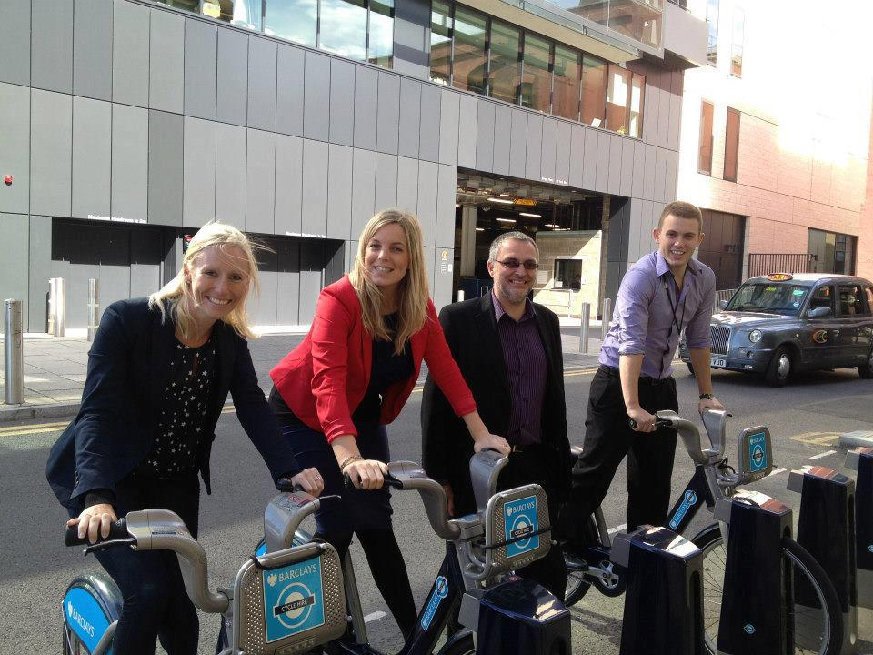
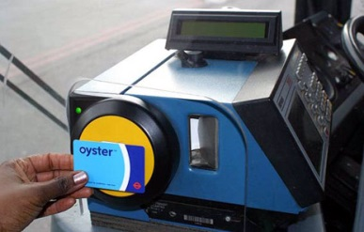
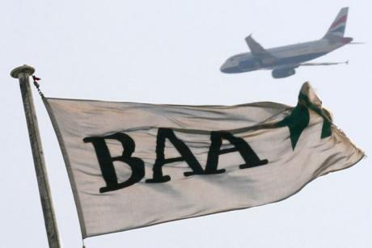
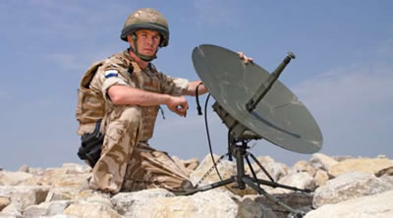
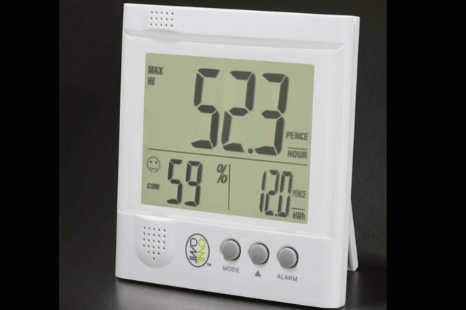
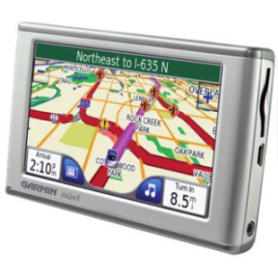
Just to name a few…
Notes:
Barclays Bikes – implement and manage IT infrastructure
Galileo – SatNav system for Europe
Weather satellite images
Faster payments
Voting system on American Idol
Gov. communications
Sent 1st ever text message
2/3rds of text messages sent go through our systems
Police National Database
Gatwick
Smart Metering

Slide 9
Degree Apprenticeship Programme
What’s IT all about?

Slide 10
Career
Info
Independent to UCAS
Apply through our website (Sep-Mar)
Open Evenings
Assessment Centres
Roles
Project Management, bidding, project support, consulting
Testing, development, architecture, programming
CGI
Employed four days a week
Career from day one
Reading or Leatherhead base
Starting salary £14, 625

Slide 11
Degree
University of Winchester
BSc (Hons) Digital & Technology Solutions
Business or IT Specialism
Study one day a week
No Tuition Fees
All course fees and materials covered
Laptop & Books provided

Slide 12
Life at CGI & Benefits
£14,625
People Manager, Line Manager, Buddy, Mentor +
Career pathways
Development & training
Laptop and phone
Relocation allowance
Sports & Social club
Other company benefits
25 days holiday

Slide 13
Entry Requirements
Minimum 5 A*-C GCSEs including English and Maths
Interest/ Passion for Business/IT
Resilience to work and study at the same time
Good communication skills
DA
120 UCAS points across 3 A-Levels at Grade C or above
HA
64 UCAS points across 2 A-Levels at Grade C or above
(Or equivalent)
(Or a completed Advanced IT Apprenticeship)

Slide 14
Application process
Open Evenings
Register on our website
Reading Office (Parents are welcome too!)
November 7th 2017
December 12th 2017
January 9th 2018
Online Application Form
- Opens Sept/Oct
- Closes Early 2018
Assessment Centre
- Interviews, Group Exercises & Written Exercise
- Not as scary as you think – designed to relax you!
Offer
- Conditional on results
- Return Visits to meet everyone
- Facebook Group
- Start in September 2018
CGI UK Students |
@CGI_UK_Students

Slide 15
Who do we love?

Slide 16
Any Questions?

Slide 17
www.cgi-group.co.uk/careers @CGI_UK_Students CGI UK Students
ukstudents@cgi.com
Thank You

