Slide 1
Notes:
Hello
Welcome
Thank you

Slide 2
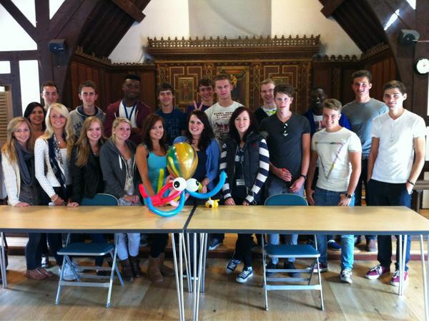
Introduction
Notes:
Introduce myself and others.
Previous SDP Student
Me graduating in 2010

Slide 3
US
A little about

Slide 4
Once upon a time….
Notes:
Me:
A-Levels finished
Didn’t know what I wanted to do
Wanted to earn money
Capable of getting a degree
Found SDP in Maidenhead Advertiser
Here I am now

Slide 5
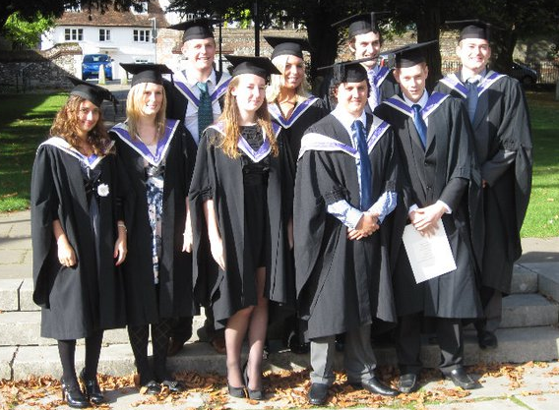
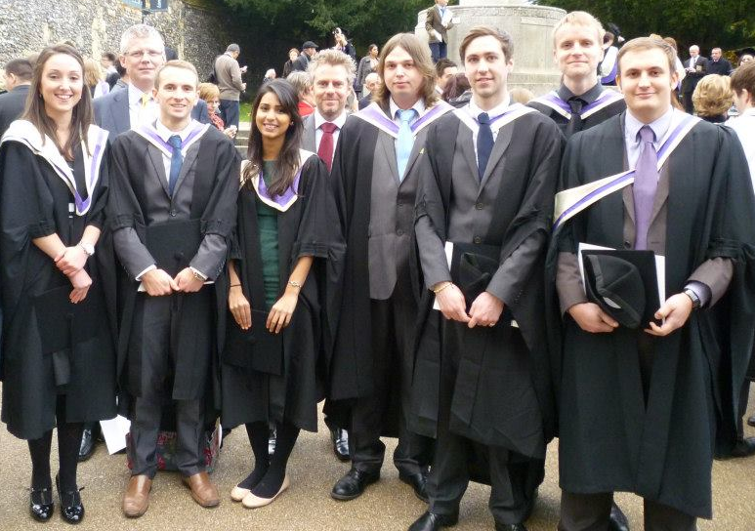
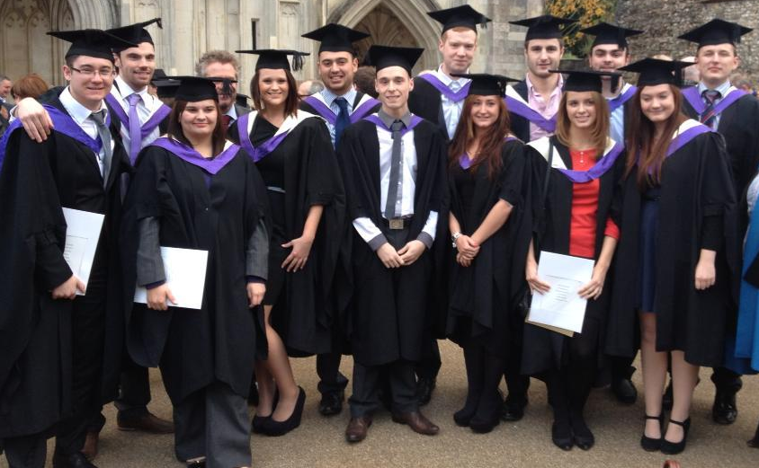
Notes:
Been going since 2007, had an intake every year
Few pictures for them to see graduation
Explain there has been two graduation and one more coming up soon

Slide 6
Any thoughts?
Notes:
Who here is thinking of going to uni?
Who wants to start earning and get a job?
Who hasn’t a clue?!

Slide 7
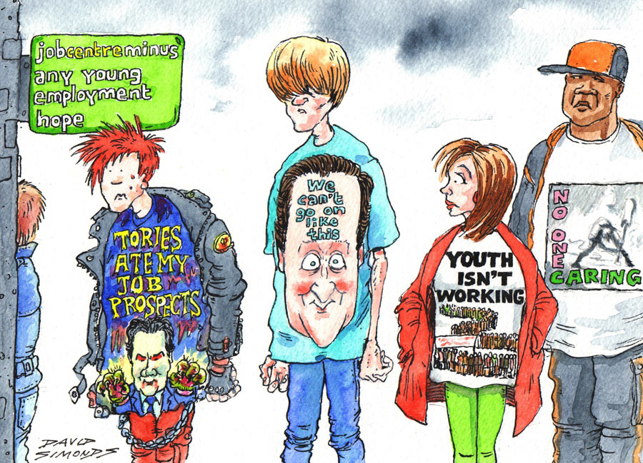
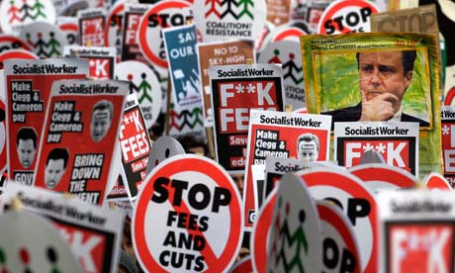
Scary Stats!
Notes:
Students face tuition fees of up to £9000
Average UK student debts could hit £53,000” (BBC, 2011)
Students starting Uni in 2012 average debts could reach £53,000 - double the figure for 2011
Quarter of this house (£220000)
“Graduates struggle to find degree-related jobs” (CIPD, 2010) surveyed 700 Graduates
59% of employees who graduated in the past two years are not currently working in a field related to the degree they studied.
58% of recent university leavers said they had been unable to find a suitable job,
28% claimed their degree did not equip them with the skills they need for the workforce,
21% chose a new career path post-qualification
More than half (52%) of current graduates are either underemployed or in non-graduate jobs – set to increase for 2011 graduates
Youth unemployment hits 1million (BBC, 2011)
recent news youth unemployment hits 1million – scary! Lots of job competition
“Computer Science/IT and Business Students are below average employment level” (Independent, 2010)
Computer Science/IT graduates and Business Graduates are below the 89.9% average employment rate – computer science/IT 81.8. Business 88.4
So made you change any of your minds about the questions I asked before?

Slide 8
Logica
A little about

Slide 9
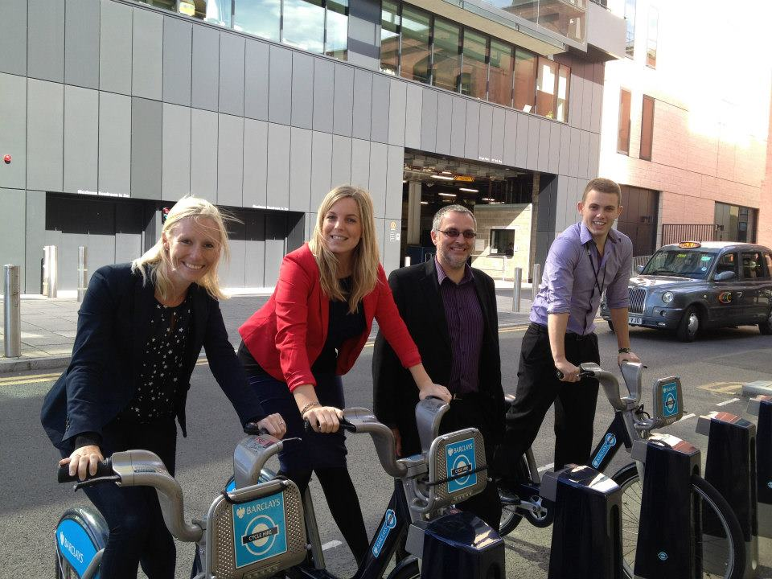
Logica, now part of CGI
Business and Technology Services
72,000 employees
40 countries, 10,000 clients
6th largest IT provider in the world!
We work in:
Space and Defence
Telecoms and Media
Public Sector
Transport + more!
We do:
Business Consulting
Innovation
Outsourcing + more!
Without Logica:
You couldn’t send texts
Criminals wouldn’t get caught
You couldn’t vote on American Idol
You’d lose your bags in Gatwick
Our troops couldn’t communicate securely
You couldn’t fly in UK airspace
You couldn’t have watched the Olympics on TV
Life would be very cold and dark
Notes:
(we designed the electricity trading markets, while our systems manage >85% of gas storage)
(we delivered the central control and monitoring system for NATS)

Slide 10
The Sponsored Degree
A little about

Slide 11
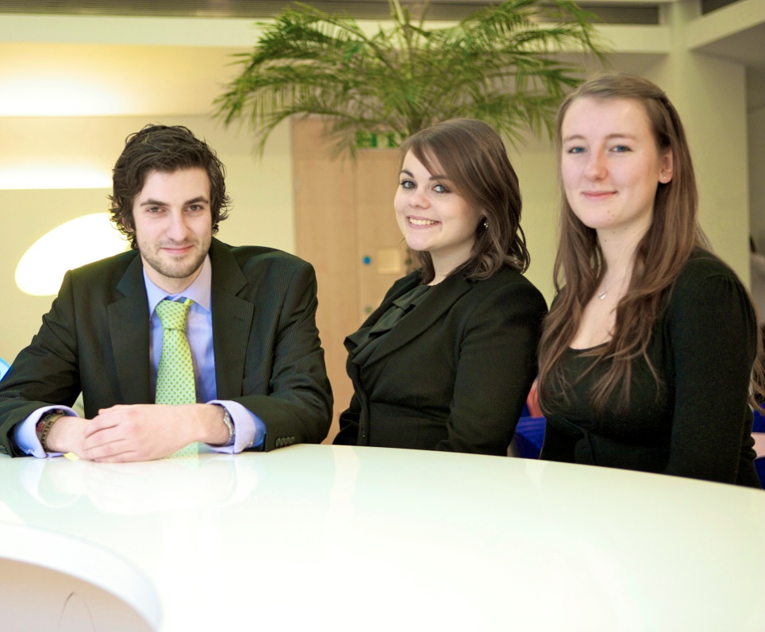
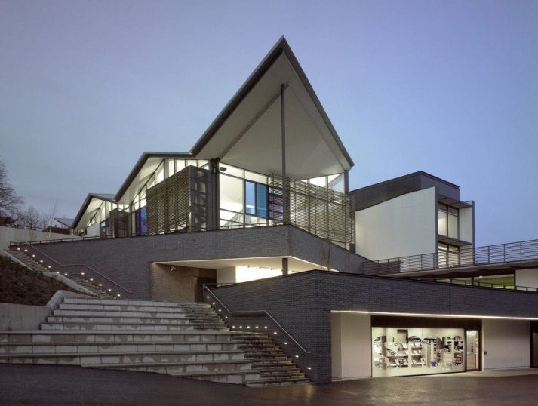
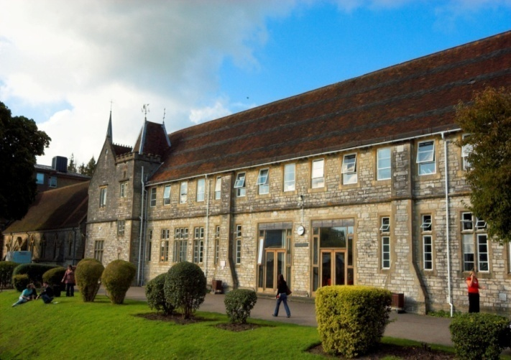
What does the Sponsored Degree Programme offer?
Career
Logica
Employed four days a week
Career from day one
Opportunity to develop and grow
Reading or Leatherhead base
Salary
Start on £13,000 and watch it rise!
It all adds up
Degree
University of Winchester
BA (Hons) Business Management or Business Management with IT
Study one day a week
Combine academic learning with on-the-job training
No Tuition Fees
All course fees and materials covered
No student debt!
Get the best of
both worlds
Notes:
2 main elements

Slide 12
Modules: To name a few...
Computer Applications for Business
Skills for Management
Responsible Management
Work Based Studies
Managing Finance
People & Organisations
Programming Concepts
Core Processes in IT Delivery
Computer Programming Skills
Networking and the internet
Development of IT
Business Communications
Management Research
Managing Change
Projects, Processes and Systems
Leadership and Management
Strategic Development
Strategy in Action
Business Ethics
Building Marketing Relationships
HRM in Context
Financial Management
Notes:
Some of the modules
Range of subjects
Taught by both Uni of Winchester and Logica – making it current

Slide 13
Roles and progression
Project Management Office
Testing
Resourcing
Analyst
Social Media
Recruitment
Project Support
Development
Consulting
Internal Communications
Bid Proposal
Junior Project Management
Team Leader
YOU can shape YOUR career

Slide 14
Three years time...
VS
Sponsored Degree Graduates
No tuition fee debt
Full time job with Logica
Three years commercial work experience
Developed and tailored career
Higher salary
‘Normal’ Graduates
Lots of student debt!
Stress of looking for a job
Little (if any) commercial work experience
Career on hold
Lower salary

Slide 15
What do we need from you?
Good grades: 300 UCAS points A-Levels (or equivalent) and at least 5 A*-C GCSEs (including Maths and English)
Hard work
Genuine long-term interest in our industry
Good communication skills
30-40 Vacancies to start September 2013.
Independent to UCAS

Slide 16
How do I apply?
Online Application Form
(Open Now)
Open Evenings
29th January
Notes:
Open eve – register online

Slide 17
What happens next?
Online Application Form
Phone Interview
Assessment Centre
Interview
Written Exercise
SHL Test
Group Exercise

Slide 18
Where are we now?
And we all lived happily ever after!
Notes:
Talk about where we are now – the benefits
No debt
House
Career
senior

Slide 19
Find out more and follow!
www.workatlogica.co.uk
Logica Sponsored Degree Programme
@LogicaDegree
Logica PLC

Slide 20
Any questions?

Slide 21
Thank You
Find out more and follow!
www.workatlogica.co.uk
Logica Sponsored Degree Programme
@LogicaDegree
Logica PLC

