Slide 1
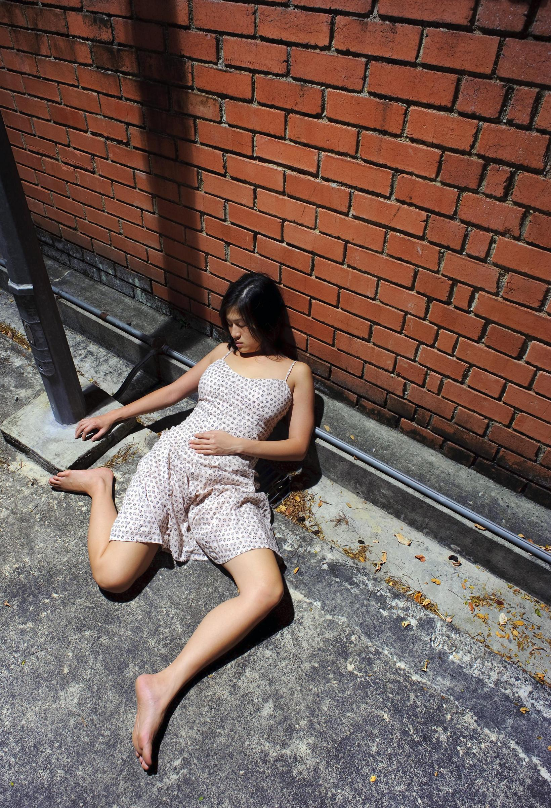
Stay
Smart
Stay
Safe

Slide 2
Not all dangerous strangers are immediately rude or forceful when you first meet them.
Some are attractive and charming

Slide 3
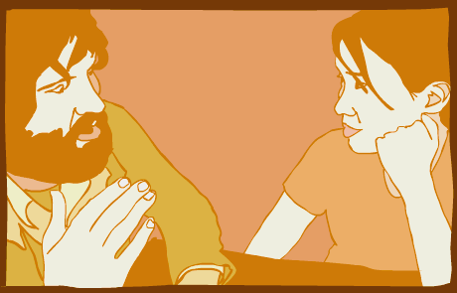
Be assertive; if a person that you don't know starts talking to you, you don't have to talk to them. Don't be afraid to sound rude if someone keeps bothering you. Stay calm and firmly and loudly say "NO". Remember that "NO" is a complete sentence - you don't have to explain yourself to someone that you don't know.

Slide 4
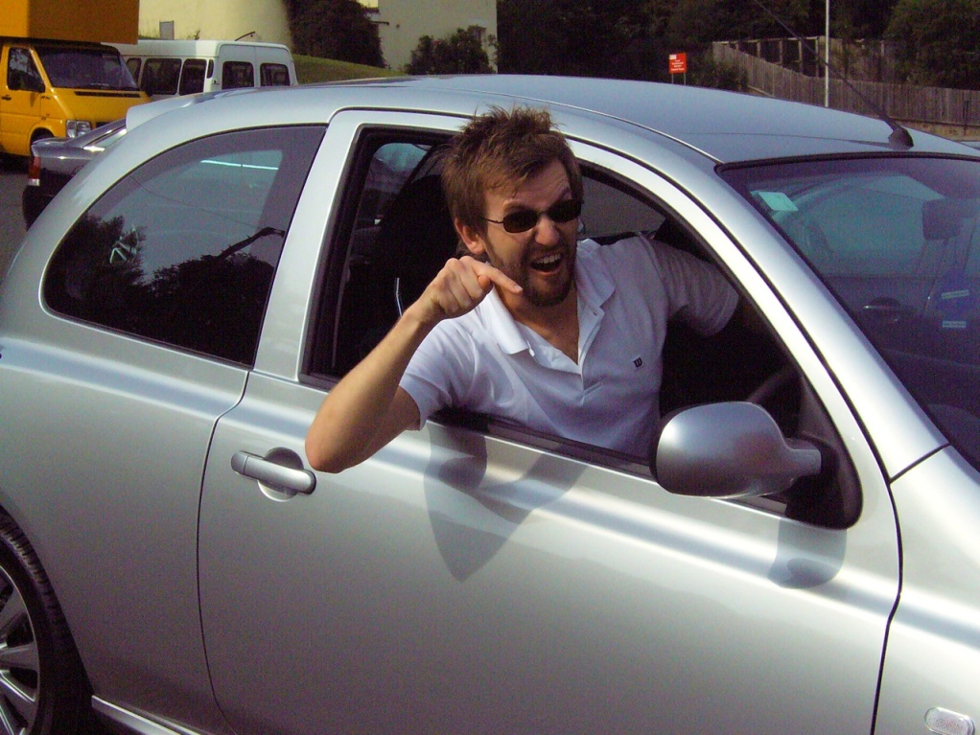
As a pedestrian be aware of anyone in a car who stops to talk to you or ask you for directions, even if you are in a familiar area.
Try to keep your distance from the car and never offer to get in the car even if it sounds like the stranger is going the same way.
Classic trick - a stranger tells you that there is some kind of an emergency requiring that they bring you home.

Slide 5
Don’t be quick to share personal information. Just because a stranger tells you where they live, it doesn't mean that you have to tell them where you live or they have been honest with you.
Don't volunteer unnecessary information about your plans or even your full name.

Slide 6
Films like The Hangover have raised the profile of Roofies / Rohypnol
TVP stats suggest a drug called C2H505 is far more deadly

Slide 8
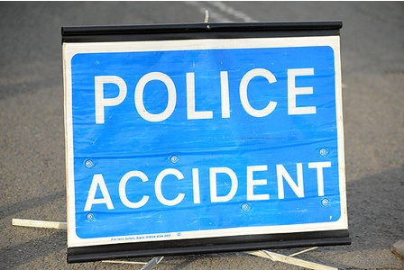
NEVER get in a motor vehicle with anyone who is under the influence of drink or drugs

Slide 9
Some tips to keep safe on the streets;
stay alert, MP3 players and phones are a huge distraction
stick to busier well-lit roads, and avoid short cuts through alleyways
if you think someone is following you, cross the road or go to a place with lots of people around, like a bus stop or shop
Some young women like to carry a whistle or shrill alarm to warn off suspicious strangers
if someone tries to take something from you, never fight. Don't carry weapons because they are more likely to be used against them, and it's illegal

Slide 11
Best of luck in Sixth Form and with your future beyond Little Heath School

