Slide 1
Little Heath School Work Experience 4th February 2019 for one week

Slide 2
About Education Business Partnership – Who are we?
Established 25 years
Active network of 1500 businesses
Based in Newbury but able to travel county wide and beyond
Working with students within primary schools, secondary schools and colleges across Thames Valley and Wiltshire
Over 1200 students involved in work related learning activities in the 2017-18 academic year

Slide 3
What do we do?
Three core areas:
Work related skills programmes
Careers Inspiration Activities
Work Experience Placements
- aimed at inspiring the future work force

Slide 4
Why do Work Experience……?
New opportunities – change in routine, new people
Gain an understanding of a particular type of job or of work in general
Gain an understanding of a type of work they do not want to do!
Employability skills
Apply what students are learning in the classroom into work situation
Discovery of new skills and interests
Valuable experience for when writing Personal Statement for University / College or work application forms, giving real life examples at interviews
Contacts for the future and may bring possible work opportunities

Slide 5
There are two options for students to find a work experience placement:
Option One – students find their own placement using their own contacts
Option Two – Education Business Partnership will source a placement for the student

Slide 6
Option One : Finding an Own Placement
The student should consider what they would like to do – any jobs, sectors and businesses they are interested in?
What interests them ? What would they like to learn more about?
Consider who they know who could provide work experience – family / friends / contacts ?
Consider logistics eg how they will get there – can you help them with transport?
When they have found a placement:
Employer completes an Own Placement Form and student returns it to school
Signatures are required as confirmation from Parents/Guardians, employer and student
EBP will undertake Pre Placement Checks

Slide 7
Option Two - EBP find a Placement
The students complete an Application Form:
- Interests
- Three general sectors they are interested in
- Locations / where they can get to and how
Be realistic, think of types of employers in the area
- Medical information
Return form to school who pass it to EBP
Signatures are required as confirmation from Parent/Guardians
EBP may need to interview some students for individual placing
EBP will source the placement and undertake Pre Placement Checks

Slide 8
Planning and Preparation - applies to all Own Placements and EBP placements:
EBP pre placement checks are undertaken for all placements
All students are issued with a job description / summary
Parental consent forms must be provided
Students must make / maintain contact with their employer prior to start

Slide 9
The Pre Placement Checks
Checking that the setting is appropriate and safe for the student
Health and safety check
Insurance
Employers asked to undertake a Risk Assessment
Students issued with a job description / summary of what they will be doing during the week
Realistic expectations and tasks

Slide 10
During the Placement
Student completes a log book
School staff visit / call the employer
Employers provide feedback – students may use this in future applications or request a reference from the employer
EBP support when needed by the school

Slide 11
After the Placement
EBP review all Placements
Student debrief at school
Students will upload the competencies gained to Unifrog
Students should update their CV / Personal Statement to reflect the skills gained during work experience.

Slide 12
Students’ Comments
“It was more tiring than school but at least I didn’t have any homework to do”
“You had to concentrate all the time as you are involved with real customers”
“It was extremely helpful and inspiring, I learnt a lot from the week and would highly recommend it to anyone else.”

Slide 13
Employers’ Comments
“. . he was quiet at first, but not for long!”
“The student was exemplary. She was hard working, able to use her initiative, demonstrated a positive attitude and was happy to do all tasks that were asked of her.”
“She was a joy to have in our office!”

Slide 14
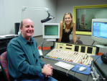
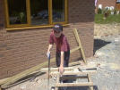
Any Questions ?

Slide 15
Costs
Own Placements cost £40
EBP sourced placements cost £77
Pay through Parent Mail accounts as with a school event / trip
All payments by 10.12.18.
Bursary students will be funded

Slide 16
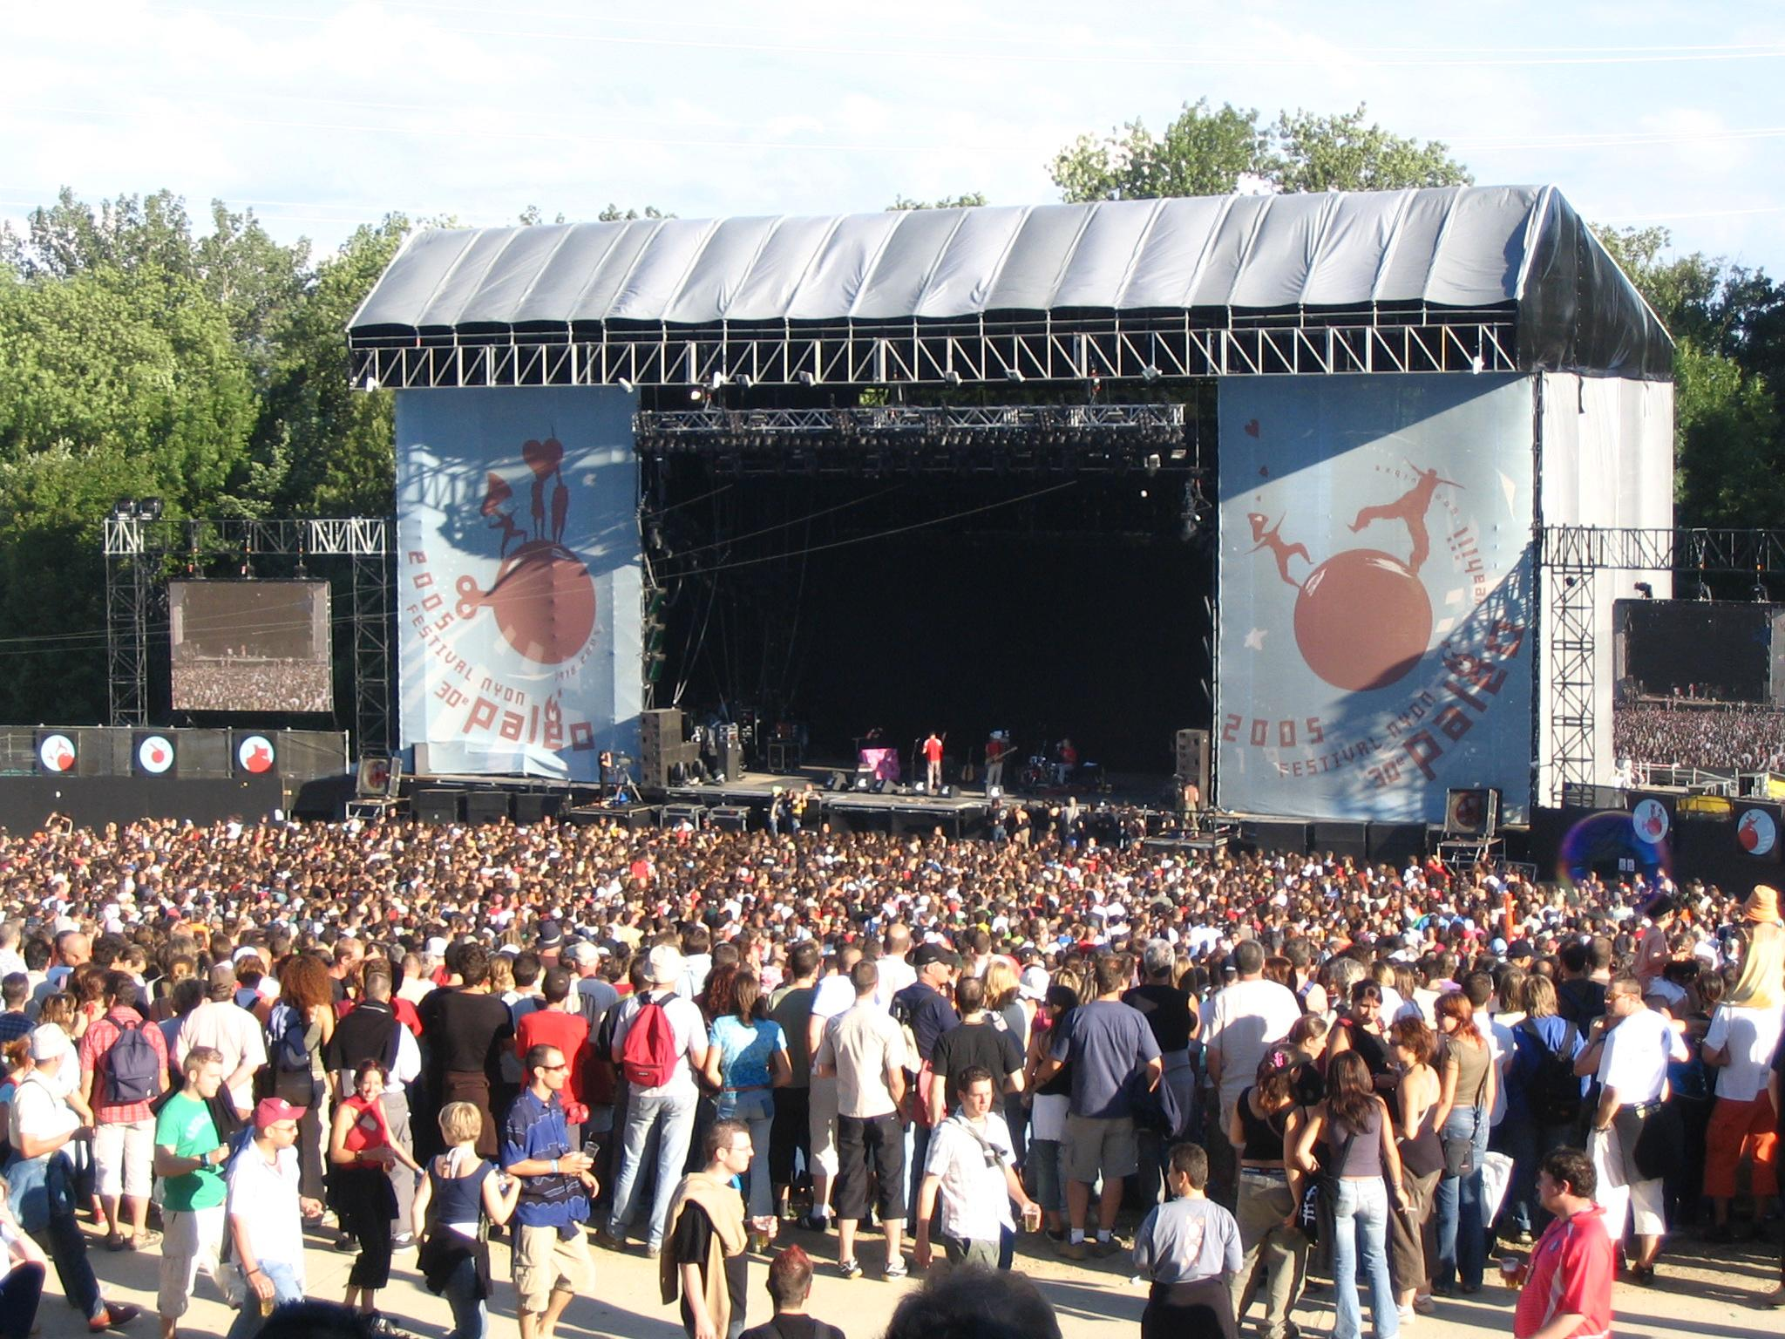
Costs
Own Placements
These cost £40
Yes there is a cost but how much would one spend in these situations and what value could this add to your future?
EBP sourced Placements
These cost £77

Slide 17
Support to find an own placement
Talk to family and friends and explore ideas
Mentor will discuss ideas with the students
Mrs Wooller (ewooller@littleheath.org.uk)
Mr Male (amale@littleheath.org.uk)
Careers fair 17.10.18. 6-7.30pm HERE!
Look online, write a letter, make a phone call. Worth a try!

Slide 18
Dates and Deadlines
Hand in Own Placement forms or EBP application form to Sixth Form Reception as soon as ready (do not wait for the deadline)
30.10.18. Deadline to hand in Own Placement or EBP application form to Sixth Form Reception (or before if ready!)
14.01.19. Health and Safety briefing in assembly and final Placement Forms issued
Parental consent form signed and returned to Sixth form Reception by 21.01.19. (or before if ready!)

Slide 19
Little heath school learning for life  together  one community

Slide 20
Growing student leadership at Little Heath School
During summer 2018 we re-designed the student leadership structure to amplify the student voice within school:
• To give students an increased influence in shaping the development and future of the school
• To offer students opportunities to develop leadership skills and gain leadership experience and training
• To provide greater leadership opportunities to more students, with the possibility of progression (eg: Prefect to Head Student)
• To connect Sixth Form student leaders with the entire student body

Slide 21
But Most importantly…
With 564,190 people applying to UK higher education courses in 2017…
We want to provide more opportunities for our students to

Slide 22
The New Student Leadership Structure at LHS
Senior Student Leadership Team (SSLT)
2 Head Students
LHS Prefect Team
(30 Students)
Pastoral Prefects
Department Prefects
Wider school community
School Council
House councils
2 Deputy Head Students
8 House Captains
Year Councils
Year 13
Year 12
Years 7-11

Slide 23
As student Leaders there are Roles and Responsibilities Personal BENEFITS
Prefects contribute to the wider school community
Will be the best ambassadors for our school
Show visitors around the school
Will help interview new employees
Will run assemblies
Will support at Parents Evening and other important school events
Will have a duty for one lunchtime
Can recommend Rewards and Consequences
To enhance your CV or UCAS reference
Enjoy coffee and cake with the sixth form team
Gain paid employment within the school duty team
Receive additional leadership training through the Royal Military Academy Sandhurst.
Complete your school service requirement
Develop valuable traits that will help you to stand out from the crowd.

Slide 24
Leadership
Organisation
Resilience
Initiative
Communication

