Slide 1
LITTLE HEATH SCHOOL
Sixth Form Information Evening
for entry September 2017
Notes:
DRA to welcome especially those new to LHS
Welcome
Hand over to GVI
Welcome to all
Format of evening - formal and informal
Thanks to all 6th formers who have volunteered to be ambassadors this evening – special thanks to Sophie and Emily agreed to talk to you
Welcome
Plans on chairs
Refreshments in canteen
Ask students for help

Slide 2
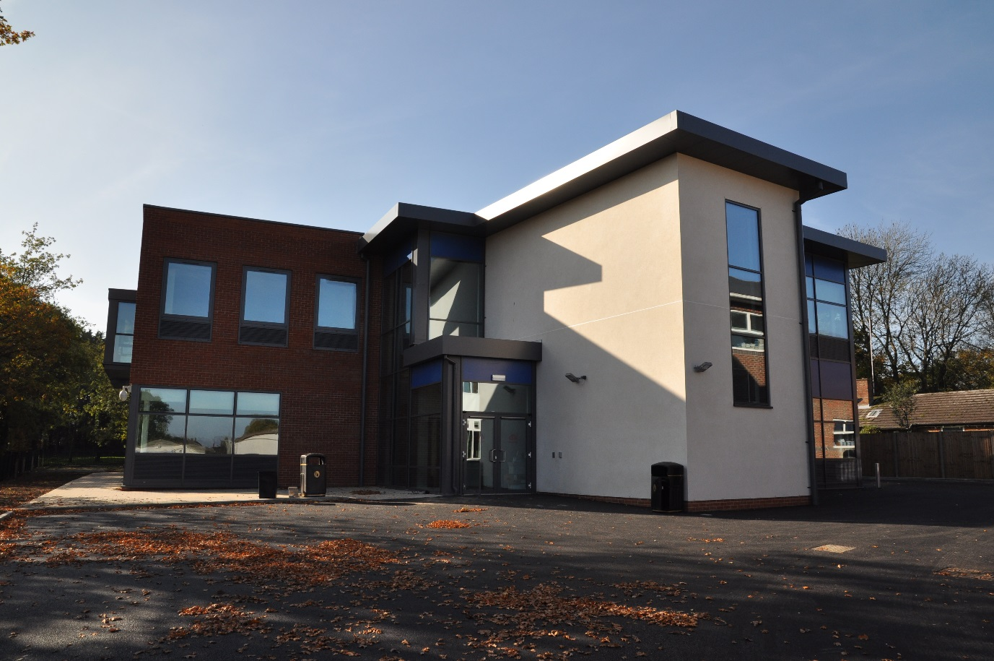
Why choose Little Heath Sixth Form?
Because we have a £3.5 million state of the art Sixth Form Centre.
Notes:
DRA Why study A Levels at LHS
New building
Best facilities in the area
Rationale behind design
T and L opportunities

Slide 3
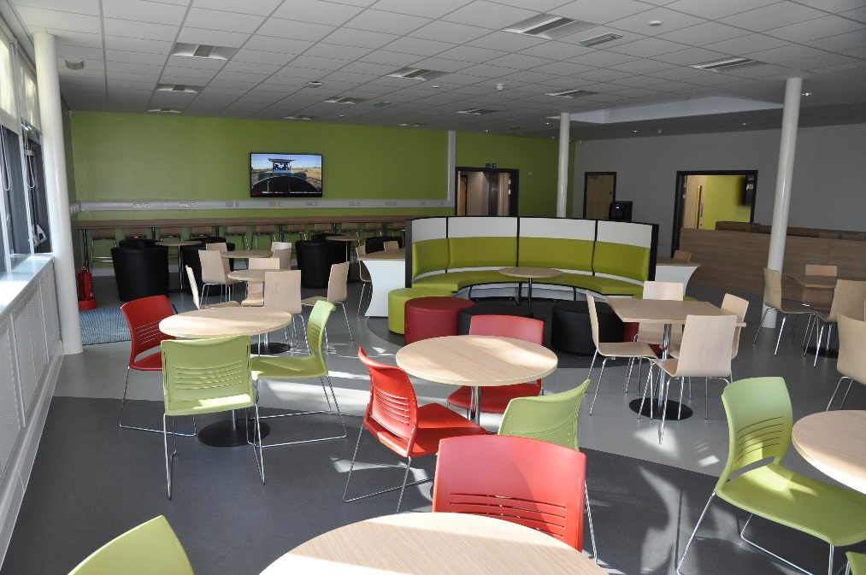
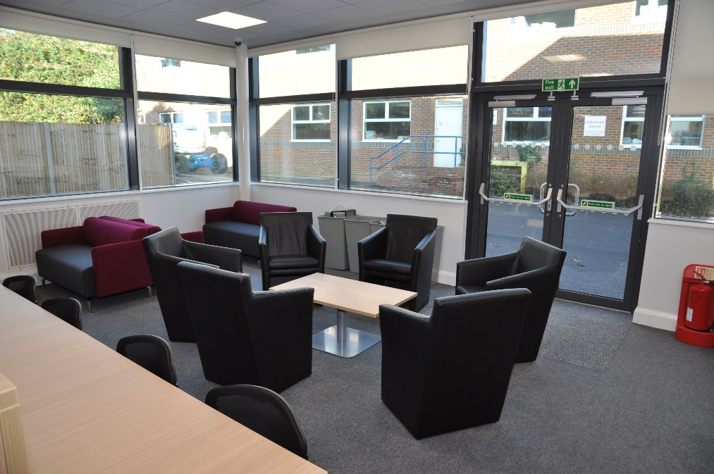
Why choose Little Heath Sixth Form?
But, we have so much more to offer than just a new building.
Notes:
DRA
Other views of new centre
University feel
Encourage students to step up and helps them make the transition to next step in career.

Slide 4
Why choose Little Heath Sixth Form?
Fresh start, but with some degree of continuity to ease the transition to KS5.
Expert teaching in smaller classes. Teachers who will work hard to support to help you achieve grades which are better than students at other schools with similar GCSE results
Motivational target setting
Broad and balanced curriculum - see the prospectus on the website for details
Ability to mix and match between academic and vocational qualifications such as Business, ICT, Level 3 courses in Science, Health & Social Care and Sport
Notes:
DRA
Big 6th form – therefore can offer a wide range of courses
Support and rigour for all students
See website - for detailed info on the range of subjects on offer
WE encourage our students to aspirational from the start of year 12

Slide 5
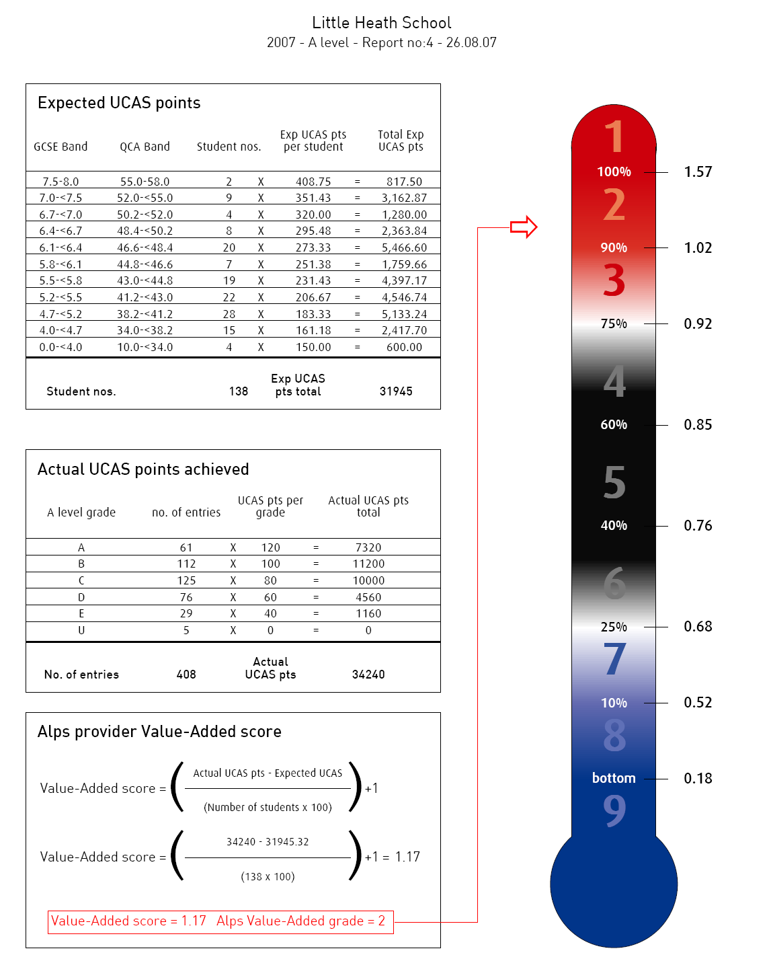
Little Heath School 2016
This rocket represents Little Heath School’s value-added performance – the improvement added to students from GCSE to A Level.
We are consistently in the top 25% of the country
Notes:
DRA
Aspirational approach works
Red hot alps explain what these means .
Students Make excellent progress with our support

Slide 6
Why choose Little Heath Sixth Form?
New way of working - experienced Sixth Form team who will treat you as young adults and listen to your opinions
Mentor system - which helps bridge the gap between KS5 and future careers/university course
Excellent track record of helping students onto their next steps – university or chosen career paths
New challenges and opportunities beyond the classroom
Notes:
GVI
New way of working - rigour but work with our young people to guide them through KS5 and prepare them for the next step.
Open door policy
Strong links with local unis and employers - unis tonight and bi annual Careers Fare
Financial support too – via DBF – more info about this tonight too.

Slide 7
Ofsted - July 2014
“Achievement in the Sixth Form is good in nearly all subjects and sometimes outstanding.”
“Sixth Form students are supported in developing mature and independent learning skills, ready for the next stage in their education or training.”
Results are good:
August 2016:
15% of students gained A or A* grades
40% of our students gained A*-B grades
Notes:
GVI
Progress excellent but OFSTED also impressed with our achievements a s a large , comprehensive 6th Form
Introduce Sophie joined LHSF in September 2016

Slide 8
Sophie Hopley
Year 12 student
Joined Little Heath Sixth Form in September 2016
Studying Biology, Drama,Geography and Home Economics

Slide 9
Which subjects to choose?
Think about your career ambitions
Not sure about the future? Choose a range of subjects which you are good at and enjoy
Taster lessons are being held on Friday
Lots of support from Sixth Form Team
Sixth Form Subject Choice Surgery 3.30-5.00 –opportunity to discuss your subject choices and career plans with members of the Sixth Form team.
Notes:
DRA
DRA
Most students don't have a definite idea of what career they want to follow so important to talk to people and be honest about likes/dislikes strengths and weaknesses.
Hopefully taster lessons have helped first time offering Rising 6th form surgery after school next week from Monday to Wednesday sday..
No need to make an appointment but see contact details on the sheet if you would like to .
Followed up by course choice interviews in January

Slide 10
A Level Reform
From September 2017 all subjects will be linear.
A Level Assessment – The final A level grade is obtained by sitting examinations at the end of Year 13 which test all the work studied by the students in Years 12 and 13.
Rigorous tracking during these two years – including internal assessments at the end of Year 12.
Notes:
DRA
All subjects the same from Sept 2017
Two year courses – final assessment at the end
But rigorous assessments half way through the course at the end of Year 12

Slide 11
A Levels
We expect most students will take 3 A Level subjects . However, there is some flexibility available for those students who are keen to study 4 subjects .
Art
Biology
Business
Chemistry
Computer Science
Drama & Theatre Studies
Economics
English Language
English Literature
Film Studies
French
Geography
German
History
Mathematics
Further Mathematics
Media Studies
Music
Music Technology
PE
Physics
Politics
Psychology
Philosophy
Spanish
Textiles
Notes:
DRA
Lots on offer
Old (GCSE subjects( and those new at KS5
Open lots of doors
Expect most students ot take three but as a large 6th form we hav ethe flexibility to offer subjects to the right students.

Slide 12
Vocational A Levels
More vocational – related to the world of work
Grading is A* - D* / D / M / P which have A Level equivalence
Some units assessed by coursework, others by external exams
Double Award = 2 A Levels
Subjects: L3 BTEC Health and Social Care Double
L3 BTEC Science Single
Cambridge Tech in ICT Single
Cambridge Tech in Business Single or Double
L3 BTEC Sport Single
Food and nutrition Single
Notes:
DRA
DRA
DRA
Also offer vocational courses
These give students the opportunity to work in a more practical setting
They are recognised by universities
Assessed by a mixture of cswk and external exams - so need t think carefully about your strengths which methods of assessment you’re best suited to .

Slide 13
Opportunities beyond the classroom
Sixth Form Committee
House Captains
Sixth Form and School Council
Community Service
Student support group and SMILE
Students ambassadors
School production and concerts
Sports teams and lower school coaching
World Challenge expeditions - Zambia and Botswana 2018
Notes:
GVI
Oppo to develop skills, confidence beyond the classroom essential part of any post 16 education offer.
we offer a wide range.
Some build on experiences lower down the school – productions, sport
Some offer new oppos to develop and learn new skills - improve confidence , something else to talk about in interview
Also - impt opp to give something bac to the community

Slide 14
Enrichment
Heathensixthform enrichment website
Oxbridge summer schools
Reading University study days & Reading Scholars
Mock EU council at the Foreign and Commonwealth Office.
Stem activities such as Physics lectures at Warwick University, lecture on the Higgs Boson and participation in competitions.
Programme of presentations from outside speakers including Andrew Miller CEO of Guardian Media
Notes:
GVI
Encourage students to take their learning outside the classroom
More information on school prospectus – this is just a small selection.
Alok Sharma in tomorrow
Intoduce Emily

Slide 15
Emily Henty
Year 13 student
Joined Little Heath Sixth Form in September 2015
Studying: A Levels in English Language, Film Studies and Geography. Also studying an EPQ the production of teaching materials for a Year 7 Geography class-
Hopes to study Geography at the university of Exeter

Slide 16
How To Apply
Deadline for all online applications forms by or before: Friday 9th December
Rising Sixth Surgery:
Monday 28th November to Wednesday 30th November 3.30-5.00pm - opportunity to discuss your subjects choices and find out more from the Sixth Form team.
Notes:
GVI
PPt on website

Slide 17
How to apply
You will have an interview to discuss your choices with you and to confirm that they are the most suitable for you.
The interviews will start in the week beginning: Monday 16th January 2017 and appointments will be issued via your tutors.
The interviews for external candidates will start in the week beginning: Monday 23rd January
Notes:
GVI talk to slide

Slide 18
What next?
Talk to the right people including your teachers
Find the courses you think you will like to study
Attend the Rising Sixth Surgeries if you have any questions
Attend the Sixth Form interview to discuss your choices and know why you are picking those subjects
Work hard & do as well as you can in your GCSEs
Thursday 29th June 2017 – Sixth Form Induction Day
Notes:
Thanks you for listening
Please don’t hesitate to talk to a member of the 6th form team - this evening if you have any questions.
Exit viaq side and back doors

