Slide 1

Adviza – Apprenticeships
Maurice Tattersdill – Careers Guidance Adviser
March 2017

Slide 2
Apprenticeships
Earn while you learn
May suit you if you know exactly what you want to do
Available from 16-24, with four different levels of apprenticeship

Slide 3
Apprenticeships
170 different industries
1500 different job roles
85% of people remain in employment
64% with the same employer
17,000 vacancies advertised at any one time in England
860,000 young people employed as apprentices at any one time

Slide 4

Apprenticeships
Apprentices set to deliver over £100b to the UK economy by 2050
Thursday 26 February 2015 - 09:30
A list ranking 40 of the UK’s wealthiest former apprentices has been released. Their combined net worth is around £20 billion, with the personal fortune of the top five making up almost half that amount.
The list includes celebrities Jamie Oliver (£240m), David Beckham (£210m), Ozzy Osbourne (£130m) and John Frieda (£150m).
Commissioned by AAT, ahead of National Apprentice Week (9 to 13 March), it follows CEBR research showing apprenticeships are set to deliver over £100 billion to the UK economy by 2050.
The biggest growth is expected in the IT and telecoms sector, with a 110% increase estimated over the next 35 years. [1]
Download the full report, including the Apprentice Rich List: Apprenticeships - a good career choice? (PDF)

Slide 5
Apprenticeships
Quite a few in; IT (many, but not all, roles), Accountancy, Engineering, Child Care, Catering & Hospitality, Business Admin, Construction trades
Some in Estate Agency, Travel & Tourism, Outdoor Adventure, Sport, Animal work (some roles) – we’ve even seen Trainee Graphic Designer (rare) and Trainee Scientist (also rare)

Slide 6
Apprenticeships
Never seen;
Apprentice Doctor
Apprentice Vet Surgeon
Apprentice Architect
Apprentice Teacher
But some supporting roles can be advertised

Slide 7
Apprenticeships
Intermediate - Level 2 equivalent to 5 GCSEs
Advanced – Level 3 equivalent to 2 A levels
Higher – Level 4 (and above) equivalent to NVQ level 4 (and above)
Degree Apprenticeships - Level 6 – e.g. in IT, Engineering, Police anticipated soon
They last one to four years
Entry requirements – vary hugely

Slide 8
How to get an apprenticeship
National Apprenticeship website
Local Papers, parents and their contacts
Adviza website, also www.notgoingtouni
Big company websites e.g. AWE, BT, BMW
Speculative – send a CV with covering letter/email to a company that interests you
Following work experience / work shadowing
WBTC, Chiltern, 3aaa, via colleges, etc.

Slide 9
National Apprenticeship website
1. Search for vacancies
2. Sign in or create an account
3. Complete and submit an application

Slide 10
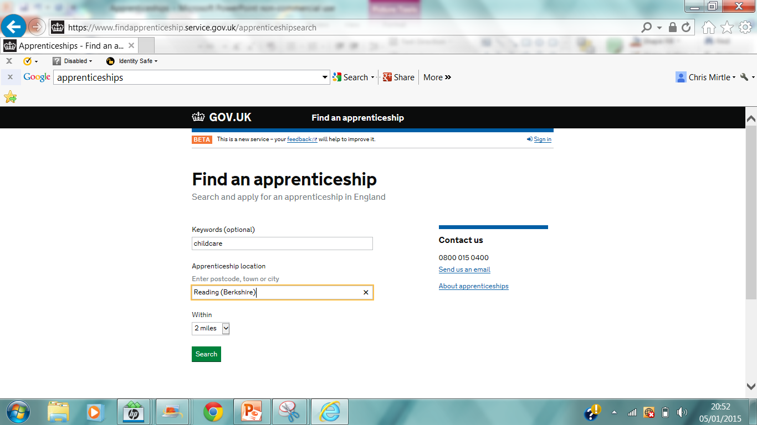

Slide 11
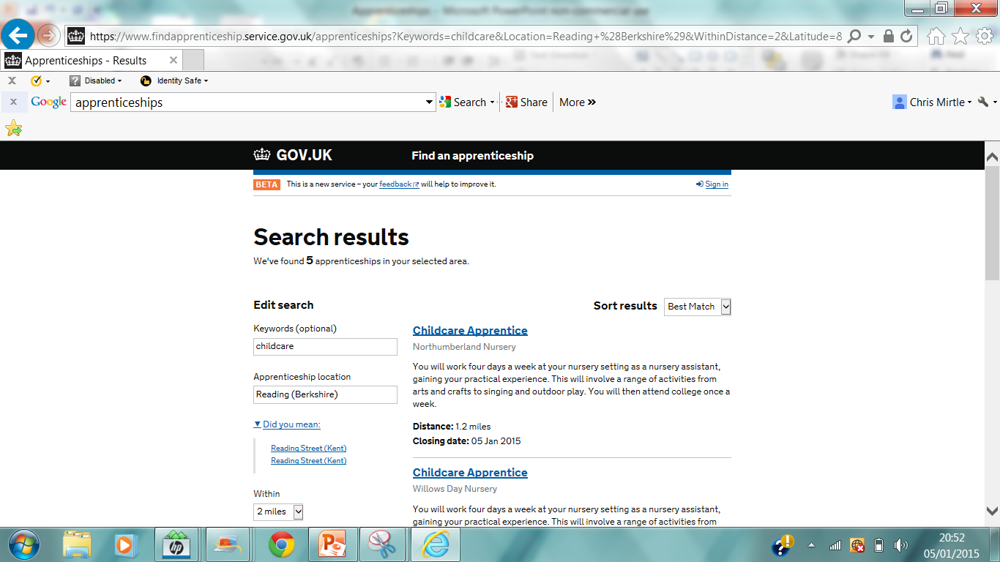

Slide 12
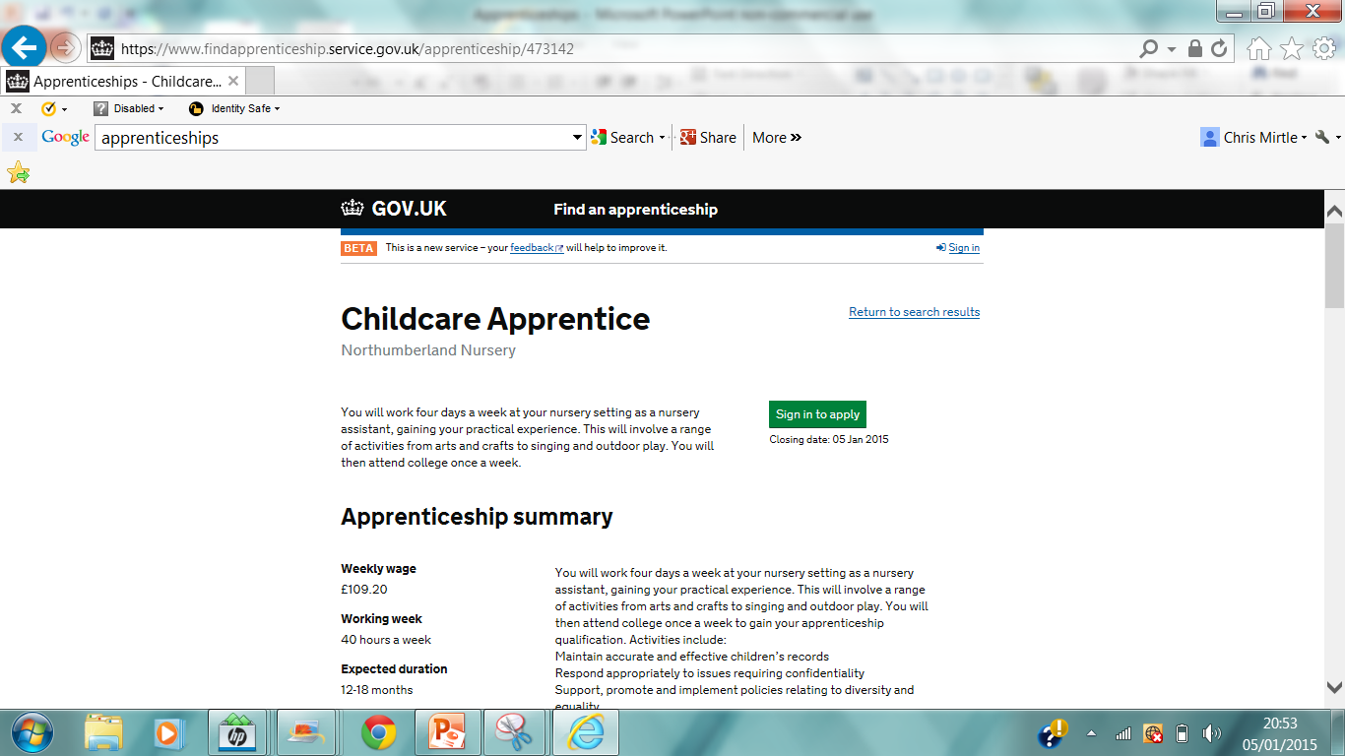

Slide 13
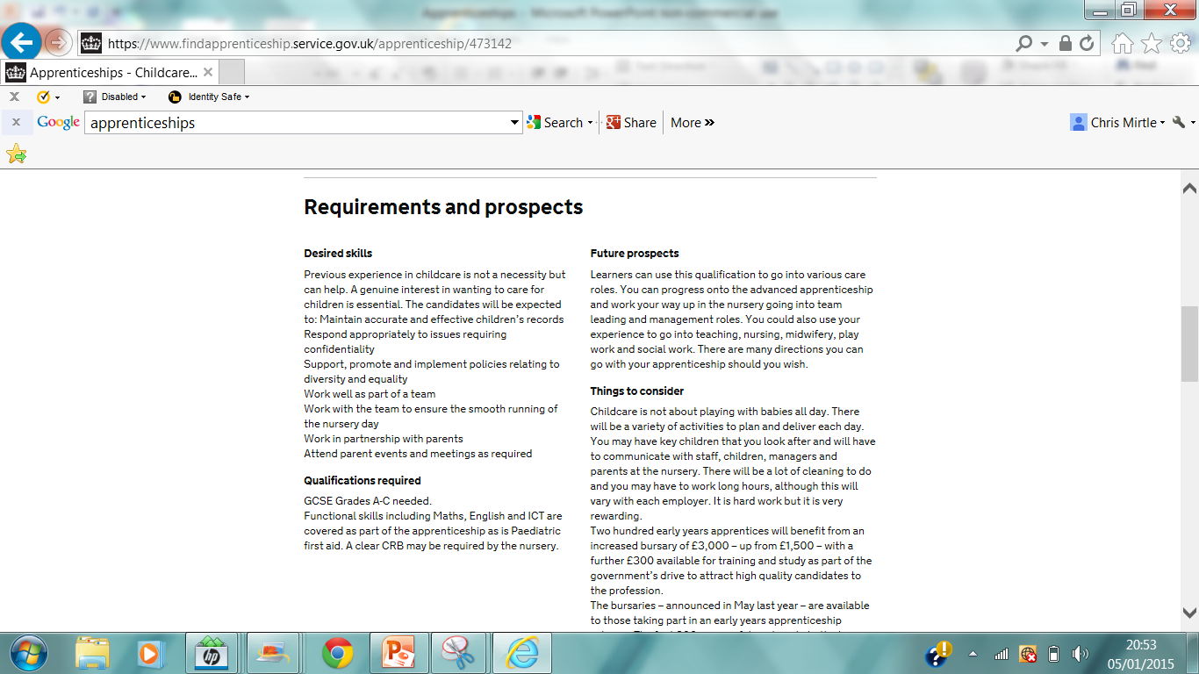

Slide 14
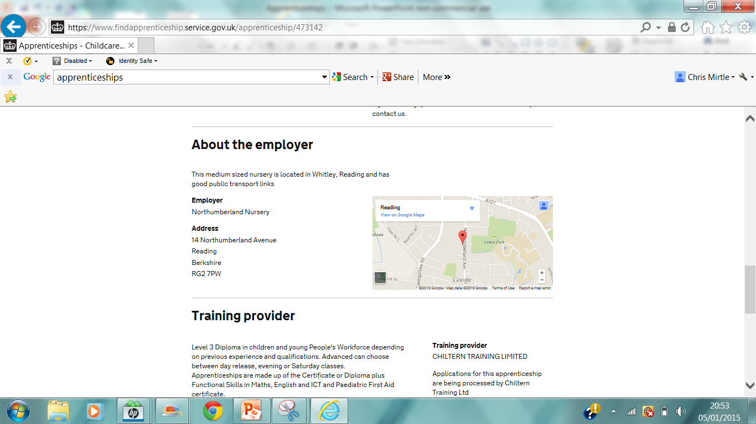

Slide 15
Apprenticeships
Level 4 Higher Java Software Developer IT Apprentice - 8047
Cgi It Uk Ltd
Return to search resultsPrint this page
Do you have a passion for IT and technology? CGI are looking for individuals who want to develop a career within the IT Industry. Apply now!
Sign in to apply Closing date: 31 May 2017
Apprenticeship summary
Weekly wage
£271.13
Working week
37.5hrs p/w Monday-Friday
Apprenticeship duration
18-24 months
Possible start date
05 Jun 2017
Date posted
30 Jun 2016
Distance
3.3 miles
Apprenticeship level
Higher Level Apprenticeship
Reference number
VAC000867502
Positions
8 available
In this role…
We are looking for smart, motivated and creative individuals who want to pursue a career in software development and can demonstrate strong problem solving skills.
We offer a range of roles across the industry including coding, development, testing, consulting and project management.
The opportunity we are offering involves learning how to apply problem solving skills to real world situations; picking up new technical skills such as programming; learning about software testing and other industry practices; seeing how software is designed and developed in modern project environments.

Slide 16
Apprenticeships
Business Management Apprentice
Nielsen
Return to search resultsPrint this page
This is an exciting opportunity for you to be a part of Nielsen the world’s largest Market Research Company and experience a comprehensive Degree Apprentice Programme which exposes you to all areas of Nielsen’s business through rotations.
This apprenticeship requires you to apply through the employer's website.
Apply now Closing date: 10 Mar 2017
Apprenticeship summary
Annual wage
£10,500.00
Working week
Monday - Friday 9am-5pm
Total hours per week: 35.00
Apprenticeship duration
3 years
Possible start date
04 Sep 2017
Date posted
09 Feb 2017
Distance
21.9 miles
Apprenticeship level
Degree Level Apprenticeship
Reference number
VAC001168854
Positions
9 available
Nielsen values the client experience and the employee experience above all else, which is why our Apprentice Programme has been carefully designed to show you the best of Nielsen, and bring out the best in you.
After a tailored on-boarding programme to quickly settle you in to the Nielsen team, you will spend each quarter developing your skills and understanding in different areas of the business through rotations.
Staff Benefits
Getting a debt free degree with 3 years work experience
25 days holiday (rising to 28 with service) + Bank holidays! If this isn’t enough we also offer a holiday purchase scheme!

Slide 17
Traineeships
… are like pre-apprenticeships, to get you ready for an apprenticeship
They involve work preparation:
Work placements
CV writing
Interview skills
English and Maths
Job searching

Slide 18
Apprenticeships
To find out more, talk to Miss Wooller, the Careers Co-ordinator at Little Heath, or Mr Tattersdill from Adviza.
Thank you!

