Slide 1
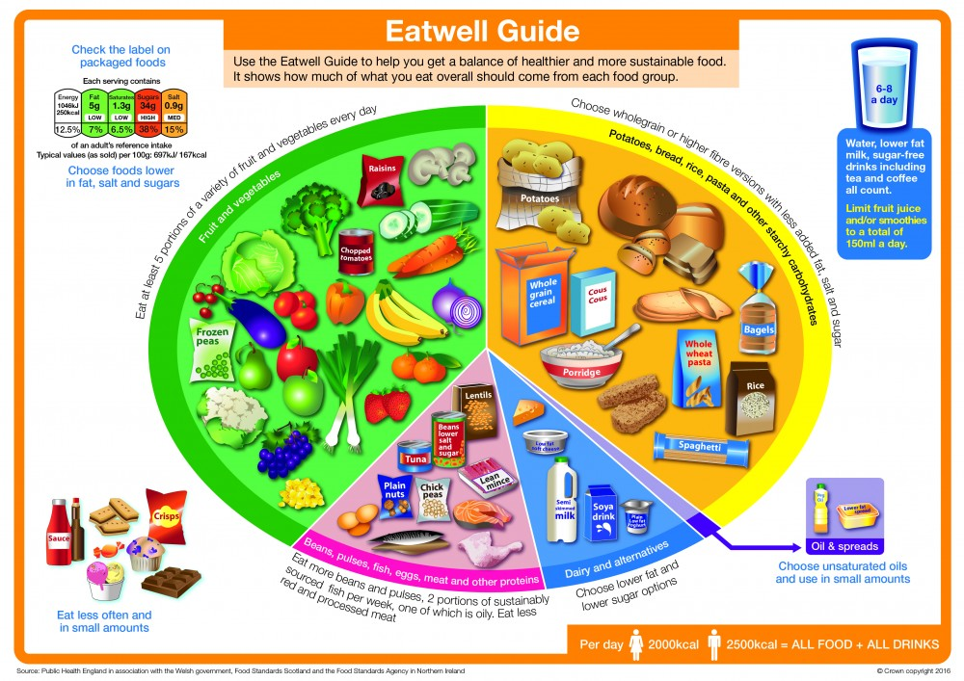

Due By: Monday 8th September
Research The Eatwell guide and answer the following questions
What are the sections?
Why is it used?
Who can benefit from the guidance?
How useful is it in terms of diet choices?
Year 12 The Eatwell Guide transition task

Slide 2
Due By: Monday 8th September
Level 3 Food Science Transistion Homework
Design a pasta in a jar. You need to use the correct proportions of each section of the Eatwell guide.
Photograph your scales to show you accurately measured the correct ingredient proportions
Make the pasta dish at home and place in a pot. Photograph the product. Send to your teacher or print it out
Make sure you hand in the recipe of what you did and include the exact ingredient list. Explain why you chose each ingredient
Log in to the nutrition program
https://www.nutritionprogram.co.uk/login
username: littleheath1 password: food
6. Put in the ingredients you have used into the program and print out a nutrition label. Come and speak to or email smcarthy@littleheath.org.uk if you have any issues with using this program
List the Ingredients you will be using for the Pasta in a jar practical. The quantities below represent the percentages from the Eatwell Guide.
95g Pasta Think about which shapes/type you will use
100g Vegetables Think about the range of shapes/colours you could use
20g Dairy This could be cheese/cream etc…
What would go well with the pasta?
30g Protein This could be vegetarians sources of protein or any range of cooked meats e.g. ham, bacon or chicken
Approx. 2.5 table spoons Fats and oils
Only a small amount is needed but can be any type of oil, vinegar, salad dressing or vinaigrette
Year 12 The Eatwell Guide transition task

Slide 3
Practical skills Glossary
You will be covering the following 34 skills throughout Year 12. For each of the terms below research and explain what they mean and include an example of a dish that would show each skill
 | 6.2 Advanced techniques Preparation skills |  | 6.4 Advanced techniques in cooking skills |  | 6.5 presentation skills
1 | Turning | 13 | boiling | 26 | Piping
2 | Shaping | 14 | Poaching | 27 | Carving
3 | Carving | 15 | Stewing | 28 | Shaping
4 | Larding | 16 | Braising | 29 | Moulding
5 | Boning meat | 17 | Steaming | 30 | Glazing
6 | Tenderising | 18 | Baking | 31 | Rolling
7 | Blending | 19 | Roasting | 32 | Cutting
8 | Mincing | 20 | Tandoori cooking | 33 | Sugar work
9 | Enriching | 21 | grilling | 34 | Couverture
10 | Separating | 22 | Frying
11 | Fish filleting | 23 | Paper bag
12 | Moulding | 24 | Microwave
 |  | 25 | Pot roasting

Slide 4
6.2 Advanced techniques Preparation skills | What it means | Practical dish example
1
2
3
4
5
6
7
8
9
10
11
12

Slide 5
6.4 Advanced techniques in cooking skills | What it means | Practical dish example
13
14
15
16
17
18
19
20
21
22
23
24
25

Slide 6
6.5 presentation skills | What it means | Practical dish example
26
27
28
29
30
31
32
33
34

