Slide 1
PE Taster Lesson What we will do today
Label Muscles
Label the Heart
Route of Blood
Short term memory games
Socio-cultural quick fire quiz
Course Outline
Questions

Slide 2
1. Label your muscles
Pectoralis Major
Deltoids
Triceps Brachii
Biceps Brachii
Wrist Flexor
Wrist Extensor
Rectus Abdominus
Quadriceps
Hamstrings
Gastrocnemius
Hip Adductors
Tibialis Anterior
Latissimus Dorsi
External Obliques

Slide 3
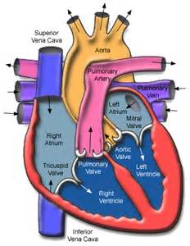
2. Label the Heart

Slide 4
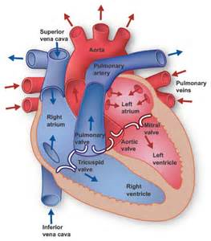
Route of Blood Around the Body
Find the correct order in
Which blood moves around
the heart.
This might help you

Slide 5
3. Route of Blood
Vena Cava
Right Atrium Body
Tricuspid Valve Aorta
Right Ventricle Semi-lunar Valve
Semi-lunar Valve Left Ventricle
Pulmonary Artery Bicuspid Valve
Lungs Left Atrium
Pulmonary Vein

Slide 6
Short Term Memory Store
Often referred to as the workplace
Information is compared to that previously learned and stored in the long term memory
E.g. when learning to pass in basketball, the individual deems it is important to extend the elbows from the demonstration and remembers to do this
If it helps, the individual will then store this in the long term memory for future use

Slide 7
Short Term Memory Game 1 – Kims game
Look at the objects on the tray for 30 seconds
How many can you remember?
Notes:
Kims game – 1st 5 items. 2nd 9 itmes, 3rd 15 items.

Slide 8
Short Term Memory Game 2
You will be shown 2 numbers, you task is to see if you can remember them.
Look at the number below for 30 seconds
Can you now remember it.
5946238106
01189 427337
Notes:
Chunking.

Slide 9
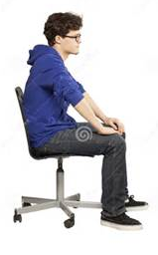
Feedback Game 3
A volunteer needs to throw some paper into the bin. They will throw backwards and not be able to see the bin. They will do this 3 times, all differently.
They will then received 3 types of Feedback on attempting to throw the paper into the bin 3 times:
No feedback
Knowledge of results – scored or not
Knowledge of performance – eg. “throw to the left a bit”

Slide 10
Socio-cultural – Quick Fire Quiz
What is the following a definition for – “an organised, competitive and skilful physical activity requiring commitment and fair play”
Physical Education
Sport
Outdoor Education
Physical Recreation
B

Slide 11
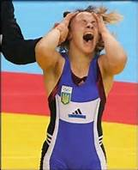
C
2. What type of benefit for physical activity is a reduction in stress?
Physical
Social
Mental
Injury Prevention

Slide 12
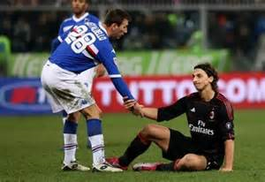
3. Which of the following do you think would show good sportsmanship?
A) Observing both written and unwritten rules B) Trying hard C) Using unconventional but not illegal tactics to gain an unfair advantage D) Sledging or time wasting
A

Slide 13
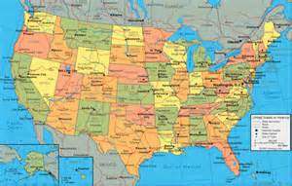
B
4. What do you think the population and size of America is?
61 million and 250,000 sq km
300 million and 9.3 million sq km
21 million and 7.8 million sq km
200 million and 1 million sq km

Slide 14
D
5. Where would you place someone on the performance pyramid who played hockey for the South East of England?
Foundation
Performance
Participation
Excellence

Slide 15
A’ Level PE Course – 2 year course
Content overview | Assessment overview
Applied anatomy and physiology Exercise physiology Biomechanics | Physiological factors affecting performance (01) 90 marks 2 hour written paper | 30% of total A’ Level
Skill Acquisition Sport Psychology | Psychological factors affecting performance (02) 60 marks 1 hour written paper | 20% of total A’ Level
Sport and Society Contemporary Issues in Physical activity and sport | Socio-cultural issues in physical activity and sport (03) 60 marks 1 hour written paper | 20% Of total A’ Level
Performance/Coaching Evaluation and Analysis of performance for improvement (EAPI) | Performance in physical education (04) 60 marks Non-exam assessment (NEA) | 30% of total A’ Level

Slide 16
ANY QUESTIONS?

