Slide 1
Philosophy deals with the big questions in life.
Philosophy deals with the big questions in life and examines the rich treasure trove of answers to questions such as:
What can we know?
Does God exist?
How do we decide what is right?
Is your mind your brain, or something different?
Philosophy A level will appeal to you if you enjoy thinking deeply, reading critically and expressing your ideas clearly in essays and discussion.

Slide 2
Why study Philosophy?
Philosophy is subject with a clear method. It trains you to think carefully and critically, and then to write (and speak) clearly. These skills can be applied to every area of study and in every profession: studying philosophy is the ideal preparation for work and life!

Slide 3
What is Philosophy?
This is a philosophical question itself!
To ask questions with the curiosity of a child, but with the rigour of logical thought.
Nothing is free from the enquiry of the philosopher, who seeks to answer the really difficult questions in life.

Slide 4


Slide 5
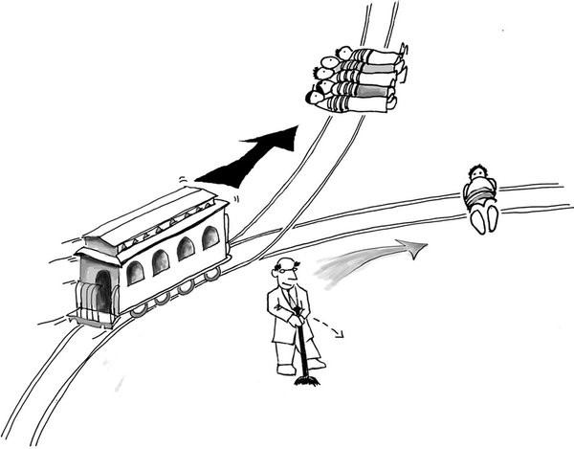
The trolley problem

Slide 6

Would you go into a virtual reality machine that gave you everything you could ever want?

Slide 7
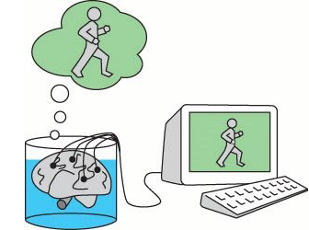
Can you be sure you’re not a brain in a jar?

Slide 8

Are you a brain or a soul or both?

Slide 9

Does God exist?

Slide 10
Where might it take you?
Studying philosophy at A Level will help you to develop transferable key skills that are vital for success in a wide range of courses and careers, including critical and independent thought, reasoned argument and debate, open-mindedness and persistent thinking.
In a famous study in America for students applying for post-graduate degrees, philosophy degree students had the best verbal and writing skills on average than any other degree course. They even did better on mathematical skills than all but the mathematically focused degrees such as maths and physics. In short, doing philosophy develops lots of important skills.
People studying philosophy are well prepared for jobs that require people to think clearly and rigorously, such as management consultancy, accountancy, law, politics, the civil service, journalism, advertising and education.
Philosophy is highly respected as a subject due to its depth, complexity and level of intellectual challenge.

