Slide 1
Welcome to A Level Film Studies!

Slide 2
Lesson outcomes
Gain an overall understanding of what you will learn during year 12.
Introduction to the ‘Key Elements of Film Form’
Use your understanding of the key elements to explain and analyse how they create meaning for the audience

Slide 3
A Level Film Studies: An overview of next year
 | Mr Alford | Miss Goodhew
Term 1 Sept- Oct | Introduction to the Key Elements of Film Form Analyse film sequences
Term 2 Oct-Dec | Component 1- Section A Hollywood 1930-1990 (comparative study) Vertigo and Bladerunner | Component 1- Section B American Film since 2005 Inception and Captain Fantastic
Term 3 Jan- Feb
Term 4 Feb- April | Component 2- Documentary film Amy | Component 1- Section C British Film Shaun of the Dead
Term 5 April- May |  | Component 1- Section C British Film Sightseers
Term 6 May- July | Component 3: Production Make a short film/ Screenplay

Slide 4
The Key Elements of Film Form
Cinematography
- Camera angles/ movements/ lighting
Mise-en-scene
- Setting/ Props/ Costume and make up/
Editing
-How the film is put together/ cuts/takes/pace
Sound
-Vocal sounds/ environmental sounds/ music/ silence
Performance
-Use of non verbal communication/body language/ facial expression

Slide 5
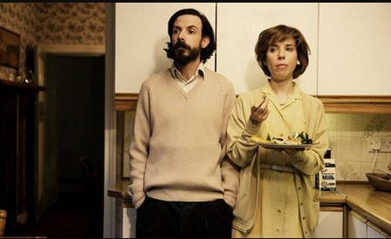
How do cinematography, mise-en-scene and performance communicate meaning?
Submarine (Ayoade, UK, 2010)

Slide 6
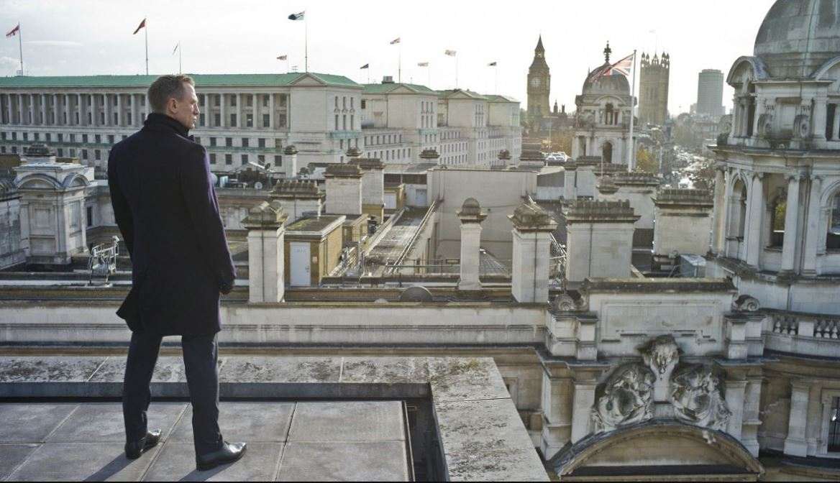
How do cinematography, mise-en-scene and performance communicate meaning?
Skyfall, Mendes (2012)

Slide 7
Lovefield (short film):
Directed by Mathieu Ratthe (2008)
How do the key elements of film form evoke meaning and generate audience response?
First screening: Sound.
What types of sound can you hear? Are any louder then others? Which ones? Why?
What genre do you think this film is? Why?
Second screening: Mise-en-scene, Cinematography, lighting, editing
Now watch it with no sound. How does the camera work offer clues/ suggest what might be happening?
Third screening:
Watch with both visuals and sound. Stop at 4 mins
What do you think happens at the end?

Slide 8
Summer transition work
We will be studying a selection of short films over the duration of the two year A Level course. All the films can be found on our blog.
http://heathenmedia.co.uk/filmc3production/
Over the summer can you choose and watch 3 of the films and complete the analysis grids.
In September I will ask you to feedback your ideas for ONE of the films you chose.
Any questions….?

