Slide 1
Welcome to A Level Media Studies!
Lesson outcomes
Gain an overview of what you will study in Year 12
Be introduced to the theoretical framework: media language
Know the basic camera shots and angles and begin to analyse them in both still and moving image
Summer transition work

Slide 2
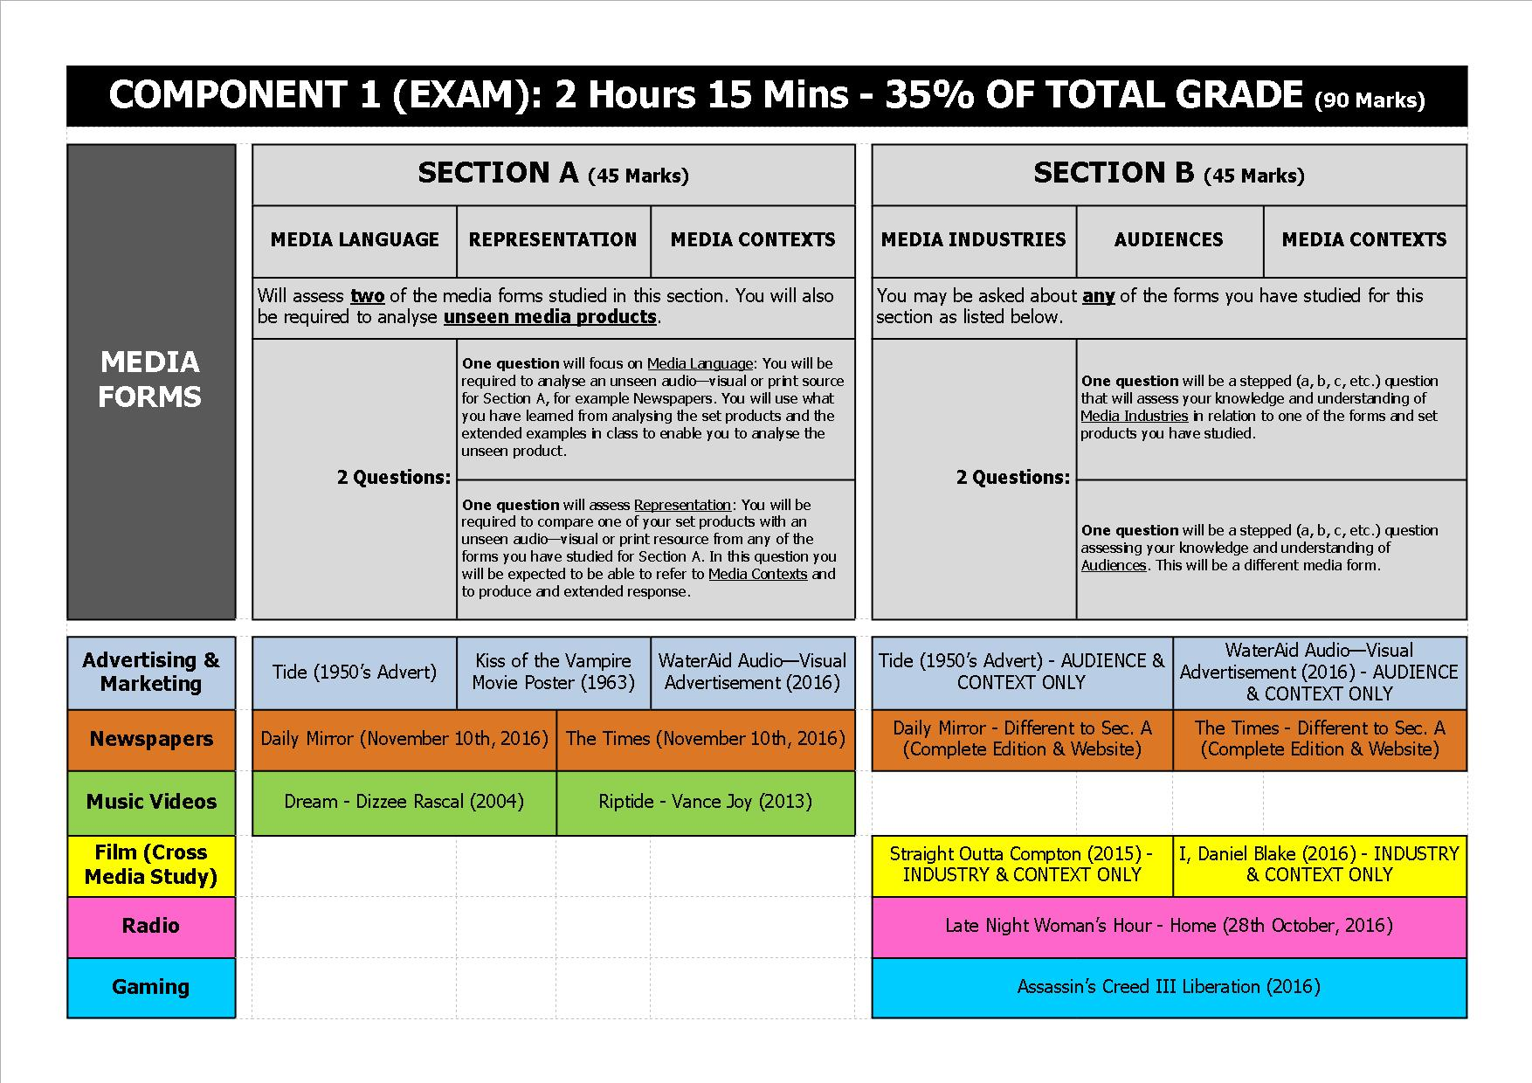
A Level Media Studies in Year 12

Slide 3
The theoretical framework
This lesson you will learn about media language
Media language
Media representations
Media audiences
Media industries

Slide 4
Theoretical Framework – media language
How the media communicates meaning through their forms, codes and conventions, and techniques
Creators of media products encode messages and meanings within their products through media language, the audience then decode these messages and respond to them in different ways.
You must study the following aspects of media language and be able to apply your understanding to the forms set for each exam component.

Slide 5
Technical Codes
You must confidently be able to discuss the TECHNICAL CODES in a range of products.
You must discuss and analyse the purpose and effect of the particular technique employed by the text.

Slide 6
Technical Codes in Moving Image Products
Camera angle/ shot/ movement and composition
Editing
Mise-en-scene
Sound
This lesson we will focus on camera shots and angles

Slide 7
An introduction to camera shots and angles
Task 1: The following slides include the main camera shots and angles. Fill in the ‘Why use it?’ section on the handout.

Slide 8
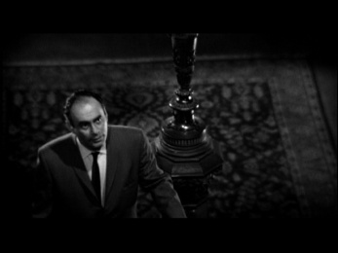
High Angle

Slide 9
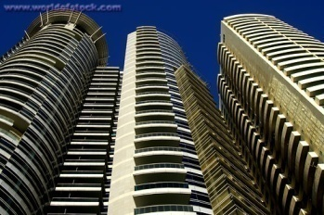
LowAngle

Slide 10
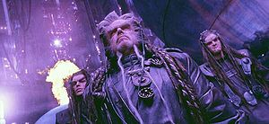
Canted Angle

Slide 11
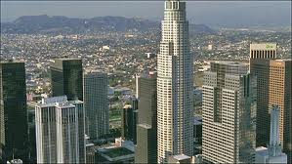
Establishing Shot

Slide 12
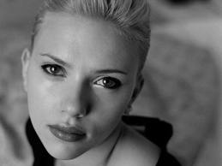
Close Up

Slide 13
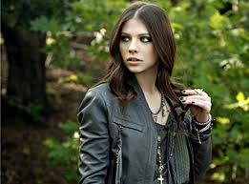
Mid Shot

Slide 14
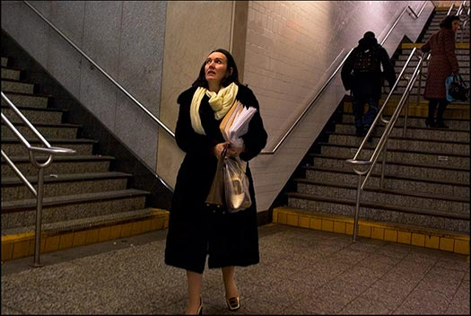
Long Shot

Slide 15
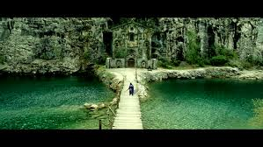
Extreme Long Shot / Wide Shot

Slide 16
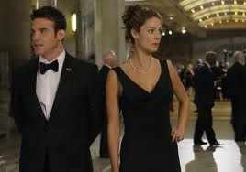
Two shot

Slide 17
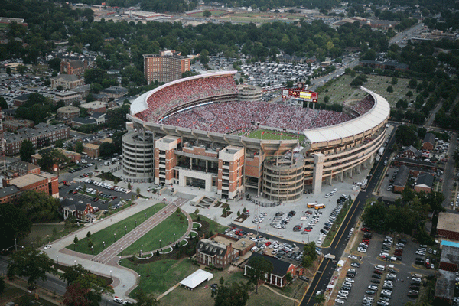
Aerial Shot

Slide 18
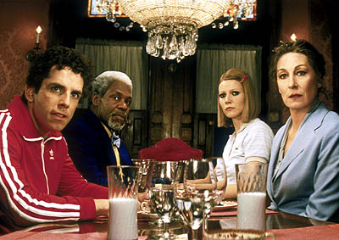
Point of View Shot

Slide 19
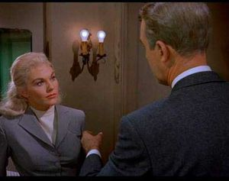
Over the Shoulder Shot

Slide 20
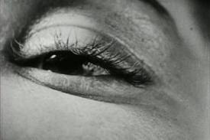
Extreme Close Up

Slide 21
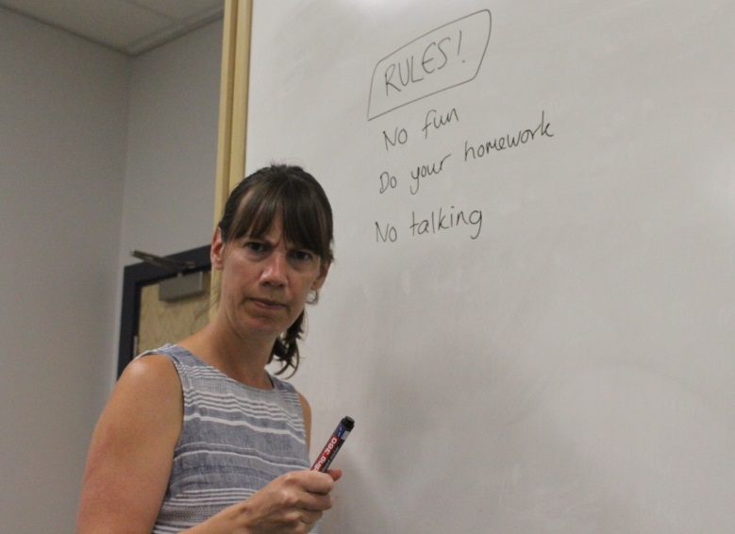
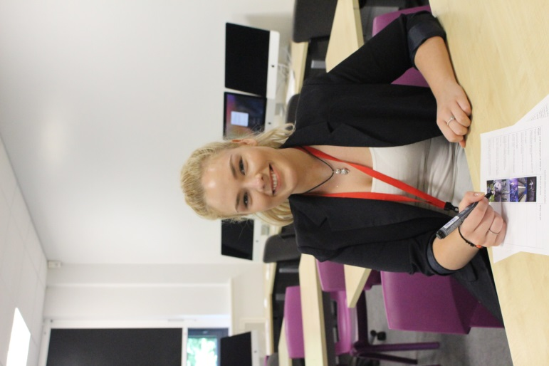
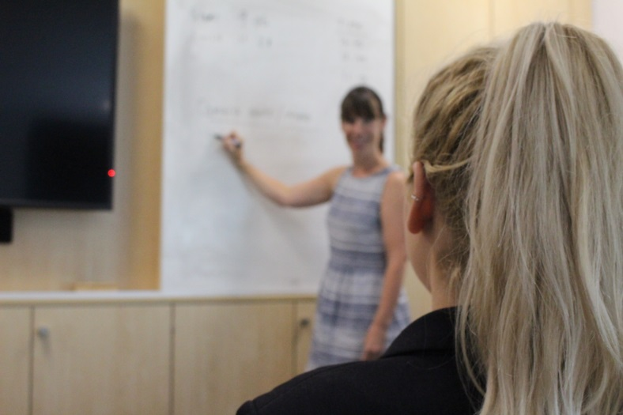
Task 2: Take your own shots
In pairs/ threes you will be given a camera. You have 10 minutes to construct and take 5 of the camera shots on the sheet.
Extension: Before you take the picture, think carefully about showing how meaning is created.
Be prepared to show some of your examples to the class.

Slide 22

Task 3: Analysing moving image:
Watch the following advert for Wateraid (2016)
-Select 3 examples of camera shots/ angles and analyse how meaning is constructed?
-Write each separate example on a post-it note.

Slide 23
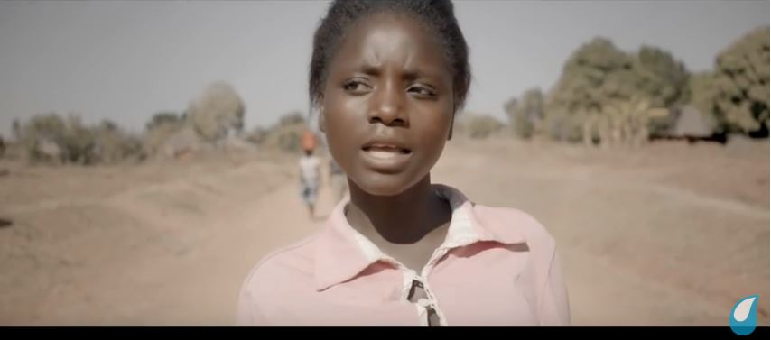
Feedback: Stick your post-its on the board.
How are camera shots/ angles used in the Wateraid advert to construct meaning?

Slide 24
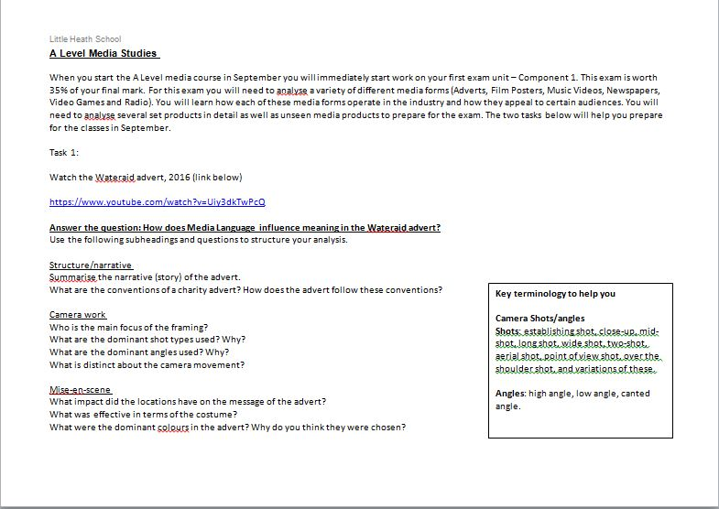
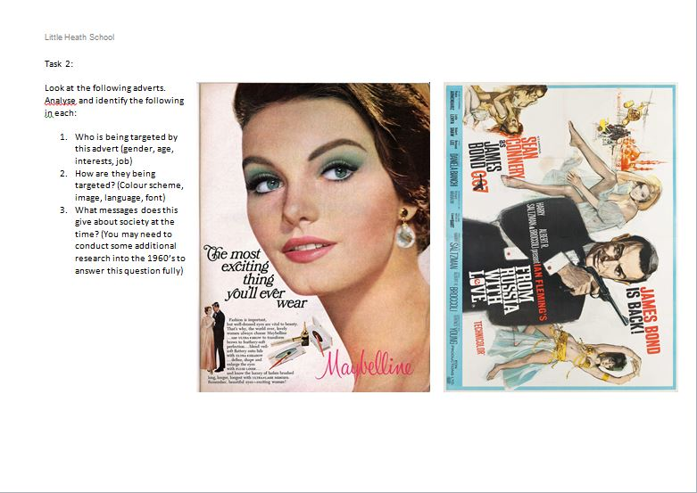
Media studies summer transition task (see handout)
To be handed in to sixth form reception in September!

