Slide 1
Assessment Overview
AS to A Level
Understanding the standard

Slide 2
What do the Assessment Objectives look like and what do they mean?

Slide 3
AO1 – Knowledge - AS
Demonstrate, organise and communicate knowledge and understanding to analyse and evaluate the key features related to the periods studied, making substantiated judgements and exploring concepts, as relevant, of cause, consequence, change, continuity, similarity, difference and significance.
Write well

Slide 4
AO1 – Knowledge – A Level
Demonstrate, organise and communicate knowledge and understanding to analyse and evaluate the key features related to the periods studied, making substantiated judgements and exploring concepts, as relevant, of cause, consequence, change, continuity, similarity, difference and significance.
Good historical skills

Slide 5
AO1 - knowledge
Demonstrate, organise and communicate knowledge and understanding to analyse and evaluate the key features related to the periods studied, making substantiated judgements and exploring concepts, as relevant, of cause, consequence, change, continuity, similarity, difference and significance.
Second order concepts

Slide 6
AO1 - Level 6 AS and A level
There is a mostly consistent focus on the question throughout the answer. Generally accurate and detailed knowledge and understanding is demonstrated throughout the most of the answer and is consistently evaluated and analysed in order to reach substantiated, developed and sustained judgements, but these are not consistently well-developed. There is a well-developed and sustained line of reasoning which is clear coherent and logically structured. The information presented is entirely relevant and in the most part substantiated.
Your ability to write with style and confidence is central to success.

Slide 7
AO2 – Source Evaluation
Analyse and evaluate appropriate source materials, primary and/or contemporary to the period, within its historical context.
Using evidence critically

Slide 8
AO2 Source Evaluation
Analyse and evaluate appropriate source materials, primary and/or contemporary to the period, within its historical context.
Context- this is the key. You do this in your Mid Tudors work

Slide 9
AO2 - Level 6 AS and A level
The answer has a very good focus on the question throughout. The sources are fully evaluated, using both provenance and detailed and accurate relevant knowledge of their historical context in a balanced way, in order to engage with the sources and reach a convincing, fully supported analysis of them in relation the issue in the question.
There may be some imbalance in the analysis between use of provenance and use of knowledge.

Slide 10
AO3 – Interpretation work
Analyse and evaluate, in relation to the historical context, different ways in which aspects of the past have been interpreted.
Good historical skills & knowledge are the key

Slide 11
AO3 –Interpretation work
Analyse and evaluate, in relation to the historical context, different ways in which aspects of the past have been interpreted.
Points of view

Slide 12
AO3 - Level 6 AS and A level
The answer has a very good analysis of the interpretation. It uses detailed and relevant knowledge of the historical context and shows thorough understanding of the wider historical debate, in the form of detailed examination of other interpretations, in order to produce a well-supported evaluation of both the strengths and weaknesses of the given interpretation.
The answer has a very good focus on the question throughout. It has thorough and sustained evaluation of the interpretations, using detailed and accurate knowledge of the historical context and the wider historical debate around the issue, in order to produce a convincing and supported analysis of them in relation to the question.

Slide 13
What does this look like in the big picture?

Slide 14
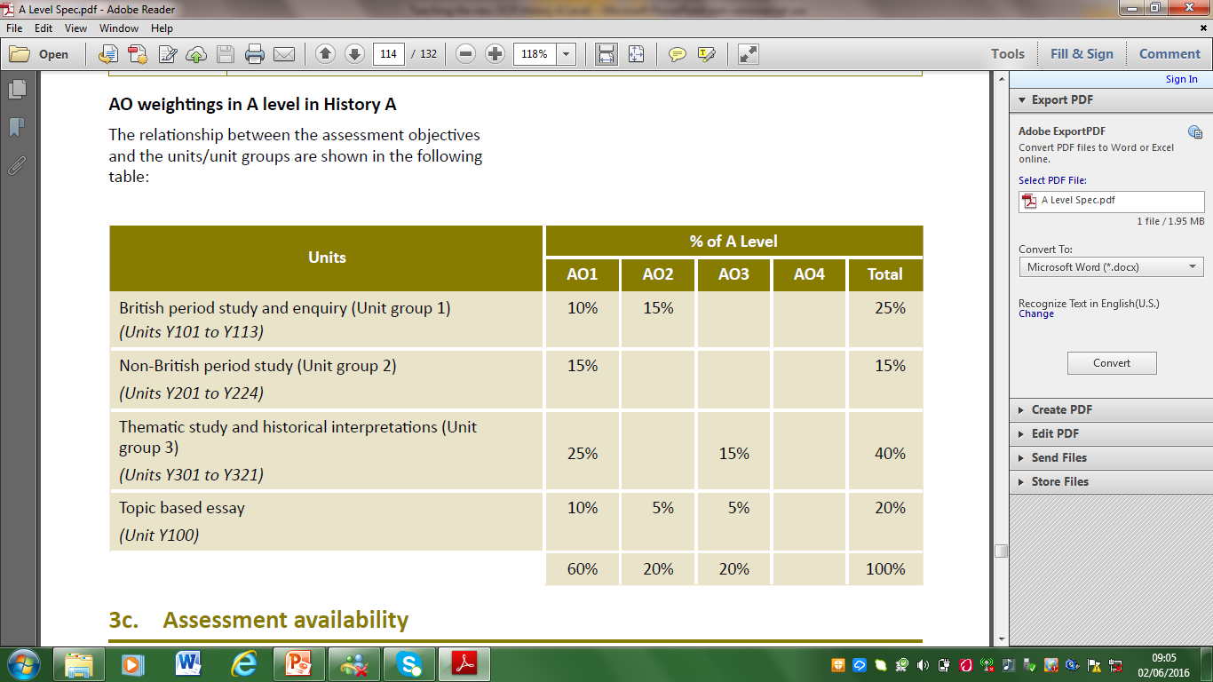
Differences between AO1 and AO3 at AS and A level – Unit 2
What has changed from AS to A2 ?

Slide 15
H505 LVS Ascot Unit break down
England 1547- 1603 The later Tudors Y107 Knowledge and Source Evaluation Your Y12 work – slight change to the examination from AS.
The USA in the C19 – Westward expansion Y216 Knowledge only Your Y12 work – now a straight essay paper.
Russia and its rulers 1855 – 1964 Y318 Knowledge and Interpretation work
Coursework Y100 All skills and independent research

Slide 16
Changes to the Tudor paper
AS Level
A Level
Two source-based questions:
10 marker assesses one source as evidence
20 marker uses three sources to assess how far they support a view
One typical knowledge and understanding question (20 marks)
One source-based question using four sources to assess how far they support a view (30 marks)
One typical knowledge and understanding question (20 marks)

Slide 17
Changes to the American paper
AS Level
A Level
One typical knowledge and understanding question (30 marks)
One interpretation-based question (20 marks)
Two typical knowledge and understanding questions:
One assessing the greater importance for something (10 marks)
One a typical knowledge and understanding question (20 marks)

Slide 18
The Five Rs of A Level Learning

