Slide 1
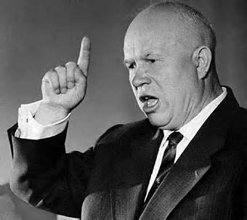
Depth Study 3: Nikita Khrushchev, in power, c1956-1964
Notes:
Question routes – 10 mins
Working on extracts – 5-10 mins
Feedback – 10 mins

Slide 2
Question routes
Potentially any aspect of the Khrushchev depth study content
Stand-alone topics
Cold War
Virgin Lands and other agricultural reforms
De-Stalinisation
Control of Eastern Europe and attitude to national minorities, including The Hungarian Uprising of 1956 (NB not China’s reaction to it as in the Holland Access textbook)

Slide 3
Question routes
Potentially any aspect of the Khrushchev depth study content
Overview topics – seem more likely
Why did he introduce his reforms? Unlikely
How far did his reforms go?
How successful were his reforms? Likely
Why was he removed from power? Likely

Slide 4
Overview questions – aspects of debate to look out for in question passages
How far did his reforms go?
De-Stalinisation as a radical restructuring: - power in Party, not individual - reduction of repression
The Thaw as uncertain, with re-freezes eg Novocherkassk
Reforming the system without getting rid of the system – eg agriculture, industry plans
Pressures on him both to reform further and not to reform at all

Slide 5
Overview questions – aspects of debate to look out for in question passages
Why was he removed from power?
Increasingly failing policies – esp. Virgin Lands, Cuban Missile Crisis
Personal flaws – hare-brained schemes, unfitting behaviour
Acting autocratically in spite of criticism of Stalin’s cult of personality
Made enemies through attempts to reform bureaucracy but didn’t eliminate them
Inevitable? Difficulty of reforming a system from within where the powerful groups in society only gained from continuing the current system – McCauley and Filtzer.

Slide 6
How successful were Khrushchev’s reforms?
Read the two passages which give different interpretations assessing Khrushchev’s reforms.
Identify key phrases in the passages which show the main elements of the historians’ views.
Use your own specific knowledge of Khrushchev’s policies to support and challenge these views. See how you get on by yourselves with this, then use the cards if you need ideas.
Draw out any areas of agreement and direct disagreement.
Show awareness of the wider debate.

Slide 7
Overview questions – aspects of debate to look out for in question passages
Why did he introduce his reforms?
USSR needed to return to Lenin-style communism after Stalin’s totalitarianism: ideological
USSR needed to reform to tackle long-term problems caused by Stalin’s system: ideological
Attempt to form better relationship with West by peaceful coexistence and aspiring to Western quality of life: ideological
Pragmatic use of reform to take initiative in the power struggle after Stalin’s death

