Slide 1
Theme 2: The impact of dictatorial regimes on the economy and society

Slide 2
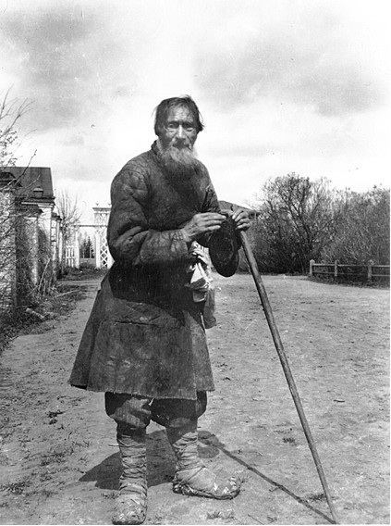
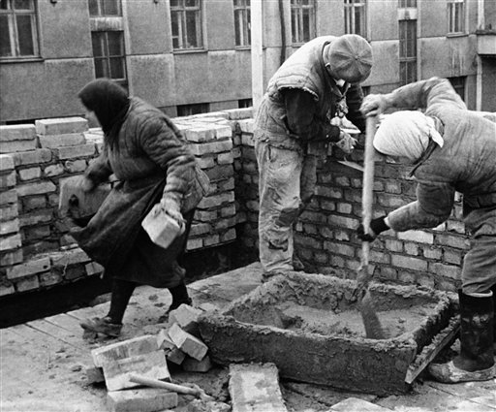
Key words in the question?
To what extent is it correct to suggest that the treatment of the Russian working classes was uniformly bleak in the years 1855 – 1964 ?
Peasants and urban workers

Slide 3
To what extent is it correct to suggest that the treatment of the Russian working classes was uniformly bleak in the years 1855 – 1964 ?
Peasants and urban workers
5 minutes to blitz plan a basic outline with a partner: - basic structure - main issues to include - key comparisons

Slide 4
Structure
As ever, more than one possible way
Could consider thematic issues affecting all:
eg food supply/working hours and conditions/housing
Types of people: eg peasants/urban workers/young-old/men-women/minorities
Peasants uniformly bleak/peasant improvements/urban worker uniformly bleak/urban worker improvements should work well as long as IT’S BEING DIRECTLY COMPARATIVE

Slide 5
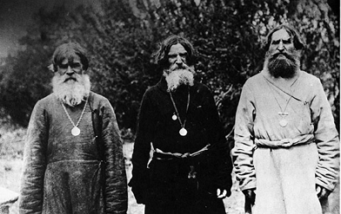
Peasants bleak – working and living
We’re always exploited to raise the funds for industrialisation.
1861 Emancipation limitations
Famines 1891, 1921 and 1932
War Communism c.1920
Collectivisation ‘second serfdom’ in 1930s
1953 agricultural workers paid 1/6 wage of urban worker
Virgin Lands movement
Grain requisitioned by force
Worst because…
Least worst because…

Slide 6
Peasants bleak – political and repression
We’re always exploited to raise the funds for industrialisation.
Land Captains 1880s
Stolypin’s necktie 1905-6
Collectivisation and de-kulakisation 1930s
No real political rights throughout
Worst because…

Slide 7
Peasants bleak - other
We’re always exploited to raise the funds for industrialisation.
Tool to help industrialisation
Suffering in WWI and WWII

Slide 8
Peasants not bleak – working and living
This is a golden age for facial hair.
1880s Peasant Land Bank
1906 Stolypin reforms
1920s NEP
1950s and 60s Khrushchev reforms
Encouraged entrepreneurialism
Best because…

Slide 9
Peasants not bleak – political and repression
This is a golden age for facial hair.
1861 Emancipation human rights
Some voting rights to 1st and 2nd Duma
Freedoms under Prov Govt – seizing land

Slide 10
Peasants not bleak – other
This is a golden age for facial hair.
Education improved
Attempts to provide technology – electrification, MTS
Younger peasants often took opportunities eg Stolypin, Virgin Lands

Slide 11
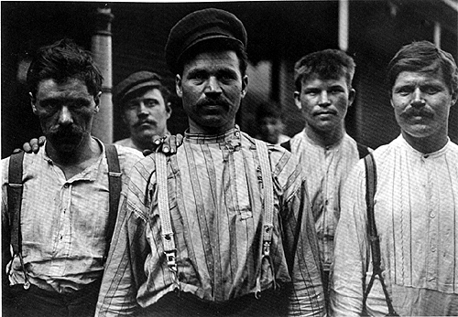
Urban workers bleak – living and working
Long hours – six days per week the norm throughout though hours did drop except under Stalin
Low pay
Appalling conditions – output always the main concern
Stalin’s new work discipline punished absenteeism etc
Could be moved to where required under Stalin
Housing always poor and often appalling – Witte and Stalin
Worst because…

Slide 12
Urban workers bleak – political and repression
Excluded from meaningful voting
Striking often subject to repression – Lena Goldfields massacre 1912, Stalin

Slide 13
Urban workers not bleak – living and working
Hours generally got shorter – 11 hours to 7 hours, Khrushchev move towards 5-day week
Factory inspectorates and child labour banned, 1880s
Insurance system introduced 1903, then expanded
Housing improved under Khrushchev
Workers’ education and healthcare prioritised under Communists
Best because…

Slide 14
Urban workers not bleak – political and repression
Unions gradually accepted more after 1900
Had some influence – esp in 1917 but generally under the Communists eg introduction of NEP, after Novocherkassk
Genuine enthusiasm from some, esp shock brigades under Stalin

Slide 15
Urban workers not bleak – other
It depended who you were – piece rates under Stalin, women paid less than men throughout

Slide 16
Add the synthesis
3 minutes to discuss with a partner and add some comparative judgements and conclusions to the plan in your booklet
Example:
Peasants and living and working conditions High point: NEP – payment incentive for all Low point: collectivisation and famine of 1932 – deliberately made worse by government Overall judgement: degrees of bleakness for most, but real opportunities at times for the most enterprising, eg Stolypin reforms

Slide 17
Tips from the examiners
From the examiner report on a similar question in 2010:
This was the most popular question. The vast majority of candidates avoided the mistake of writing only about the peasants but a large number over-compensated by ignoring them completely. There was general ignorance about the working class in the Tsarist period except that they were exploited. Life under the communists was better handled although the more positive aspects of Stalin’s rule, such as educational, health and social improvements, were rarely mentioned.
Show diversity of experience – young/old; men/women; regional

Slide 18
Your plan
Self assess your plan or swap it with a partner. Does it:
Include frequent direct comparison?
Include both peasants and urban workers?
Cover the full 100+ years across the full answer?
Directly answer the question, and hopefully show a line of argument running through the answer?
Include a firm basis of secure factual knowledge?
Show diversity of experience, not just treating all peasants and all workers as one?
Notes:
If time

