Slide 1
Assess the short-term significance of the Kansas-Nebraska Act?

Slide 2
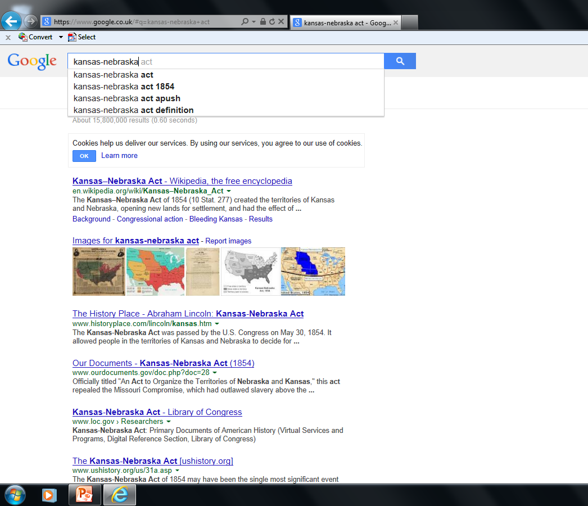

Slide 3
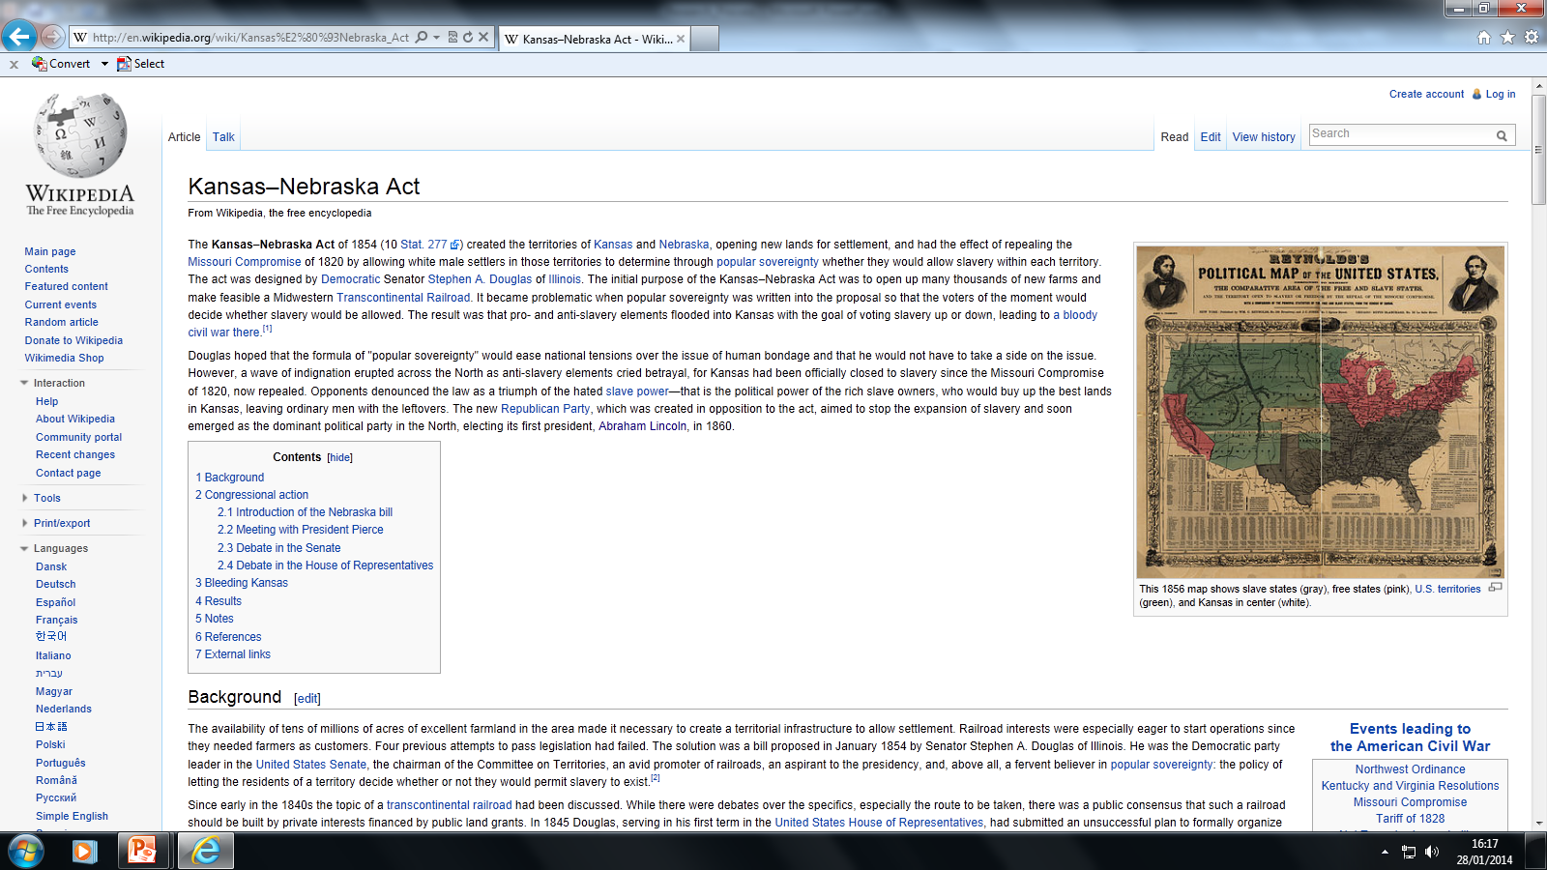

Slide 4
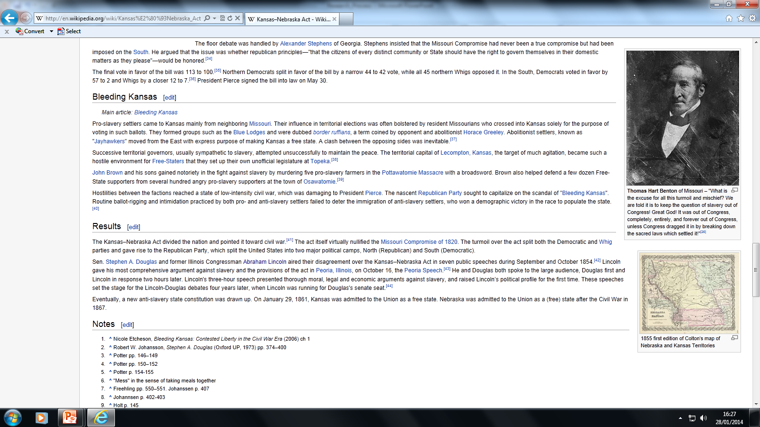

Slide 6
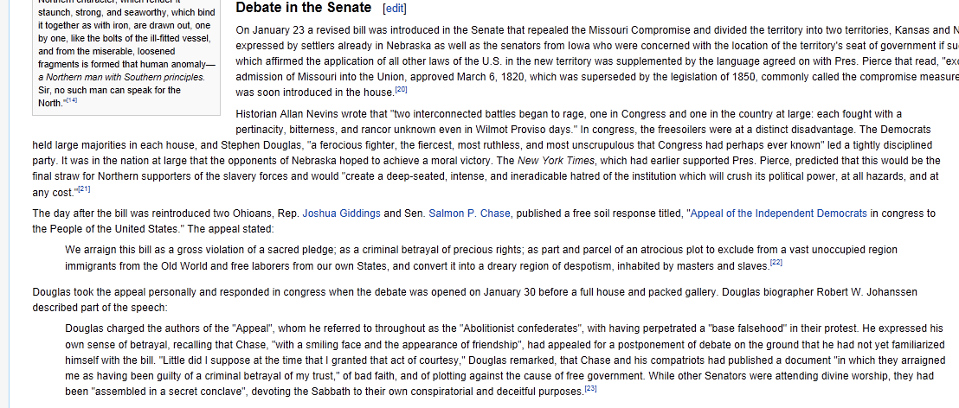

Slide 7
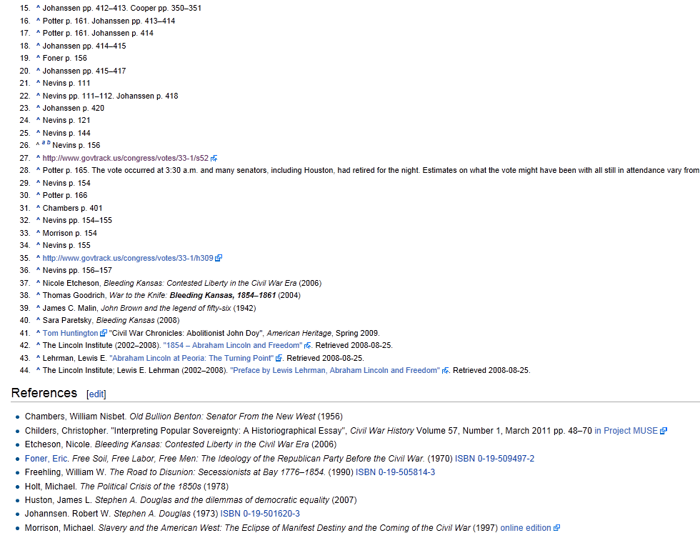

Slide 8
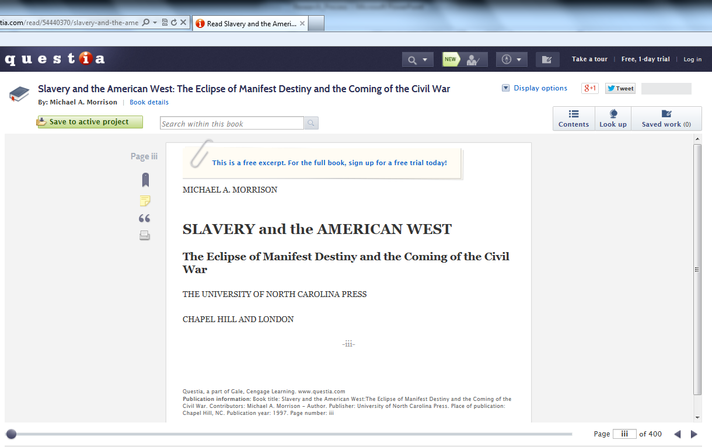
Page 154

Slide 10
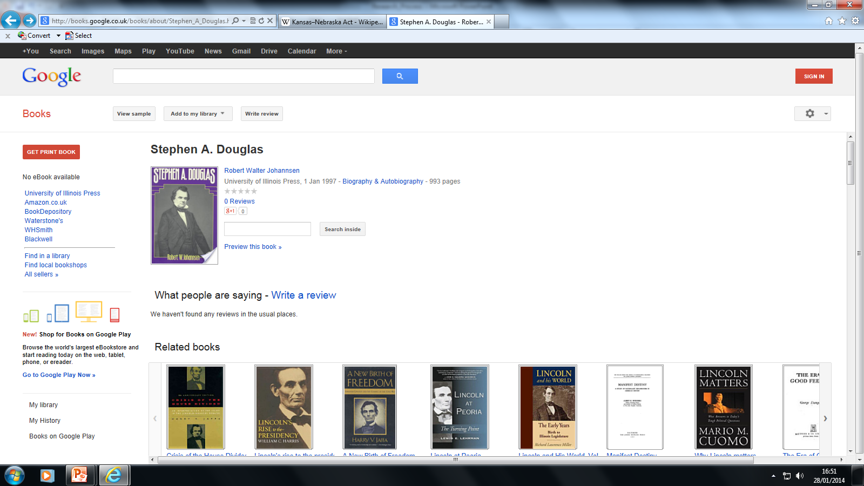

Slide 11
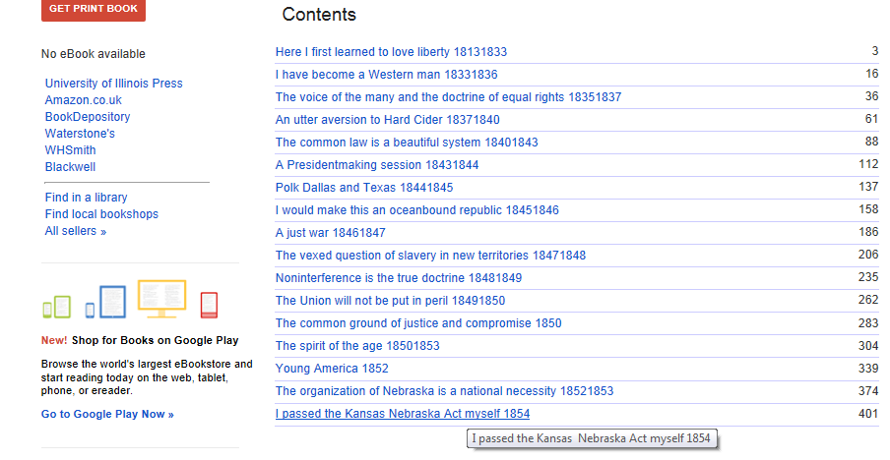

Slide 12
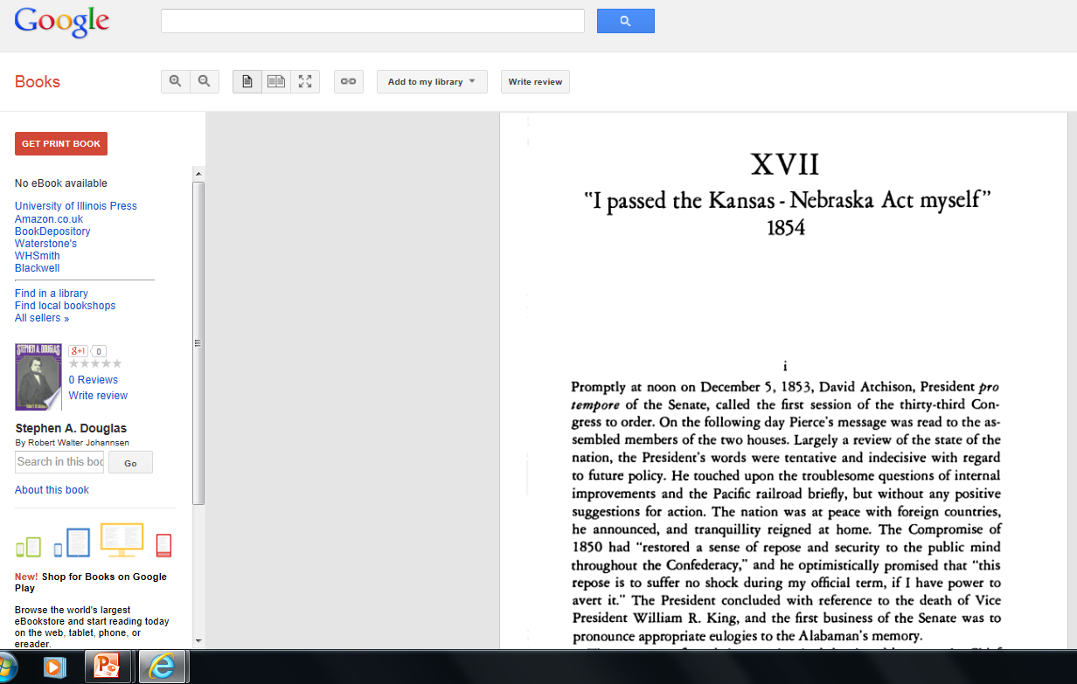

Slide 14
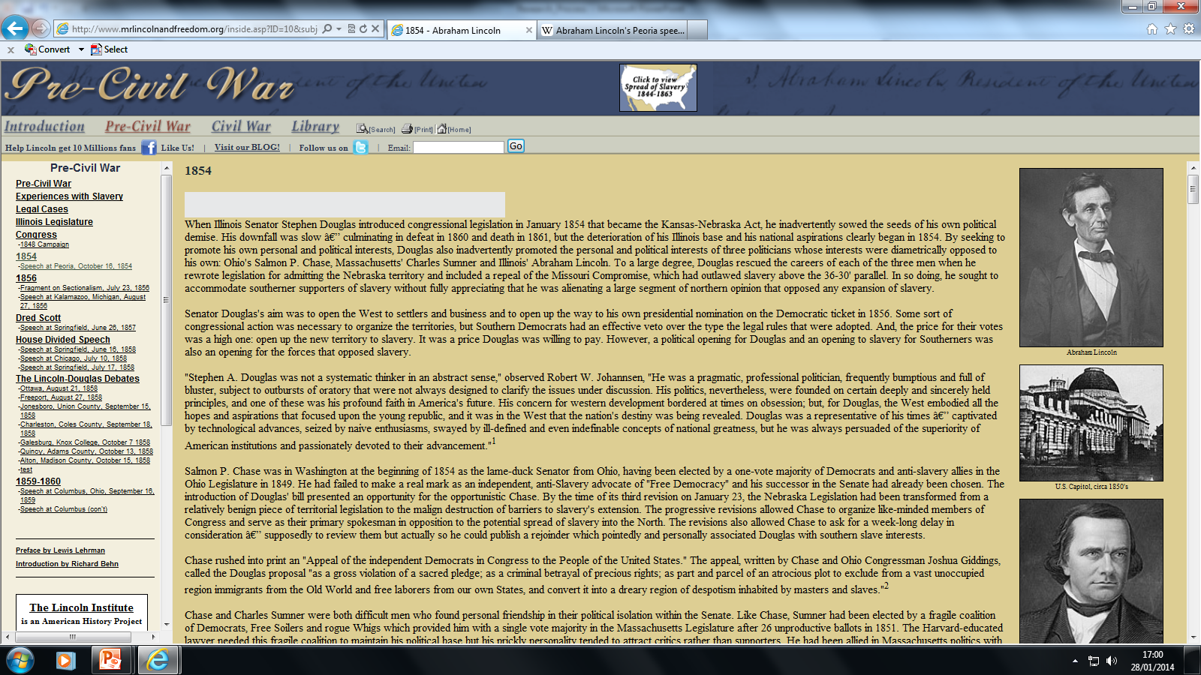

Slide 15
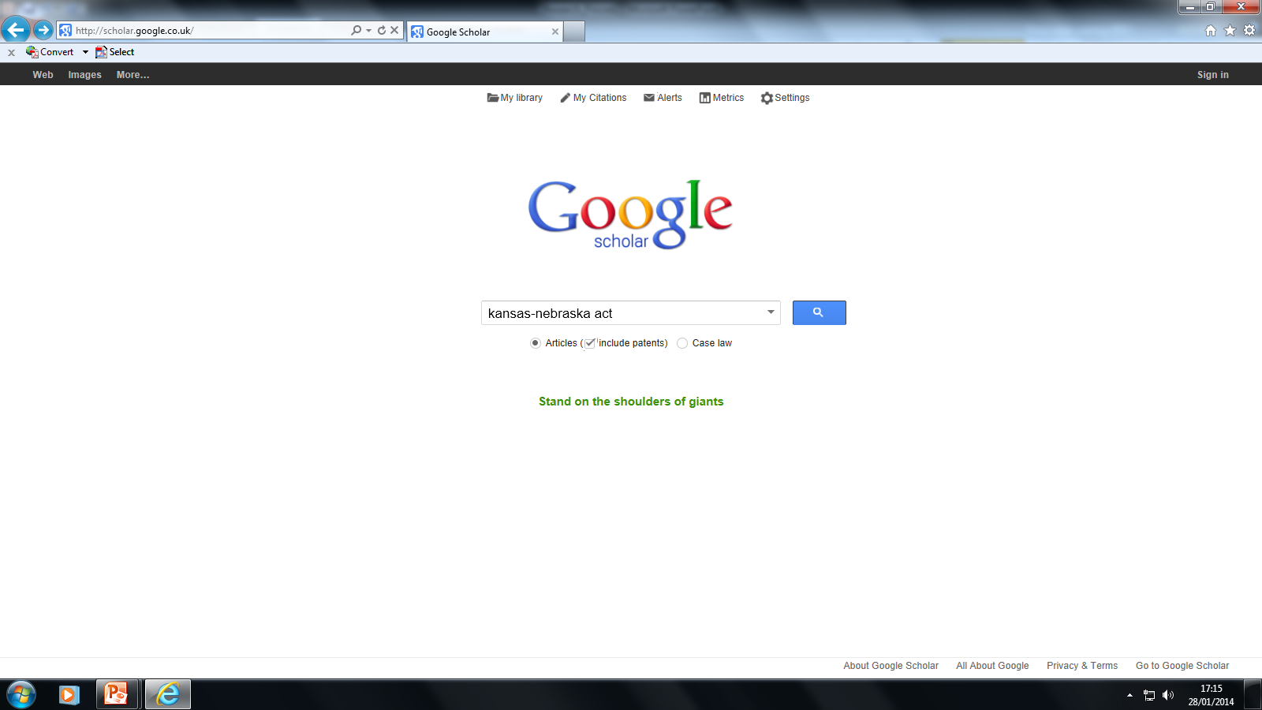
scholar.google.co.uk

Slide 16
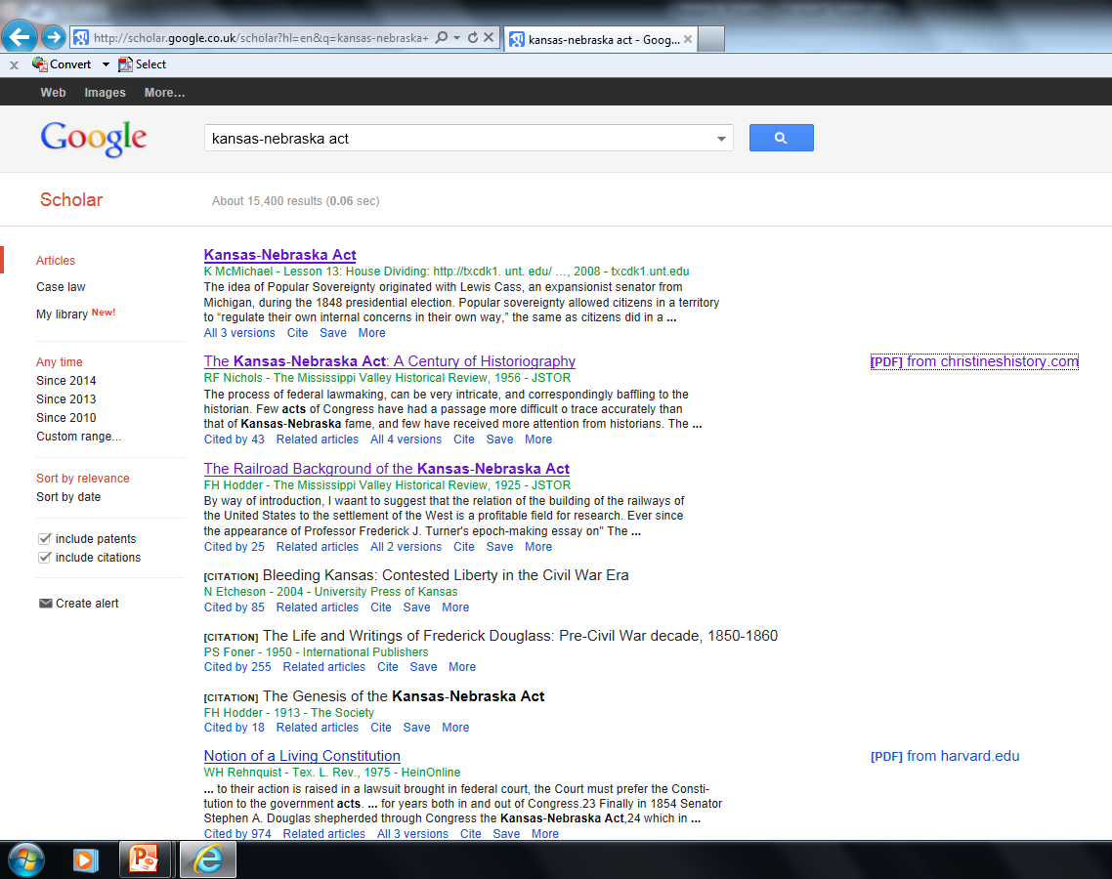

Slide 17
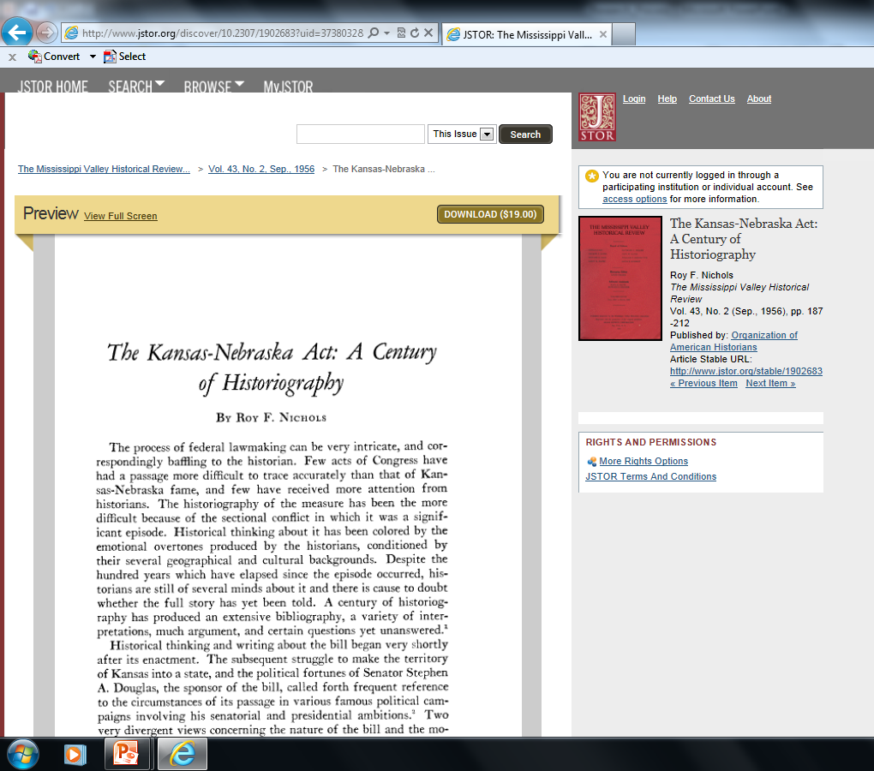

Slide 19
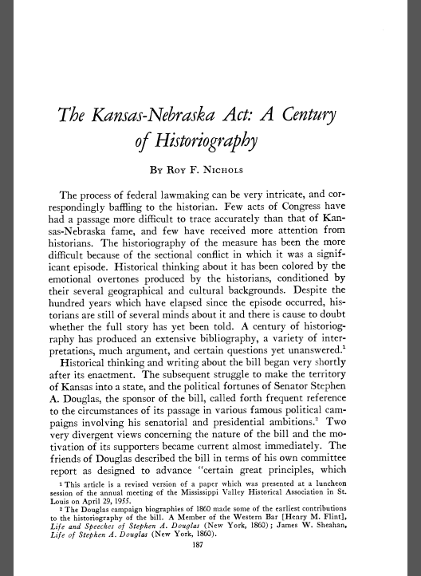

Slide 20
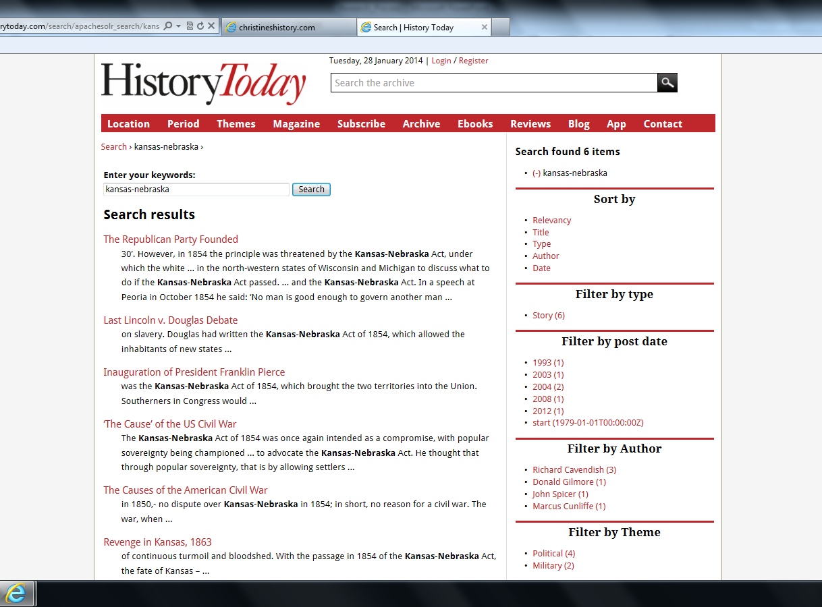
http://www.historytoday.com/archive
Username: LVSLRC
Password: Learning21

Slide 21
Don’t Forget…
You need books / articles!
  Quality historical writing by respected historians
  2º sources
  10 minimum; 15 is ‘safe’
Use index pages and content to be efficient

Slide 22
Remember…
You are researching for facts and opinion.
This applies to both contemporary and secondary sources.
KEEP A RECORD

