Slide 1
Step 1 – Who to research?
Find a someone involved in the First World War to research. This will probably be a soldier, but there are lots of other possibilities. For example, many women worked in munitions factories. Your topic does not have to be a family member, or even British.
Trap to avoid
We are of course studying the First World War (1914 – 1918)
Not
The Second World War (1939-45)

Slide 2
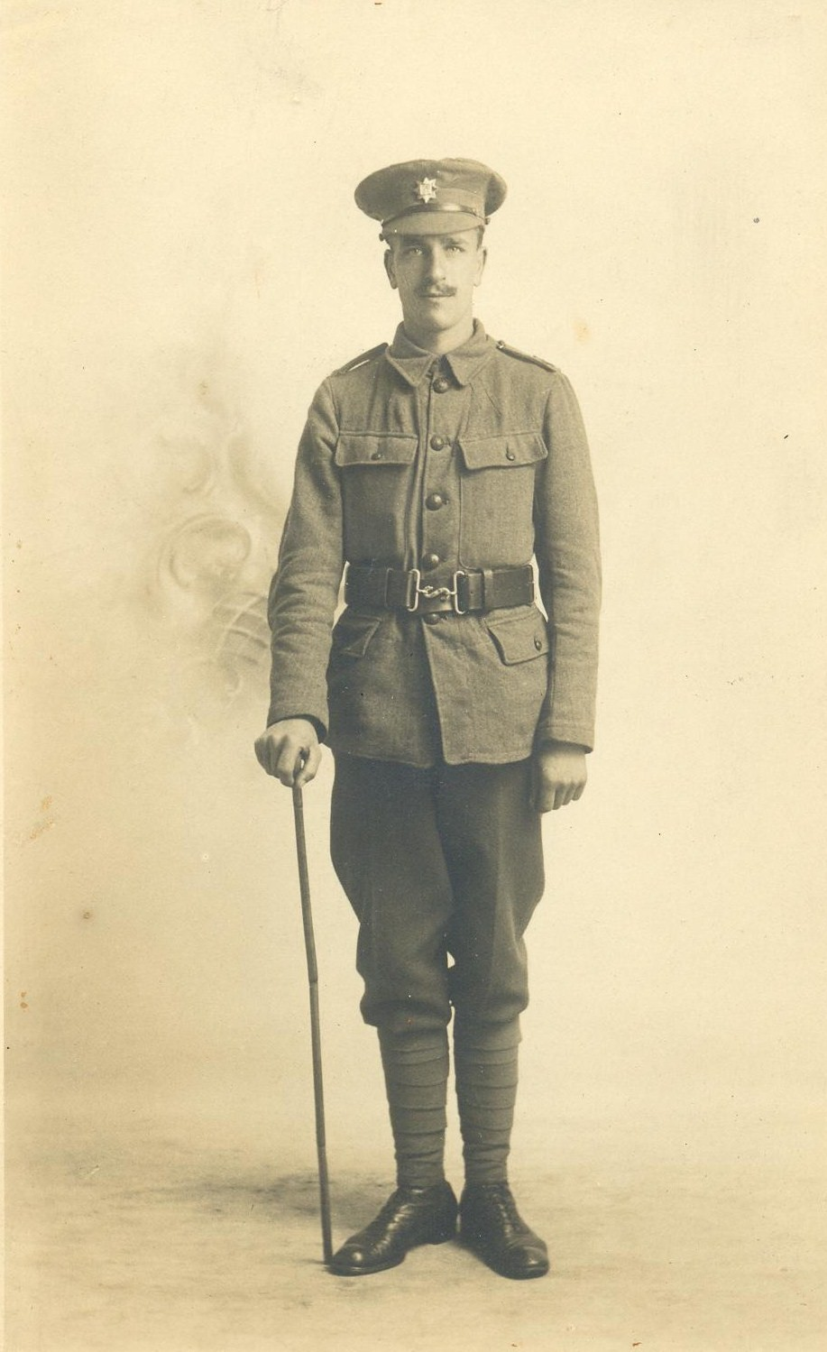
Action – if you have a family member…
See what you can find out from family members
After speaking to members of my family, I found out that I had a Great Uncle called Bob Hubbard who we think died in the Battle of the Somme in 1916.

Slide 3
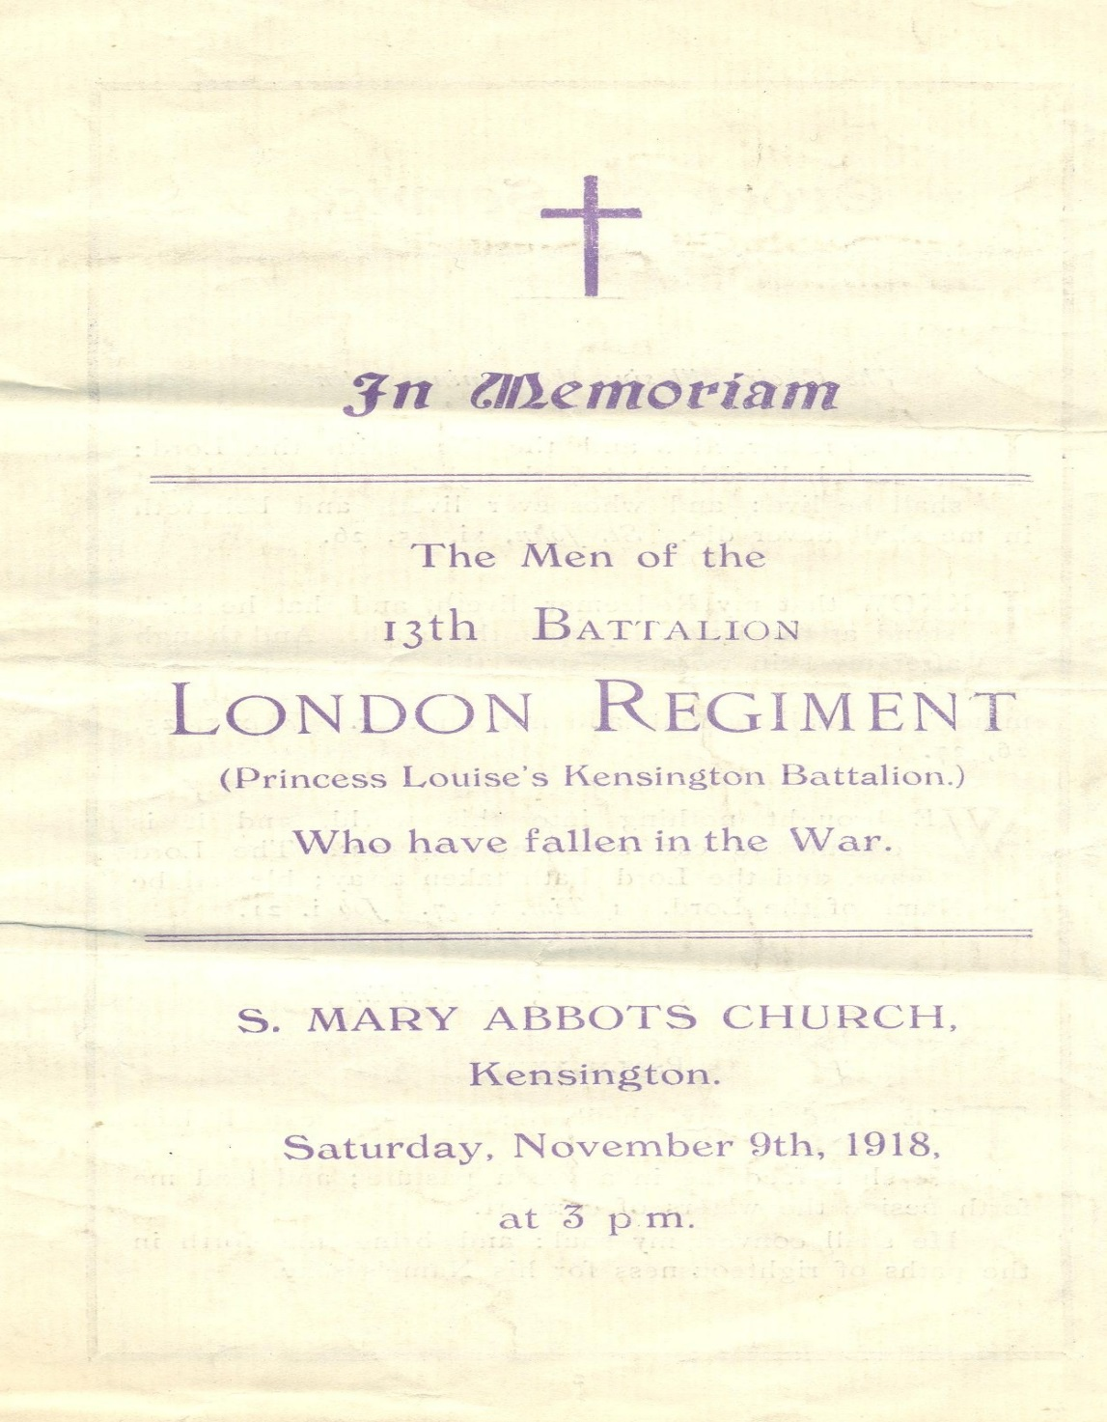
I was lucky here, by speaking to my mother I managed to get a photograph, and memorial document. I scanned these, taking care of the original documents (don’t bring them in).
I now a good a start on Bob Hubbard. On the back of the photograph it says he died in 8th October 1916 (towards the end of the Battle of the Somme). I know he was in the London regiment (13th Kensington Battalion of the London regiment) .

Slide 4
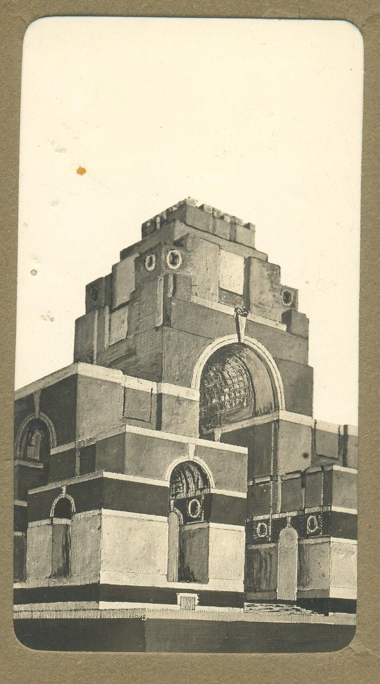
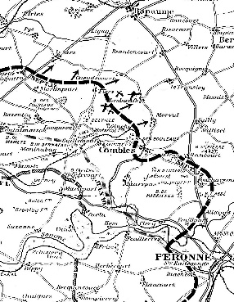
This photograph and map were also with my Great Uncle’s photograph

Slide 5
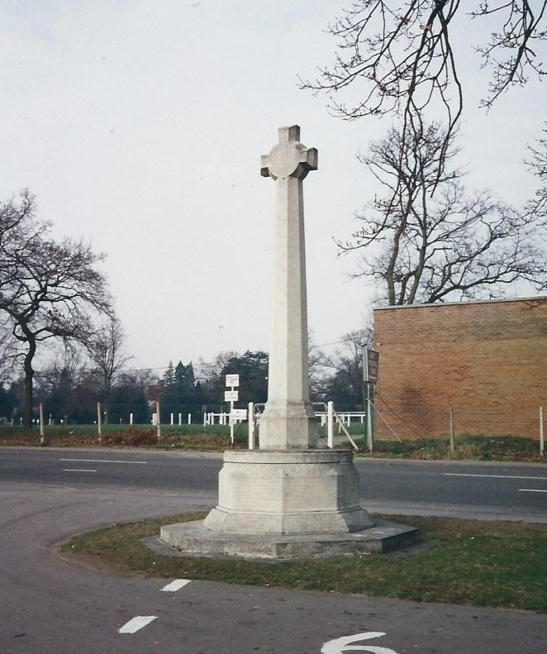
Step 1 – Who to research?
What if there is no information in my family?
No problem.
Your should use names from the Ascot War memorial
They exist electronically here
https://www.warmemorialsonline.org.uk/memorial/147923/

Slide 6
Step 2 – Research questions and using the School library
My prep was to set myself some research questions. I came up with six, but in the end I agreed the following three with my teacher in the LRC lesson
When did Bob die?
Can I find out where Bob was laid to rest?
As I know that Bob Hubbard died in the Battle of the Somme, can I find out about it?
We researched the most helpful websites to use. Mrs Keeler suggested that I use the War Graves Commission website as Bob died in the War.
https://www.cwgc.org/
http://www.bbc.co.uk/guides/zwpx6sg

Slide 7
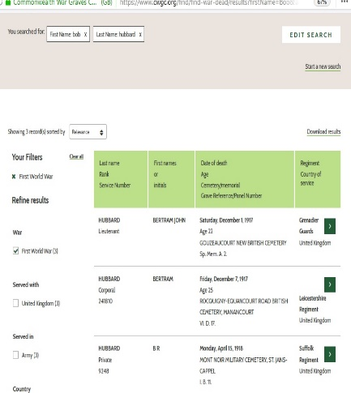
When did Bob die?
When I could not find anything for Hubbard Bob (left), I searched for Hubbard, Robert. This time I remember to set the filter for the First World War and British. I also used the initial R (Robert) instead on B (Bob).

Slide 8
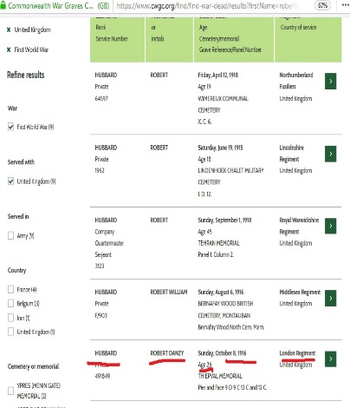
Success.
I now know for certain that Robert Danzy Hubbard died on the 8th October 1916 aged 26.

Slide 9
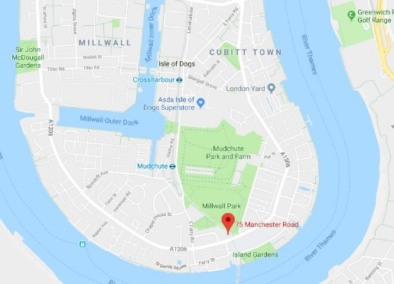
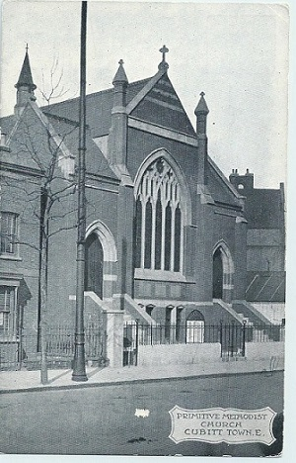
2. Can I find out where Bob was laid to rest?
By following the links on the War Graves Commission website, I found out the following;
He was a Private and his service number was 491849
He did die 08/10/1916 aged 26
He was a member of the 1st/13th Kensington Bn. London Regiment
He was the son of Henry and Susannah Hubbard, of 75, Manchester Rd., Cubitt Town, London. Screenshot map below. This was his church.

Slide 10
The War Grave Commission website was again really helpful here. I found out that Bob is remembered at the Theipval Monument. This is a memorial to the missing of the Somme battlefields, and it bears the names of 72,194 men of the United Kingdom and South African forces whose bodies were never identified. In other words, I learnt that his body was sadly lost. The website showed me exactly where his name is however.
http://www.greatwar.co.uk/somme/memorial-thiepval.htm#inscribednames

Slide 11
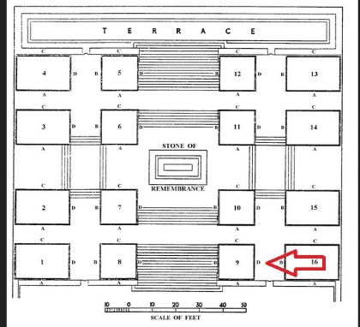
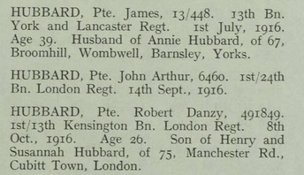

Slide 12
3. As I know that Bob Hubbard died in the Battle of the Somme, can I find out about it?
I then checked the online wartimes memory project. I cross referenced the battle that the 13th Kensington Battalion fought in with the date Bob died. I also had the map to help me. I think that Bob died in the Battle of the Battle of Transloy Ridge. It was described as follows;
The Battle of Le Transloy, 1 – 18 October 1916
“A period of fighting in terrible weather in which the heavy, clinging, chalky Somme mud and the freezing, flooded battlefield became as formidable an enemy as the Germans. The British gradually pressed forward, still fighting against numerous counter-attacks, in an effort to have the front line on higher ground from which the offensive could be renewed in 1917.”

Slide 13
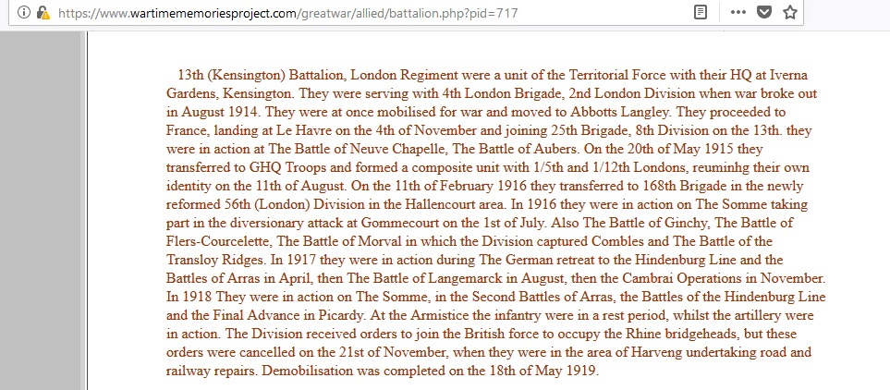
https://www.wartimememoriesproject.com/greatwar/allied/battalion.php?pid=717

Slide 14
Another Battle just before Transloy was Morval. This was described a British soldier, Coningsby Dawson in a letter home dated September 19, 1916:
“A modern battlefield is the abomination of abominations. Imagine a vast stretch of dead country, pitted with shell-holes as though it had been mutilated with small-pox. There's not a leaf or a blade of grass in sight. Every house has either been leveled or is in ruins. No bird sings. Nothing stirs. The only live sound is at night--the scurry of rats. You enter a kind of ditch, called a trench; it leads on to another and another in an unjoyful maze… From the sides feet stick out, and arms and faces--the dead of previous encounters. “One of our chaps,” you say casually, recognising him by his boots or khaki, or “Poor blighter—a Hun!” One can afford to forget enmity in the presence of the dead.”
https://www.longlongtrail.co.uk/battles/battles-of-the-western-front-in-france-and-flanders/the-battles-of-the-somme-1916/
http://mentalfloss.com/article/86704/battles-morval-and-thiepval-ridge

Slide 15
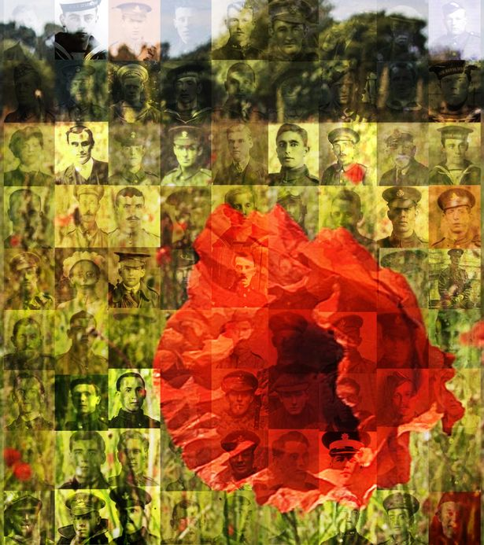
Step 3 – Writing this up
I now have two jobs to do.
If I have one, I need to email my photograph to my history teacher, as we plan to make a collage of all those that we have researched (see - right) to mark the centenary of the ending of the First World War. A copy should also go in my book.
I need to write up my research and findings on my A3 sheet. The exact structure should be agreed with my teacher, but it should focus on my research questions.

