Slide 1
Understanding success evening
11th October 2018
Assessment and Weightings
Board – OCR
Code - H505

Slide 2
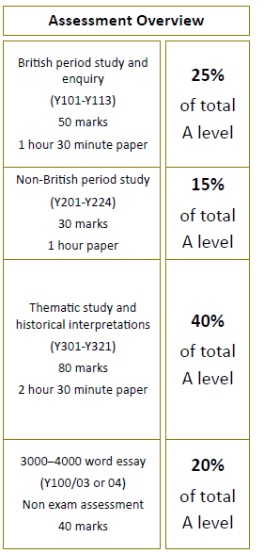
H505 LVS Ascot Unit break down
England 1547- 1603 The later Tudors Y107 Knowledge and Source Evaluation Your Y12 work – slight change to the examination from AS.
The USA in the C19 – Westward expansion Y216 Knowledge only Your Y12 work – now a straight essay paper.
Russia and its rulers 1855 – 1964 Y318 Knowledge and Interpretation work
Coursework Y100 All skills and independent research

Slide 3
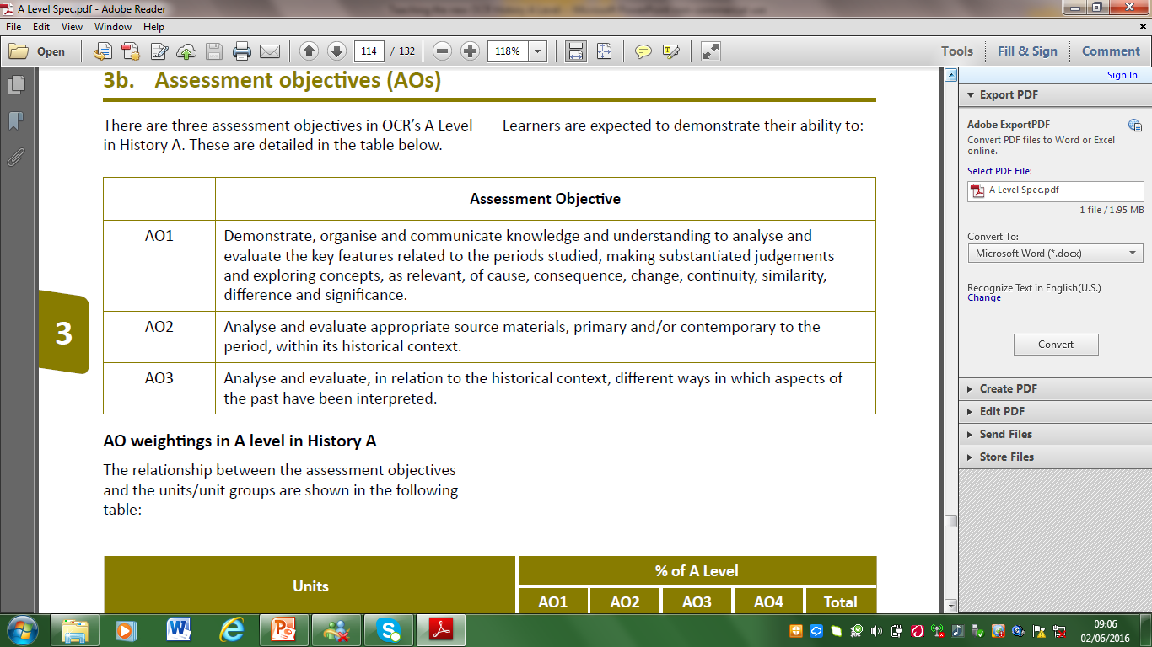
What do the Assessment Objectives look like, and what do they mean?
AO1 | Knowledge and understanding
AO2 | Source evaluation
AO3 | Interpretations

Slide 4
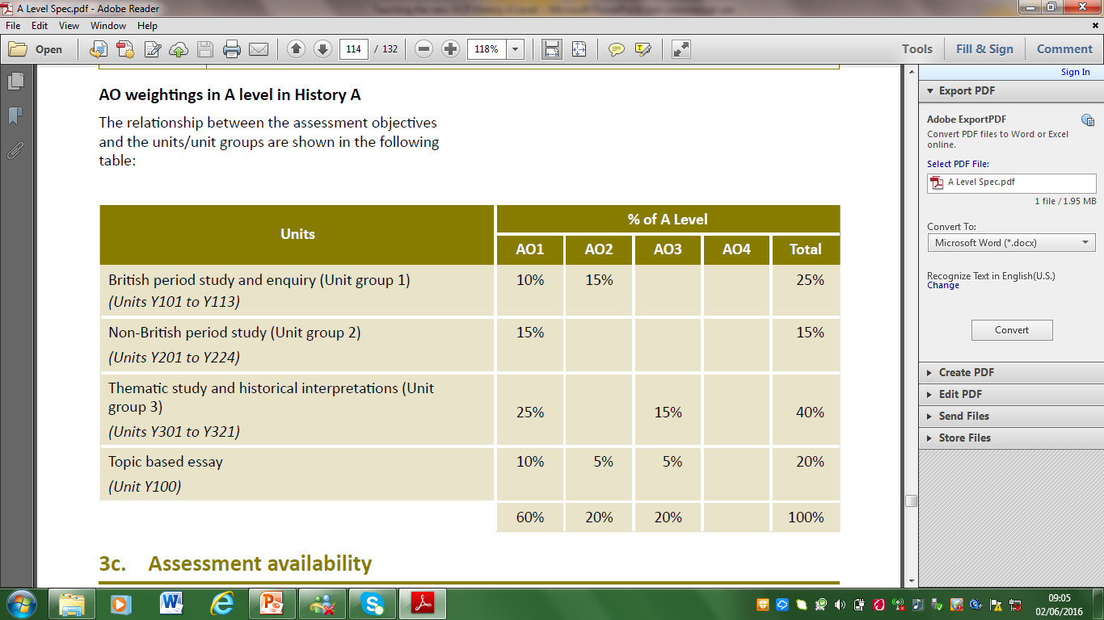
AO1 | Knowledge and understanding
AO2 | Source evaluation
AO3 | Interpretations

Slide 5
AO1 – Knowledge
Demonstrate, organise and communicate knowledge and understanding to analyse and evaluate the key features related to the periods studied, making substantiated judgements and exploring concepts, as relevant, of cause, consequence, change, continuity, similarity, difference and significance.
Good historical skills- you do this everywhere

Slide 6
AO2 – Source Evaluation
Analyse and evaluate appropriate source materials, primary and/or contemporary to the period, within its historical context.
Using evidence critically. You do this in your mid-Tudors work and your coursework
The importance of provenance

Slide 7
AO3 –Interpretation work
Analyse and evaluate, in relation to the historical context, different ways in which aspects of the past have been interpreted.
A new skill in Year Thirteen. You do this in your coursework and Russia paper.

Slide 8
Getting the later tudors (Y107) correct
Please look at the 2018 paper and marked answer
Task | Timings | Paragraphs | Marks
Analysing the sources Essay planning | 10 minutes 5 minutes
Writing | 35 minutes | 4 + a conclusion | 30
Mid Tudors
Elizabeth
Essay planning | 5 minutes
Writing | 35 minutes | 3/4 + a conclusion | 20

Slide 9

There will be ONE Question:
Using these four sources in their historical context, assess how far they support the view that….
The examiner wants
From the board…
“Evaluation is the application of own knowledge to a source in order to judge the validity of the view of the source about an issue. The knowledge may either support or challenge the view in the source.”

Slide 10
The question will require candidates to:
Interpret the Source
Explain the view of the Source about the issue in the Question
Consider the provenance of the sources
Apply contextual knowledge to the source to judge its validity
Analyse the source in relation to the Question
Evaluate the Sources
In order to score well answers must:
Focus on the Question
Evaluate all the sources, using both Provenance and own knowledge
Reach a judgement about the issue in the Question by evaluating the sources

Slide 11

C-O-P
Hardest skill
Top Tips
Use your Compendium of Usefulness
Tudor Tuesdays
Sample papers
  C – Context
  O – Origin
  P – Provenance

Slide 12
Typical Structure
Introduction
Key terms / arguments for and against
Expose your argument
Two source-led paragraphs to support the statement
C-O-P
Two source-led paragraphs to challenge the statement
C-O-P
Conclusion
Which view best supported ?

Slide 13
Writing the Elizabeth and usa Essays the examiner wants;
A tight line of argument tied to the key terms in the question.
Detailed hard evidence throughout.
Linking and relative importance in the body of your essays.
Judgements not assertions.
Sustained conclusion
Top Tips
Use your Compendium of Usefulness
Tudor Tuesdays
Electronic planning sheets

Slide 14
In a top band answer
A – 17+/20
There is a consistent focus on the question throughout the answer.
Accurate and detailed knowledge and understanding is demonstrated throughout the answer
and is consistently evaluated and analysed in order to reach substantiated, developed and sustained judgements.
There is a well-developed and sustained line of reasoning which is coherent and logically structured.
The information presented is entirely relevant and substantiated.

Slide 15
NAILING the USA Paper
(Y216)
ONE HOUR
30 MARKS
15%
TWO QUESTIONS
  Comparison question (10 marks; 20 minutes)
  Essay question (20 marks; 40 minutes)
CLEVER / CUNNING STRUCTURE…

Slide 16
NAILING the USA Paper
(Y216)
Four topics…
Westward Expansion
Native Americans
Causes of the US Civil War
The US Civil War
But… in any FIXED combination!

Slide 17
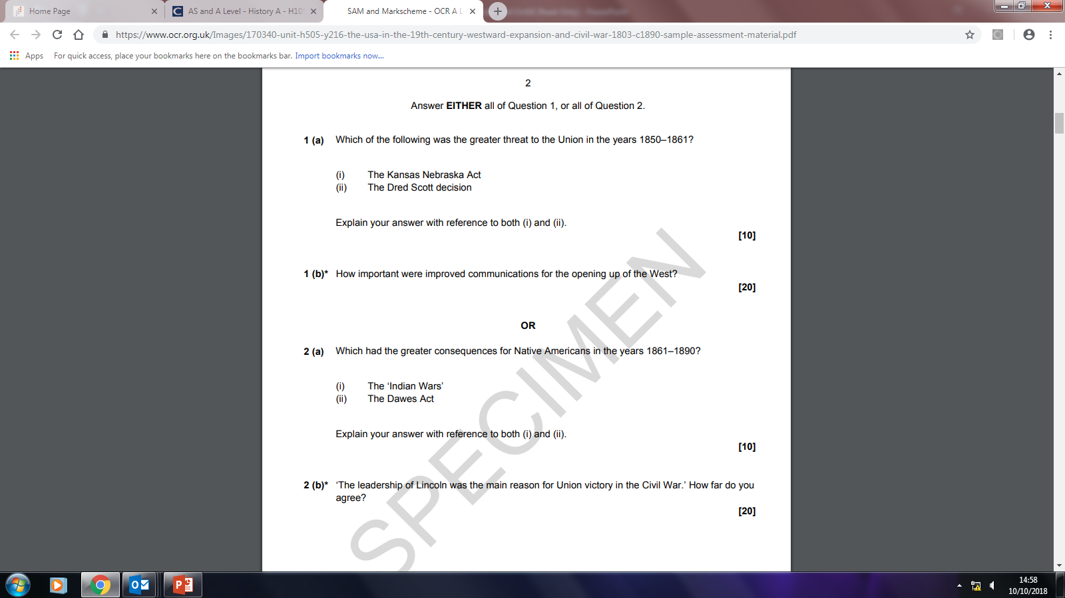
CAUSES
EXPANSION
NATIVES
CIVIL WAR

Slide 18
The Comparison question

Slide 19
Paragraph 1 – Factor 1
Knowledge
Analysis of [e.g. significance]
Paragraph 2 – Factor 2
Paragraph 3 – Direct Comparison & Judgement

Slide 20
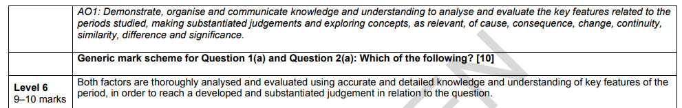
Three factors…
Knowledge & understanding
Analysis & evaluation
Judgement (via direct comparison)
“Assigning relative weight or value to evidence or argument”
Notes:
Move to sample answer PDF at this point…

Slide 21
Getting the Russia and her rulers Paper (Y318) correct
Please look at the 2018 paper and marked answer
Task | Timings | Paragraphs | Marks
Interpretations Essay planning | 10 minutes 5 minutes
Writing | 40 minutes | 4 + a conclusion | 30
Depth Study
Synoptic writing
Essay planning | 10 minutes
Writing synoptic essays x2 | 40 minutes x2 | 3/4 + a conclusion x2 | 25 x2

Slide 22
Getting the Russia and her rulers Paper (Y318) correct
Two skills interpretations (below) and synoptic writing
Please look at the 2018 paper and marked answer
From OCR Guidance booklet:
“The key to high-scoring answers will be recognition that the past has been debated about, that different views are held over particular issues, and the application of knowledge through which candidates can present the strengths and limitations of a given interpretation.”

Slide 23
From OCR Guidance booklet:
“The interpretations selected will always be deliberate constructs by historians, produced much later than the historical event.”
DO NOT EVALUATE THE PASSAGES FOR PROVENANCE
Level 6 A 26 - 30 | The answer has a very good focus on the question throughout. It has thorough and sustained evaluation of the interpretations, using detailed and accurate knowledge of the historical context and the wider historical debate around the issue, in order to produce a convincing and supported analysis of them in relation to the question.
Notes:
Provenance is not an issue. Historiography is not an issue (though the views of other historians might be use, this is not necessary, and discussion of ‘Marxist schools’ or shortcomings of the ‘revisionist school’ on a topic won’t help.

Slide 24
Analysing interpretations
Top Tips
You need to plan, plan plan.
Detailed knowledge builds confidence.
Read the two passages twice.
Identify the different interpretations.
Colour code the two views and the evidence deployed.
Assess strengths & weaknesses of each using your own knowledge.
Decide which is most convincing.
Lead with the view that you agree with least.

Slide 25
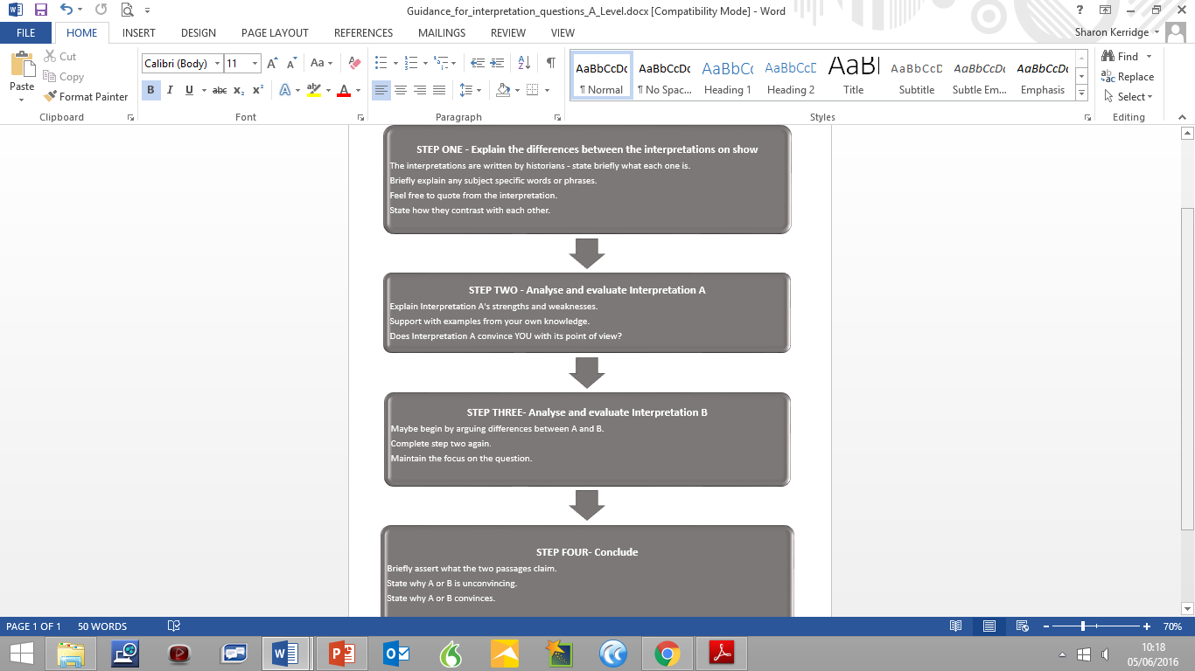

Slide 26
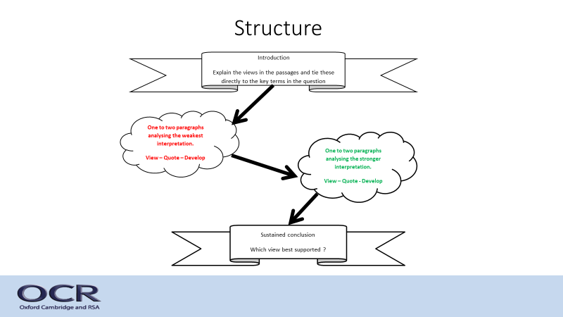

Slide 27




Synoptic essays

Slide 28
The Thematic Essay and Synthesis
What is synthesis?
The bringing together of material from across the whole period
Making links and connections between the material
Explaining the similarities and differences, continuity and change between the events
Comparing events/issues in each paragraph
This is much easier if the essay is structured thematically and not chronologically

Slide 29
Mark Scheme
Level 6 A 25 - 22 | The answer has a very good focus on the question. Detailed and accurate knowledge and understanding is used to analyse and evaluate key features of the period studied in order to reach a fully developed synthesis supporting a convincing and substantiated judgement. There is a well-developed and sustained line of reasoning which is coherent and logically structured. The information presented is entirely relevant and substantiated.

Slide 30
Types of essay
‘X was the most significant turning point in Y during the period from A to B.’ How far do you agree with this view?
How far do you agree that X remained the same throughout the period?
‘X was the main cause of Y throughout the period.’ To what extent do you agree with this view of the period from A to B?
Quotation about the period. How far do you agree with this view?
Assess the reasons for X throughout the period.
To what extent was X the main factor in Y?

Slide 31
Top tips
Focus on the issue in the Question.
TIE BACK YOUR ANALYSIS TO THE KEY TERMS IN THE QUESTION
Support the argument with relevant and accurate knowledge.
- HARD EVIDENCE AT PACE (CAN YOU INTERACT WITH IT ?)
Analysis of the issues
-COMPARE WHERE YOU CAN
Reach a supported and developed judgement
-A SUSTAINED CONCLUSION AND IN YOUR PARAGRAPHS
Show synthesis across the whole period
PRE and POST 1917 IN EVERY PARAGRAPH

Slide 32
Writing your coursework
(y100)
Research methodology
Mark Scheme

Slide 33
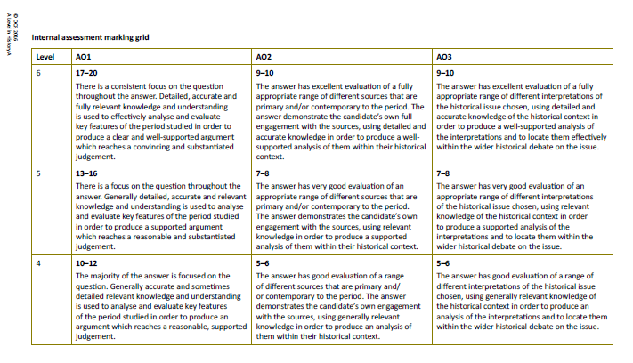
Knowledge & Argument
Contemporary Sources
Historical Interpretations

Slide 34
Writing your coursework
(y100)
Research methodology
Mark Scheme
A-grade work
Calendar
October HT - Question

Slide 35
Writing your coursework
(y100)

Slide 36
Writing your coursework
(y100)
Research methodology
Mark Scheme
A-grade work
Calendar
October HT - Question
Christmas - First draft
February HT - Final submission

Slide 37


Slide 38
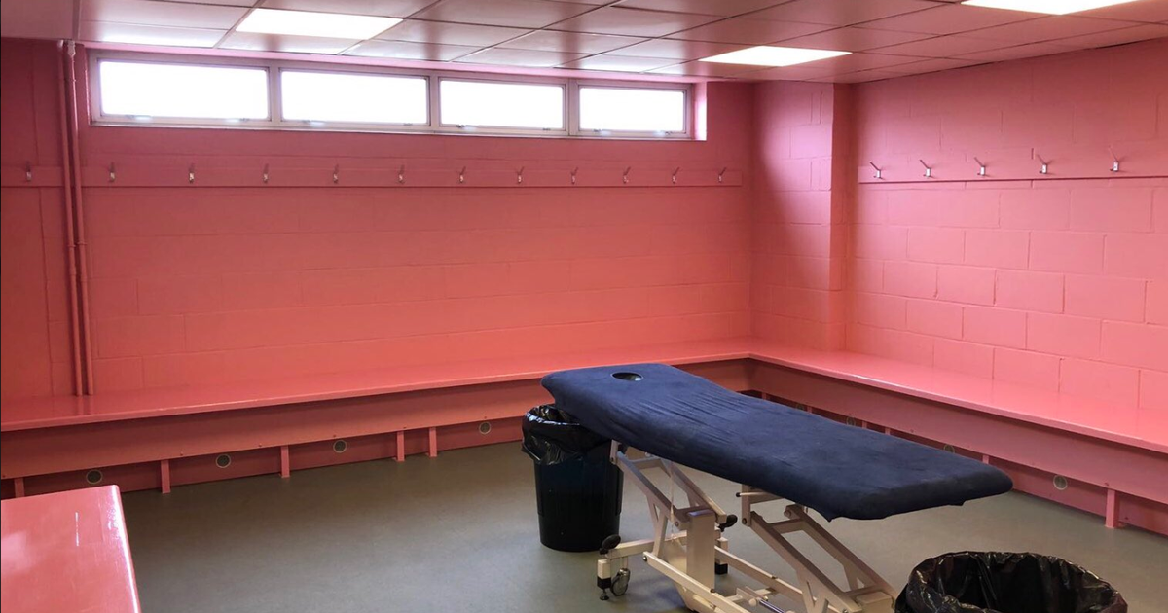
Key messages
Demanding but doable for the professional student
Organisation is crucial.
Get “outside the classroom” right.
60% knowledge means detailed learning.
The importance of assessment opportunities.
Hunt as a pack.

