Slide 1
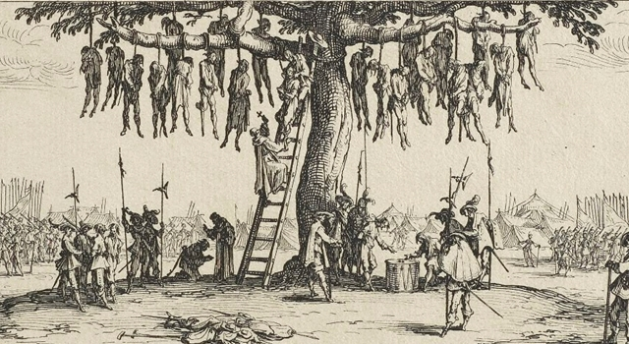
Re-cap
Re-read your notes. What was the Bloody Code / when was it introduced?

Slide 3
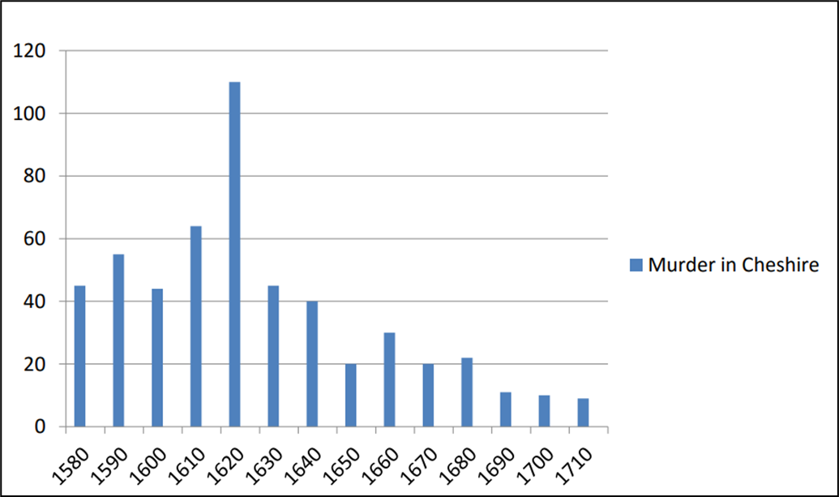
What do these graphs show?
Complete these 2 questions:
Is crime increasing or decreasing in Cheshire?
Why is that surprising when we are thinking about the Bloody Code?
Hint: think about when crime is decreasing and when the code was introduced?
Murder in Cheshire
So if crime was already falling, why was the bloody code introduced?

Slide 4
What do these graphs show?
Complete these 2 questions:
Is crime increasing or decreasing in Cheshire?
Why is that surprising when we are thinking about the Bloody Code?
Hint: think about when crime is decreasing and when the code was introduced?
So if crime was already falling, why was the bloody code introduced?

Slide 6
So what factors led to the Bloody Code’s introduction?
Read pages 52 -53

Slide 7
It could be argued that travel is the most important factor in causing the Bloody Code. For example, travel became cheaper and easier because roads improved and horses became cheaper. This meant that people could travel between towns more easily and would take rumours of crimes around the country. This shows that travel caused the Bloody Code because as people spread rumours, it seemed like the crime rate was increasing. This meant people demanded harsher punishments from the authorities to stop crime. It could be seen as the most important factor because if people felt the crime rate was low, they would not have wanted to make punishments harsher. This supports the statement that travel was the most important factor for causing the Bloody Code
Point
Evidence
Explanation
Link

Slide 8
Explain why the Bloody Code was developed. (12 marks)
You may use the following in your answer:
The growth of towns
Pamphlets being produced about crime.
You must also use your own knowledge.
The exam gives you information you may want to use but you don’t have to.
However these are not factors. When we talk about these points what factors could we refer to?
We also need to use our own knowledge – outside of these 2 bullet points.

Slide 9
Other punishments in 1700 Using Page 51, please copy and complete What crimes would lead to these punishments?
Fines
Other Punishments
Transportation
Corporal Punishment
Prisons and Houses of corrections

