Slide 1
New topic: Henry VIII & his ministers, 1509-1540
What might this mean?

Slide 2
New topic: Henry VIII & his ministers, 1509-1540
3 sections:
Henry VIII & Wolsey 1509-1529
Henry VIII & Thomas Cromwell 1529-1540
The Reformation & its Impact

Slide 3
New topic: Henry VIII & his ministers, 1509-1549
Question types:
Describe two features of … (4)
Explain why …. (12)
‘Statement’. How far do you agree? (16)

Slide 4
Tudor Society under Henry VIII
What can you remember about Tudor Society from the Crime & Punishment course?
Can you remember anything about the Tudors from Y7?
Make a bullet point list of what you can remember.
Next: share with your partner and try add 3 of their ideas.
https://www.youtube.com/watch?v=odZsn7Y-VRA
What event is this video focussing on?
Anything else we notice?

Slide 6
When Henry VIII became King in 1509….
England’s population was:
1.3 million
2.5 million
6 million

Slide 7
When Henry VIII became King in 1509….
The percentage of people living in towns (rather than the countryside) was:
6%
27%
44%

Slide 8
When Henry VIII became King in 1509….
Most people in England were:
Protestant
Atheist
Catholic

Slide 9
When Henry VIII became King in 1509….
England’s biggest export was:
Cloth
Grain
Weapons

Slide 10
When Henry VIII became King in 1509….
England’s population was:
1.3 million
2.5 million
6 million
How is that different from England today?

Slide 11
When Henry VIII became King in 1509….
The percentage of people living in towns (rather than the countryside) was:
6%
27%
44%
What would most people in England’s life have been like?

Slide 12
When Henry VIII became King in 1509….
Most people in England were:
Protestant
Atheist
Catholic
Almost the whole population were practising Catholics. Why?

Slide 13
When Henry VIII became King in 1509….
England’s biggest export was:
Cloth (woollen)
Grain
Weapons

Slide 14
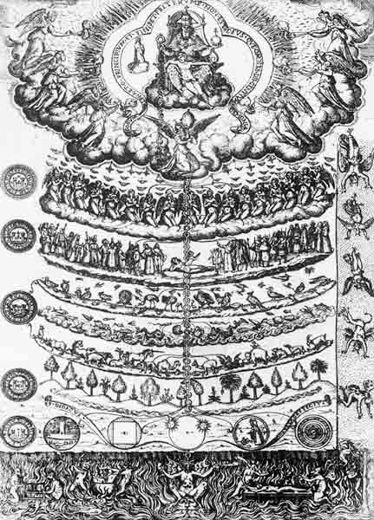
What can you see in this image?

Slide 15
Read the ‘Tudor Society’ section on p. 11 and see if you can work it out.

Slide 16
This is a Tudor image of the ‘Great Chain of Being’
God
Angels
Humanity
Animals
Plants

Slide 17
Look at the two social hierarchies on p. 12. Why do you think towns and the countryside had different social structures? Which was seen as more important and why?
Using the information we have covered on pp. 11-12 bullet point 3 key features of Tudor England’s social structure.

Slide 18
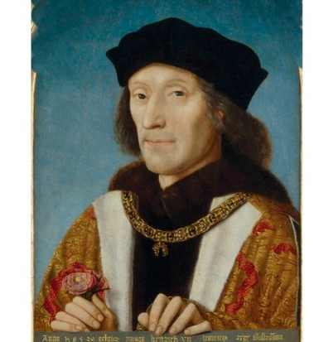
Introducing: Henry VII
Read the information sheet about Henry VII (that’s Henry VIII’s Dad!)
Underline/highlight the following in different colours:
Henry VIII’s upbringing and family life
Actions that were positive for Tudor England
Actions that were negative for Tudor England
Think:
What areas of strength will Henry VIII inherit from his father?
What areas of weakness will there be?

Slide 21
Strengths
Weaknesses
Opportunities
Threats

Slide 22
Review
On your post-it note, write two quiz questions about Tudor England.
Include the answer
Some of these will be picked for our starter next lesson – if you create a harder question then you may be the only one who knows the answer!
If your question is picked you will receive HPs.

