Slide 1
Weimar and Nazi Germany – overview
For each time period, chose a suitable title from the list:-
1918-1923
1924-1929
1929-1933
1933-1934
1933-1939
Titles: Life in Nazi Germany; Recovery – the Golden Years;
Uprisings and economic problems; Hitler – from Chancellor to Fuhrer;
Nazi rise to power.

Slide 2
Weimar and Nazi Germany – overview
1918-1923 Uprisings and economic problems
1924-1929 Recovery – the Golden Years
1929-1933 Nazi rise to power
1933-1934 Hitler – from Chancellor to Fuhrer
1933-1939 Life in Nazi Germany

Slide 3
1918-1923
What can you remember about the problems Germany faced?

Slide 4
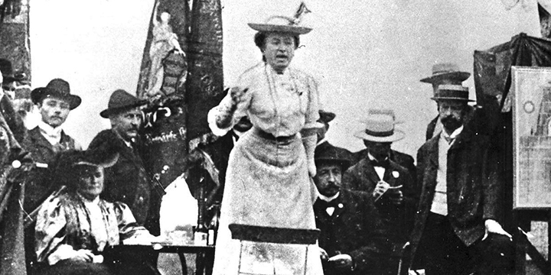
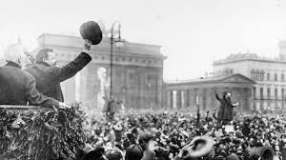
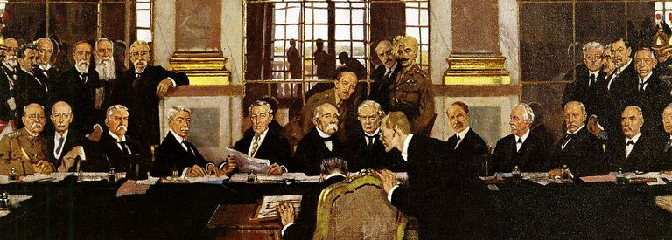
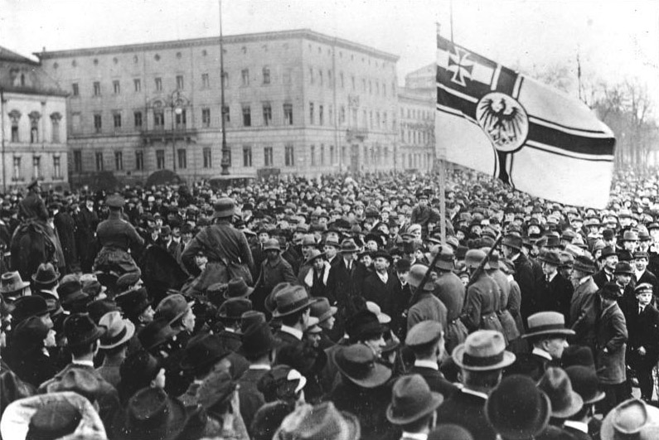
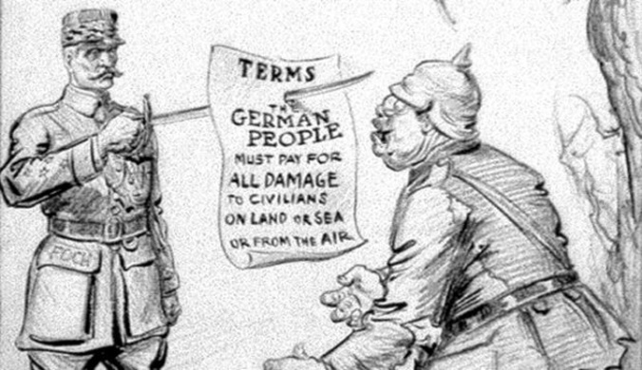
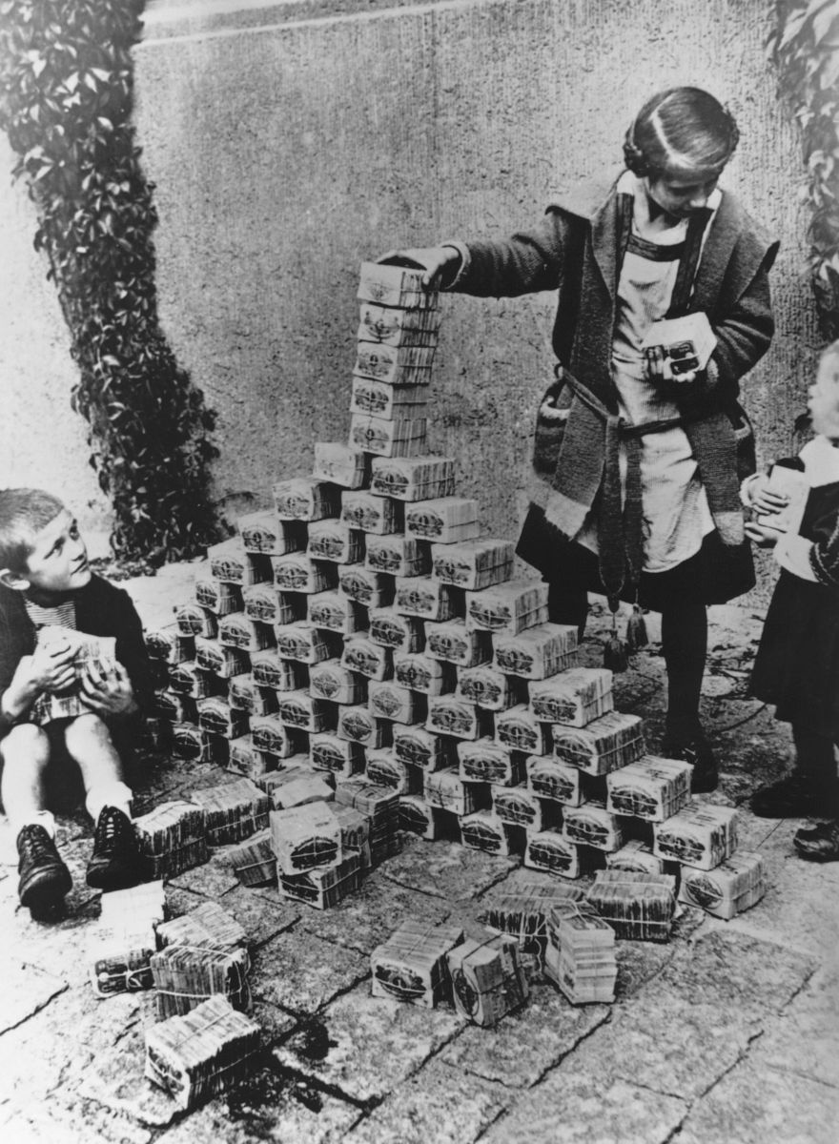
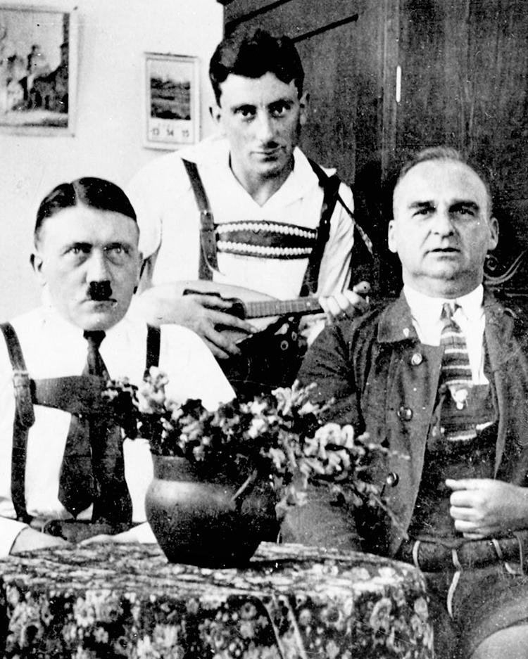
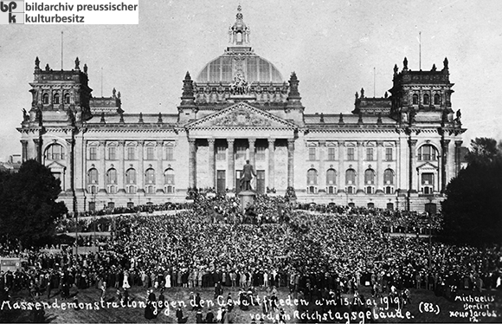
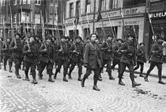
1918-1923
What can you remember about the problems Germany faced?

Slide 5
Massendemonstration gegen den Geweltfrieden am 15 Mai 1919 vordem Reichstagsgebaude
Notes:
Translation: Mass demonstration against the peace treaty in front of the Reichstag building 15th May 1919

Slide 6
1918-1923
What can you remember about the problems Germany faced?
Weimar Constitution
Treaty of Versailles:-
Loss of land
Army reduced
War guilt
Reparations
Uprisings:
Left-wing and right-wing
Hyperinflation
Invasion

Slide 7
What can you remember about how and why Germany recovered?
1924-1929

Slide 8
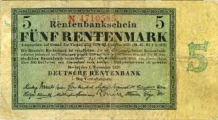
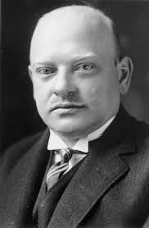
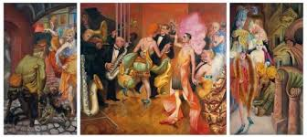
What can you remember about how and why Germany recovered?
1924-1929

Slide 9
What can you remember about how and why Germany recovered?
Stresemann
Rentenmark
Dawes Plan
1924-1929
Young Plan?
Economic prosperity
Locarno
Culture – art, architecture, cinema
Coalition governments
Kellogg Pact

Slide 10
1929-1933
What can you remember about how and why the Nazis rose to power?

Slide 11
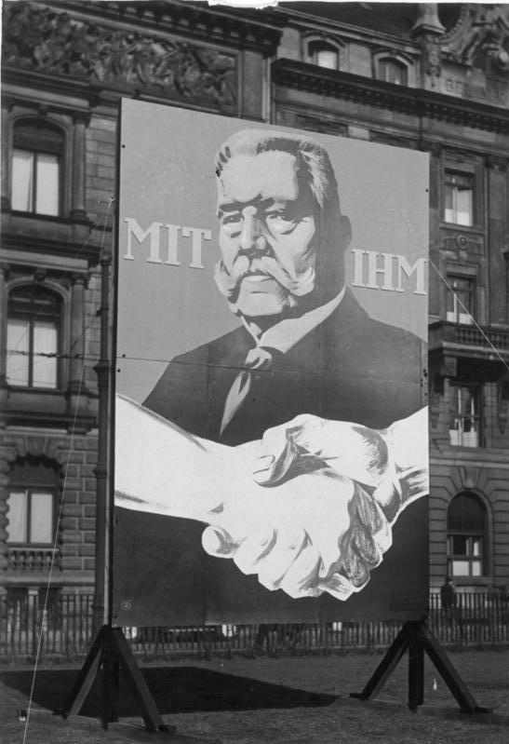
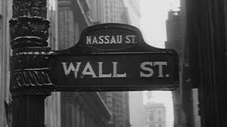
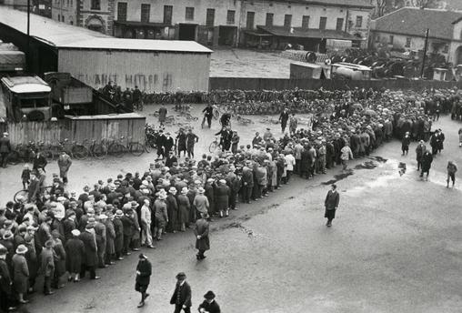
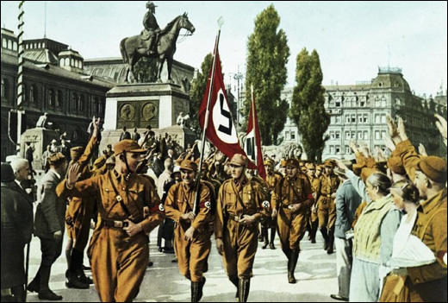
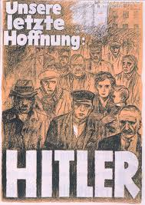
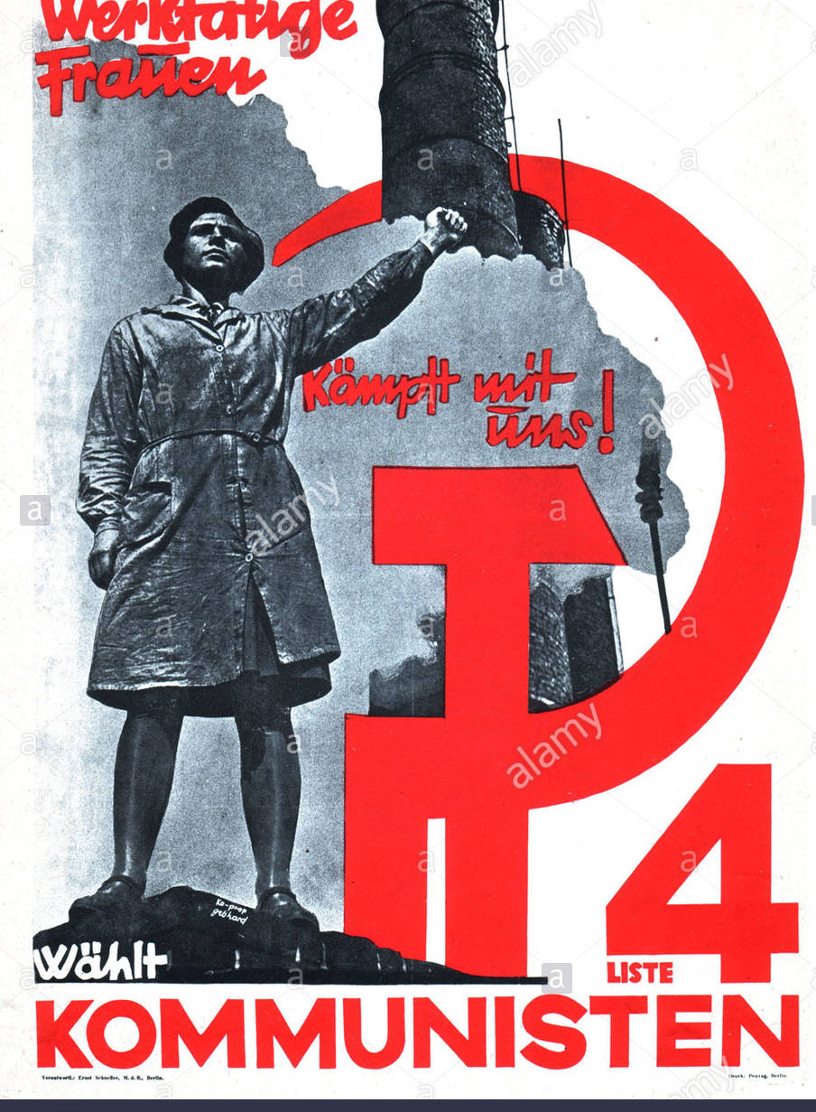
1929-1933
What can you remember about how and why the Nazis rose to power?

Slide 12
1929-1933
What can you remember about how and why the Nazis rose to power?
Unemployment
Wall Street Crash - Depression
Rise in support for Communism
Rule by decree
Nazi propaganda and organsiation
Rise in support for Nazism

Slide 13
1933-1934
What can you remember about how Hitler made himself dictator?

Slide 14
1933-1934
What can you remember about how Hitler made himself dictator?
Reichstag Fire
Enabling Act
Terror
Propaganda
Censorship

Slide 15
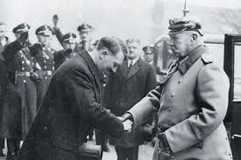
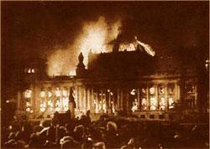
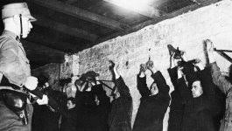
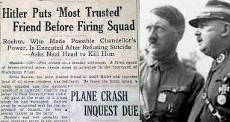
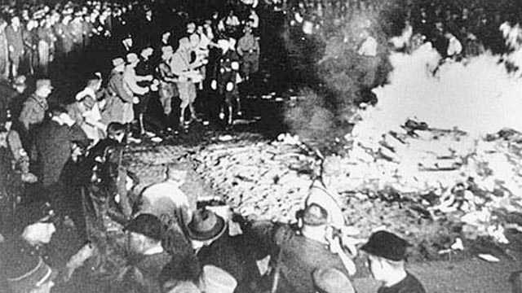
1933-1934
What can you remember about how Hitler made himself dictator?

Slide 16
1933-1939
What can you remember about life in Nazi Germany?

Slide 17
1933-1939
What can you remember about life in Nazi Germany?
Hitler Youth
SS
Employment
Rearmament
Propaganda
Terror
Persecution of Jews and other minorities
Censorship
Concentration camps

Slide 18
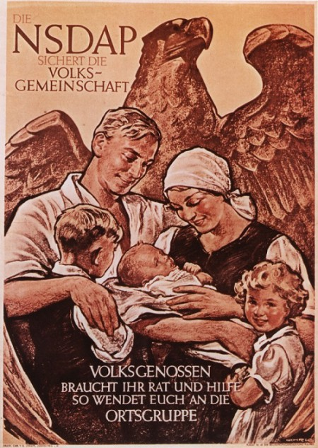
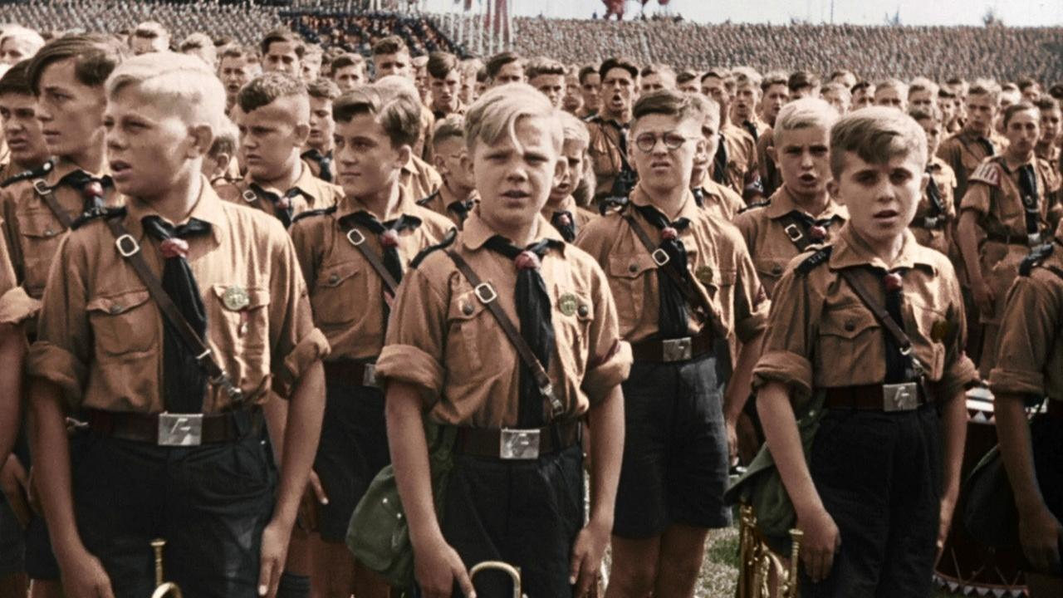
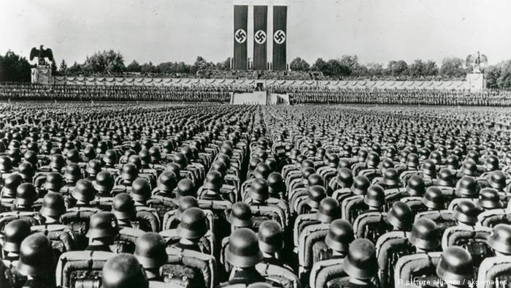
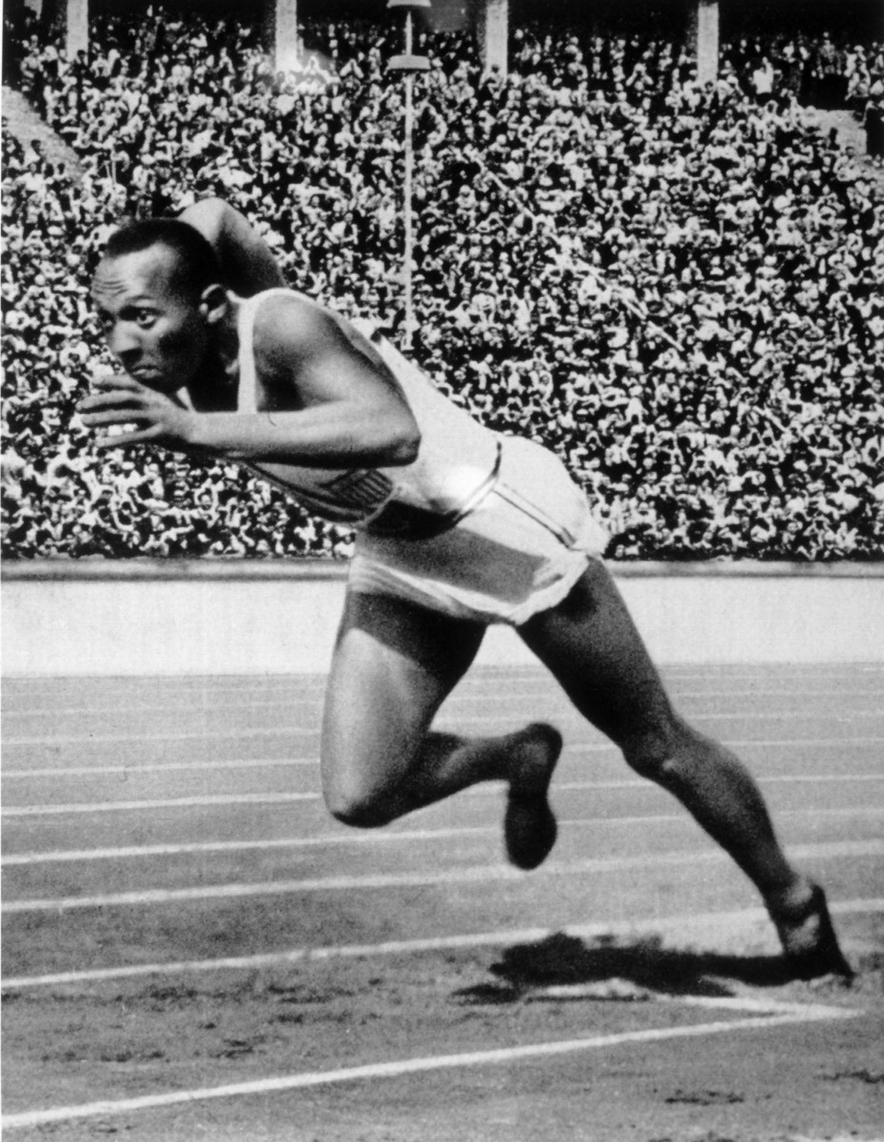
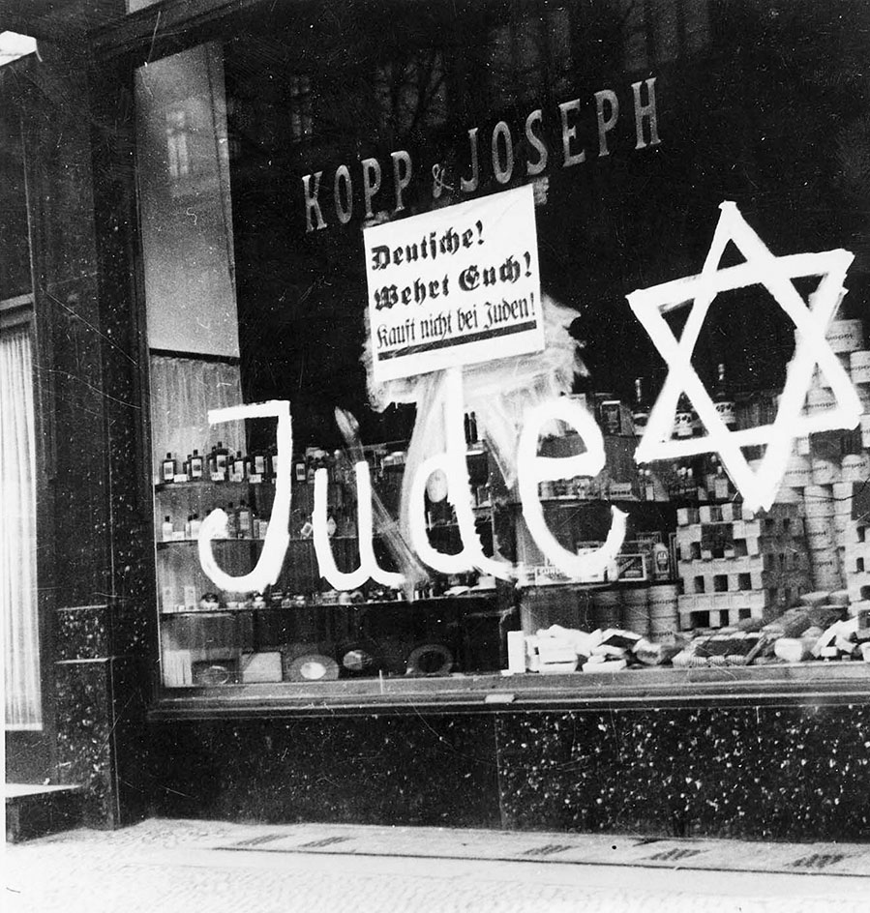
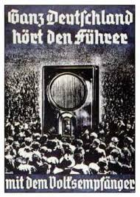
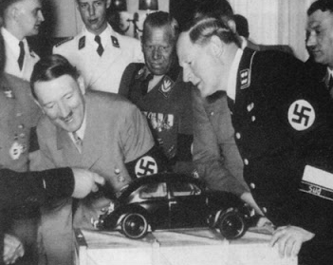
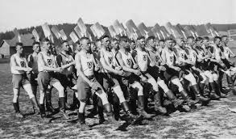
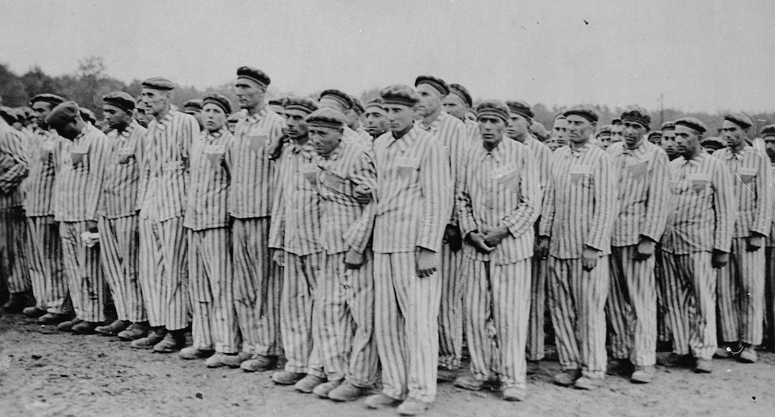
1933-1939
What can you remember about life in Nazi Germany?

Slide 19
Quick quiz:-
1. Which group carried out a left-wing uprising in Berlin in 1919?
2. What event made many Germans feel that their country had been ‘Stabbed in the back’ in 1919?
2. What is the name for the extreme rise in prices during 1923?
3. Name the leader who helped Germany recover 1924-1929.
4. Which country lent money to Germany under the Dawes plan?

Slide 20
Quick quiz:-
1. Which group carried out a left-wing uprising in Berlin in 1919?
Spartacists
2. What event made many Germans feel that their country had been ‘Stabbed in the back’ in 1919?
The Treaty of Versailles
3. What is the name for the extreme rise in prices during 1923?
Hyperinflation
4. Name the leader who helped Germany recover 1924-1929.
Stresemann
5. Which country lent money to Germany under the Dawes plan?
The USA

