Slide 1

c50 minutes
32 marks
Three types of question
Consequences
Narrative account
Importance

Slide 2
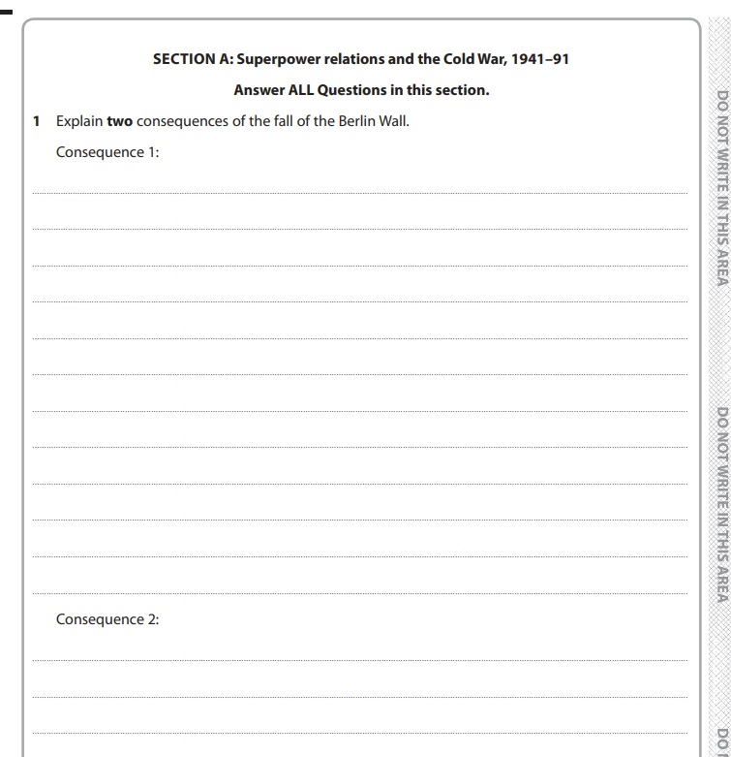
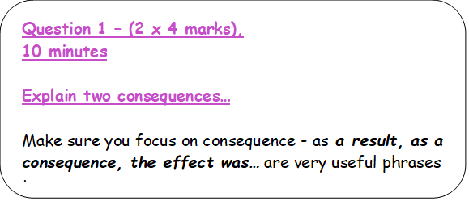
Consequence questions
https://www.youtube.com/watch?v=FiYtTwd4RYs

Slide 3
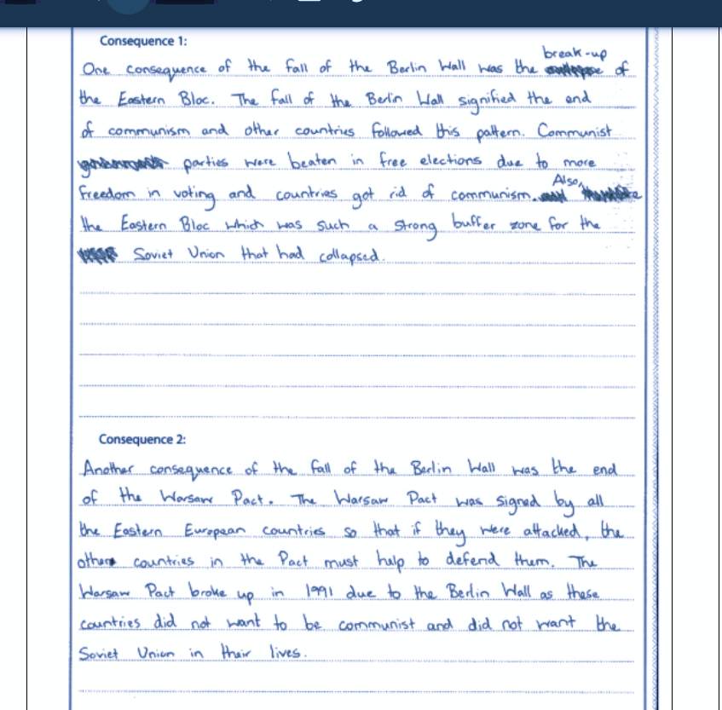
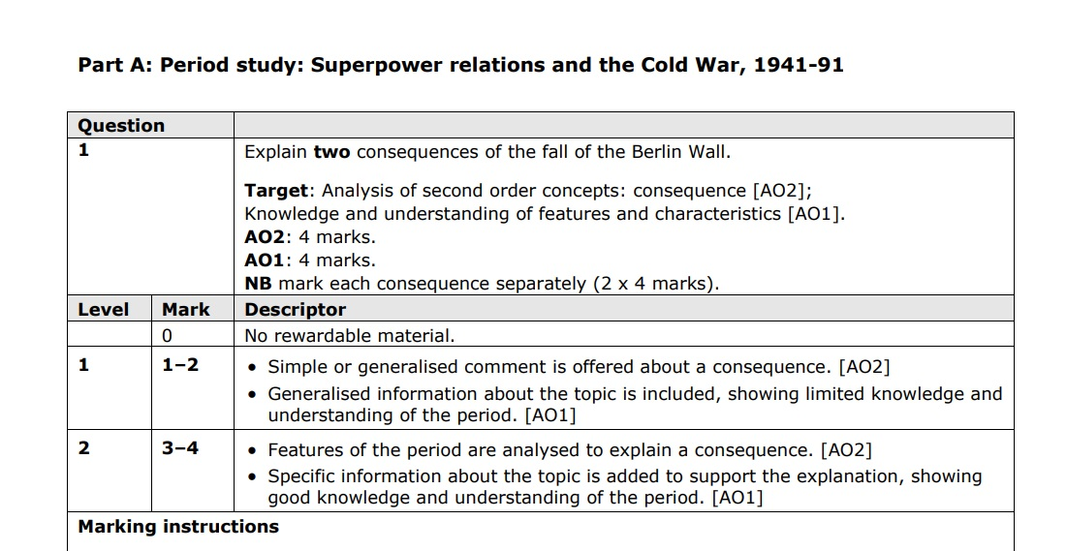
Marking task
What level would you give this?
What mark would you give this?
Why?

Slide 4
Marking task
Examiner comment: These are clear examples
of Level 2 responses. Both are Level 2 by
giving a feature of the period to explain a
consequence. The first discusses 'the break-up
of the Eastern bloc' and 'the end of communism’.
This is supported at AO1 with specific information
on 'free elections'. The second consequence is
Level 2 AO2, by commenting on 'the end of
the Warsaw Pact' with specific information on its
breaking up in 1991. The response shows a sound
understanding of the period, and of countries not
wishing to be controlled by the Soviet Union, with
the comment ‘did not want the Soviet Union in their lives'.

Slide 5
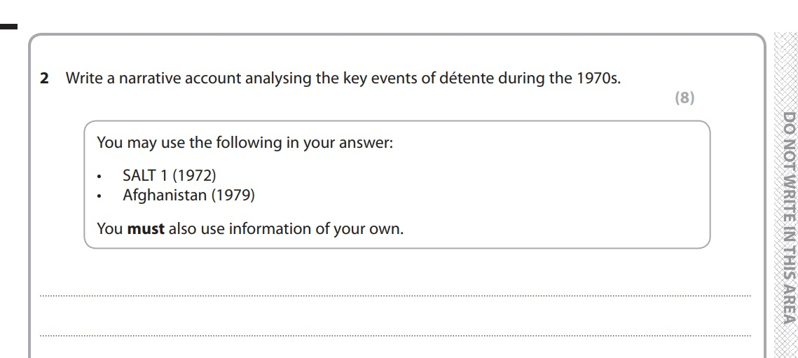
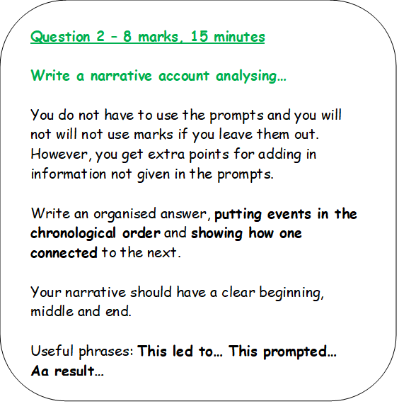
Narrative account questions
https://www.youtube.com/watch?v=K001dQPvT00

Slide 6
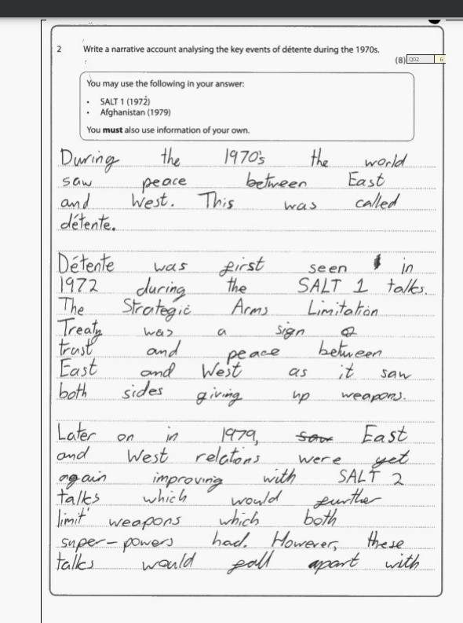
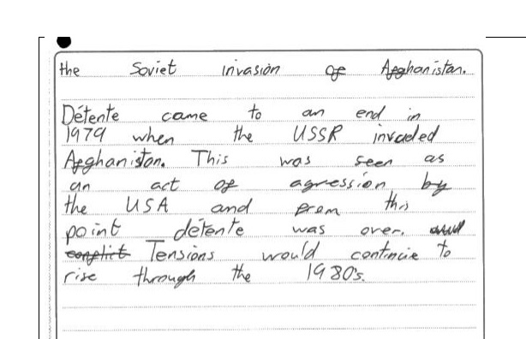
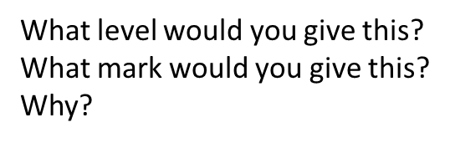
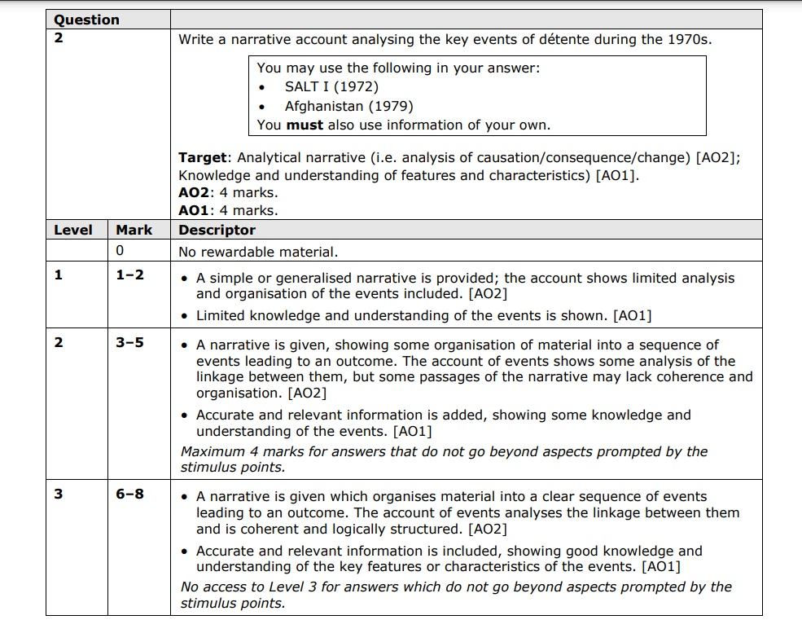
Marking task

Slide 7
Marking task
This script is an example of a low Level 3 answer, The sequencing is strong – 'Detente was first seen in ...’, 'Later on in 1979 East and West relations were yet again improving...’, 'However, these talks would fall apart with the Soviet invasion of Afghanistan', 'Detente came to an end in 1979....'. These phrases lend a strong coherence to the structure of the response. Good knowledge is shown of SALT1, SALT2 and some knowledge is shown of the invasion of Afghanistan. Examiner Tip: Candidates should try to ensure that responses show a clear sequence of events, which is supported with accurate and relevant information.

Slide 8
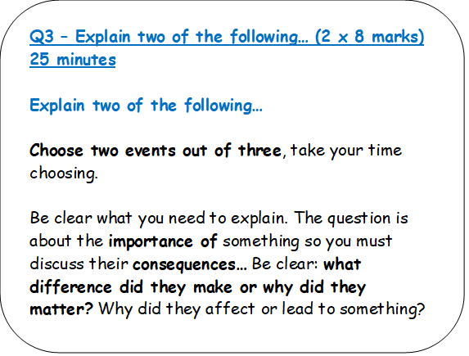
Importance questions
https://www.youtube.com/watch?v=3SEKlJm9FYM

Slide 9
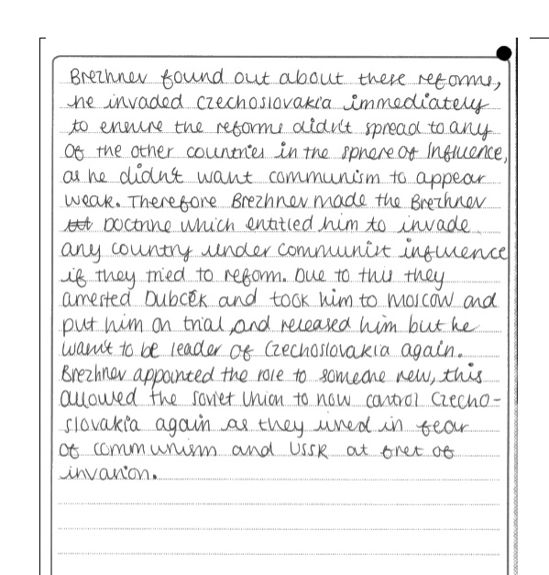
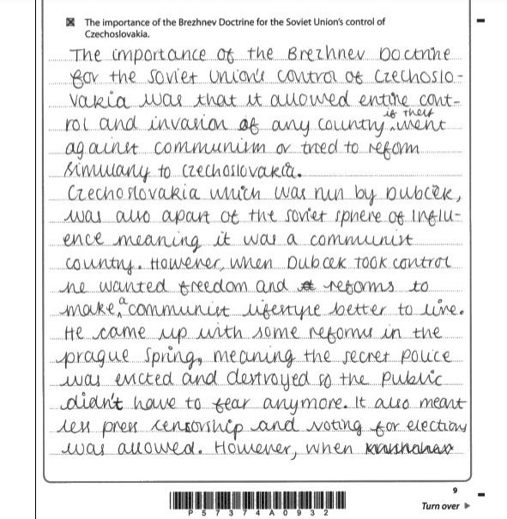
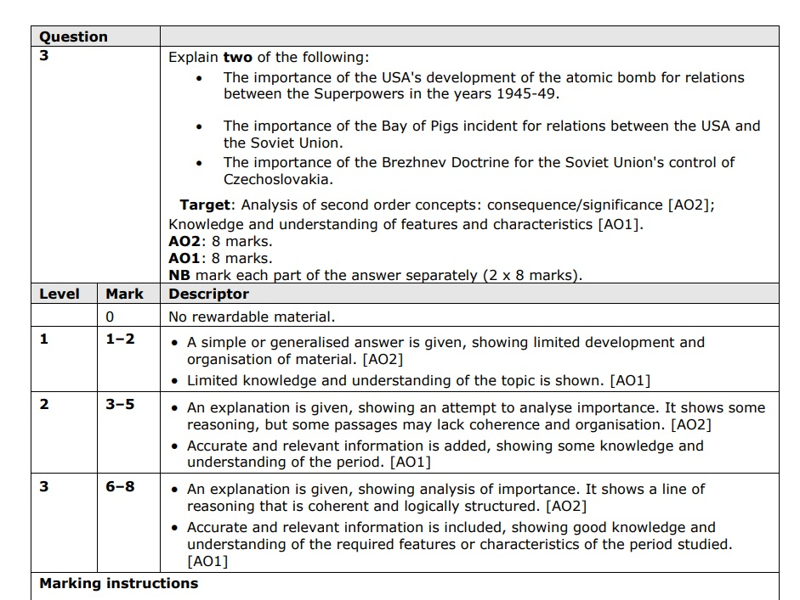
Marking task

Slide 10
Marking task
Examiner comment:
The answer is a low Level 3 on the importance of the Brezhnev Doctrine for the Soviet Union's control of Czechoslovakia, because it uses accurate and relevant information show some knowledge and understanding of the Doctrine and its impact on Czechoslovakia.
Examiner tip: Candidates should focus on the ways in which the specified aspect in the first part of the statement make a difference to the development given in the second part of the statement.

