Slide 1
Year 11 Revision Morning Wednesday 6th April 2022
All these materials will be placed on Google classroom

Slide 2
Dates of your exams
Weimar and Nazi Germany 1918 – 1939
Thursday 9th June
Henry VIII and his ministers 1509 – 1540
Thursday 16th June
The Cold War and the Superpowers 1941 – 1991
Tuesday 21st June

Slide 3
1. Overview / give you lots of useful stuff before the Easter break. 20mins. 2. To ensure that you know what you need to know for each part of the Cold War exam. Content Timings Different types of writing for the different questions. 30mins - Break 3. To revisit your mocks / attempt a new paper 55mins

Slide 4
1. Overview / give you lots of useful stuff before the Easter break. 15mins.
You should have;
A chocolate.
Two booklets – these contain the content, technique and timings for your three exams.
An excellent A3 content revision guide for the Cold War.
A paper planner to organise your Easter work.

Slide 5
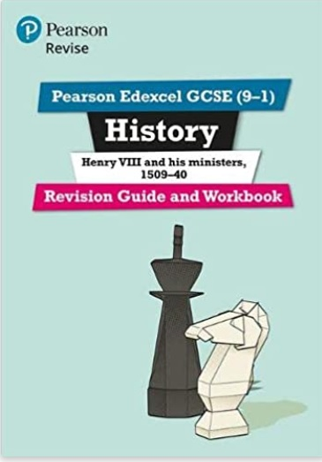
Revision Guides from the school shop/Amazon

Slide 6
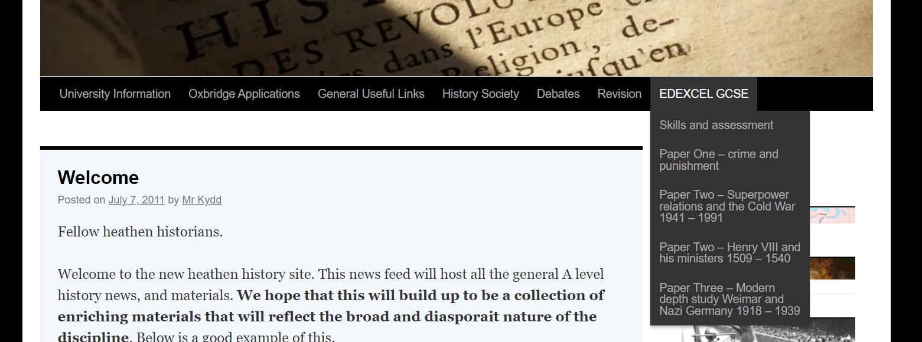
www.heathenhistory.co.uk
Contains;
Videos in course order
Revision guides
Podcasts
2018 papers / mark scheme / model answers

Slide 7
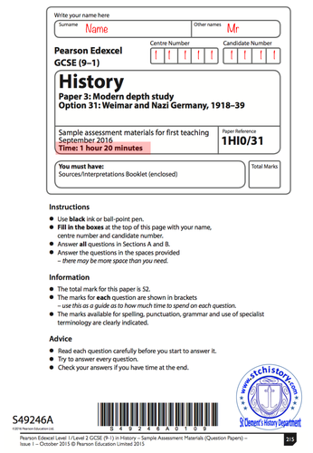
Past papers with
mark schemes
Can be found via the link below…
https://mathsmadeeasy.co.uk/all-past-papers/edexcel-gcse-history-past-papers/
You do them – we will mark them…

Slide 8
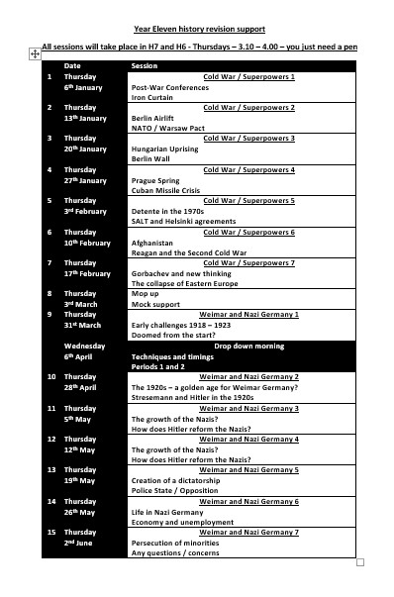
Teacher support is there if you want it

Slide 9
Re-cap
You now know…
What you need to know for when.
Your options for how you revise.

