Slide 1
Wednesday 1st June 2022

Slide 2
Dates of your exams
Weimar and Nazi Germany 1918 – 1939
Thursday 9th June
Henry VIII and his ministers 1509 – 1540
Thursday 16th June
The Cold War and the Superpowers 1941 – 1991
Tuesday 21st June

Slide 6
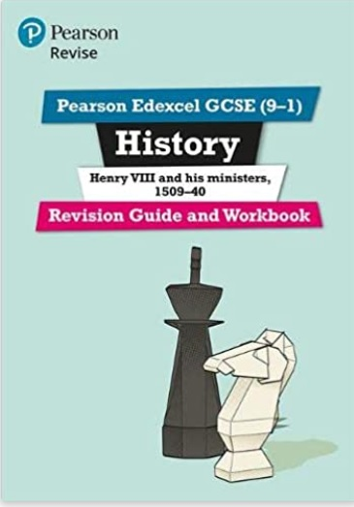
Revision Guides from the school shop/Amazon

Slide 7
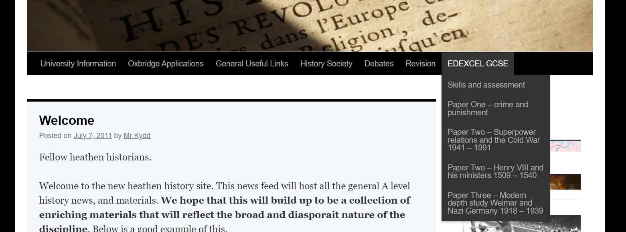
www.heathenhistory.co.uk
Contains;
Videos in course order
Revision guides
Podcasts
2018 papers / mark scheme / model answers

Slide 8
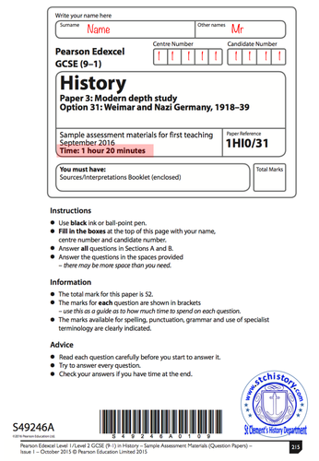
Past papers with
mark schemes
Can be found via the link below…
https://mathsmadeeasy.co.uk/all-past-papers/edexcel-gcse-history-past-papers/
You do them – we will mark them…

Slide 9
A good 20 minute video walk through
https://www.youtube.com/watch?v=8Bt9kJONnHs

Slide 11
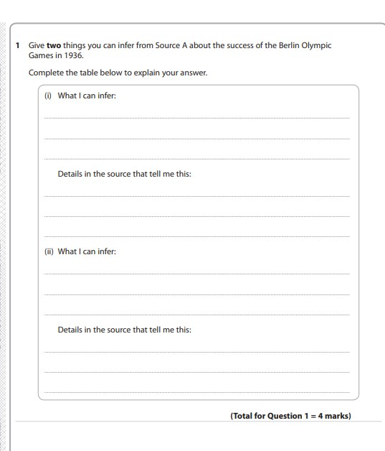

Slide 12
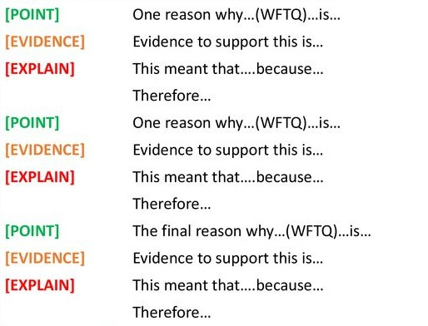
Explain why questions – causation 15 minutes – three paragraphs

Slide 18
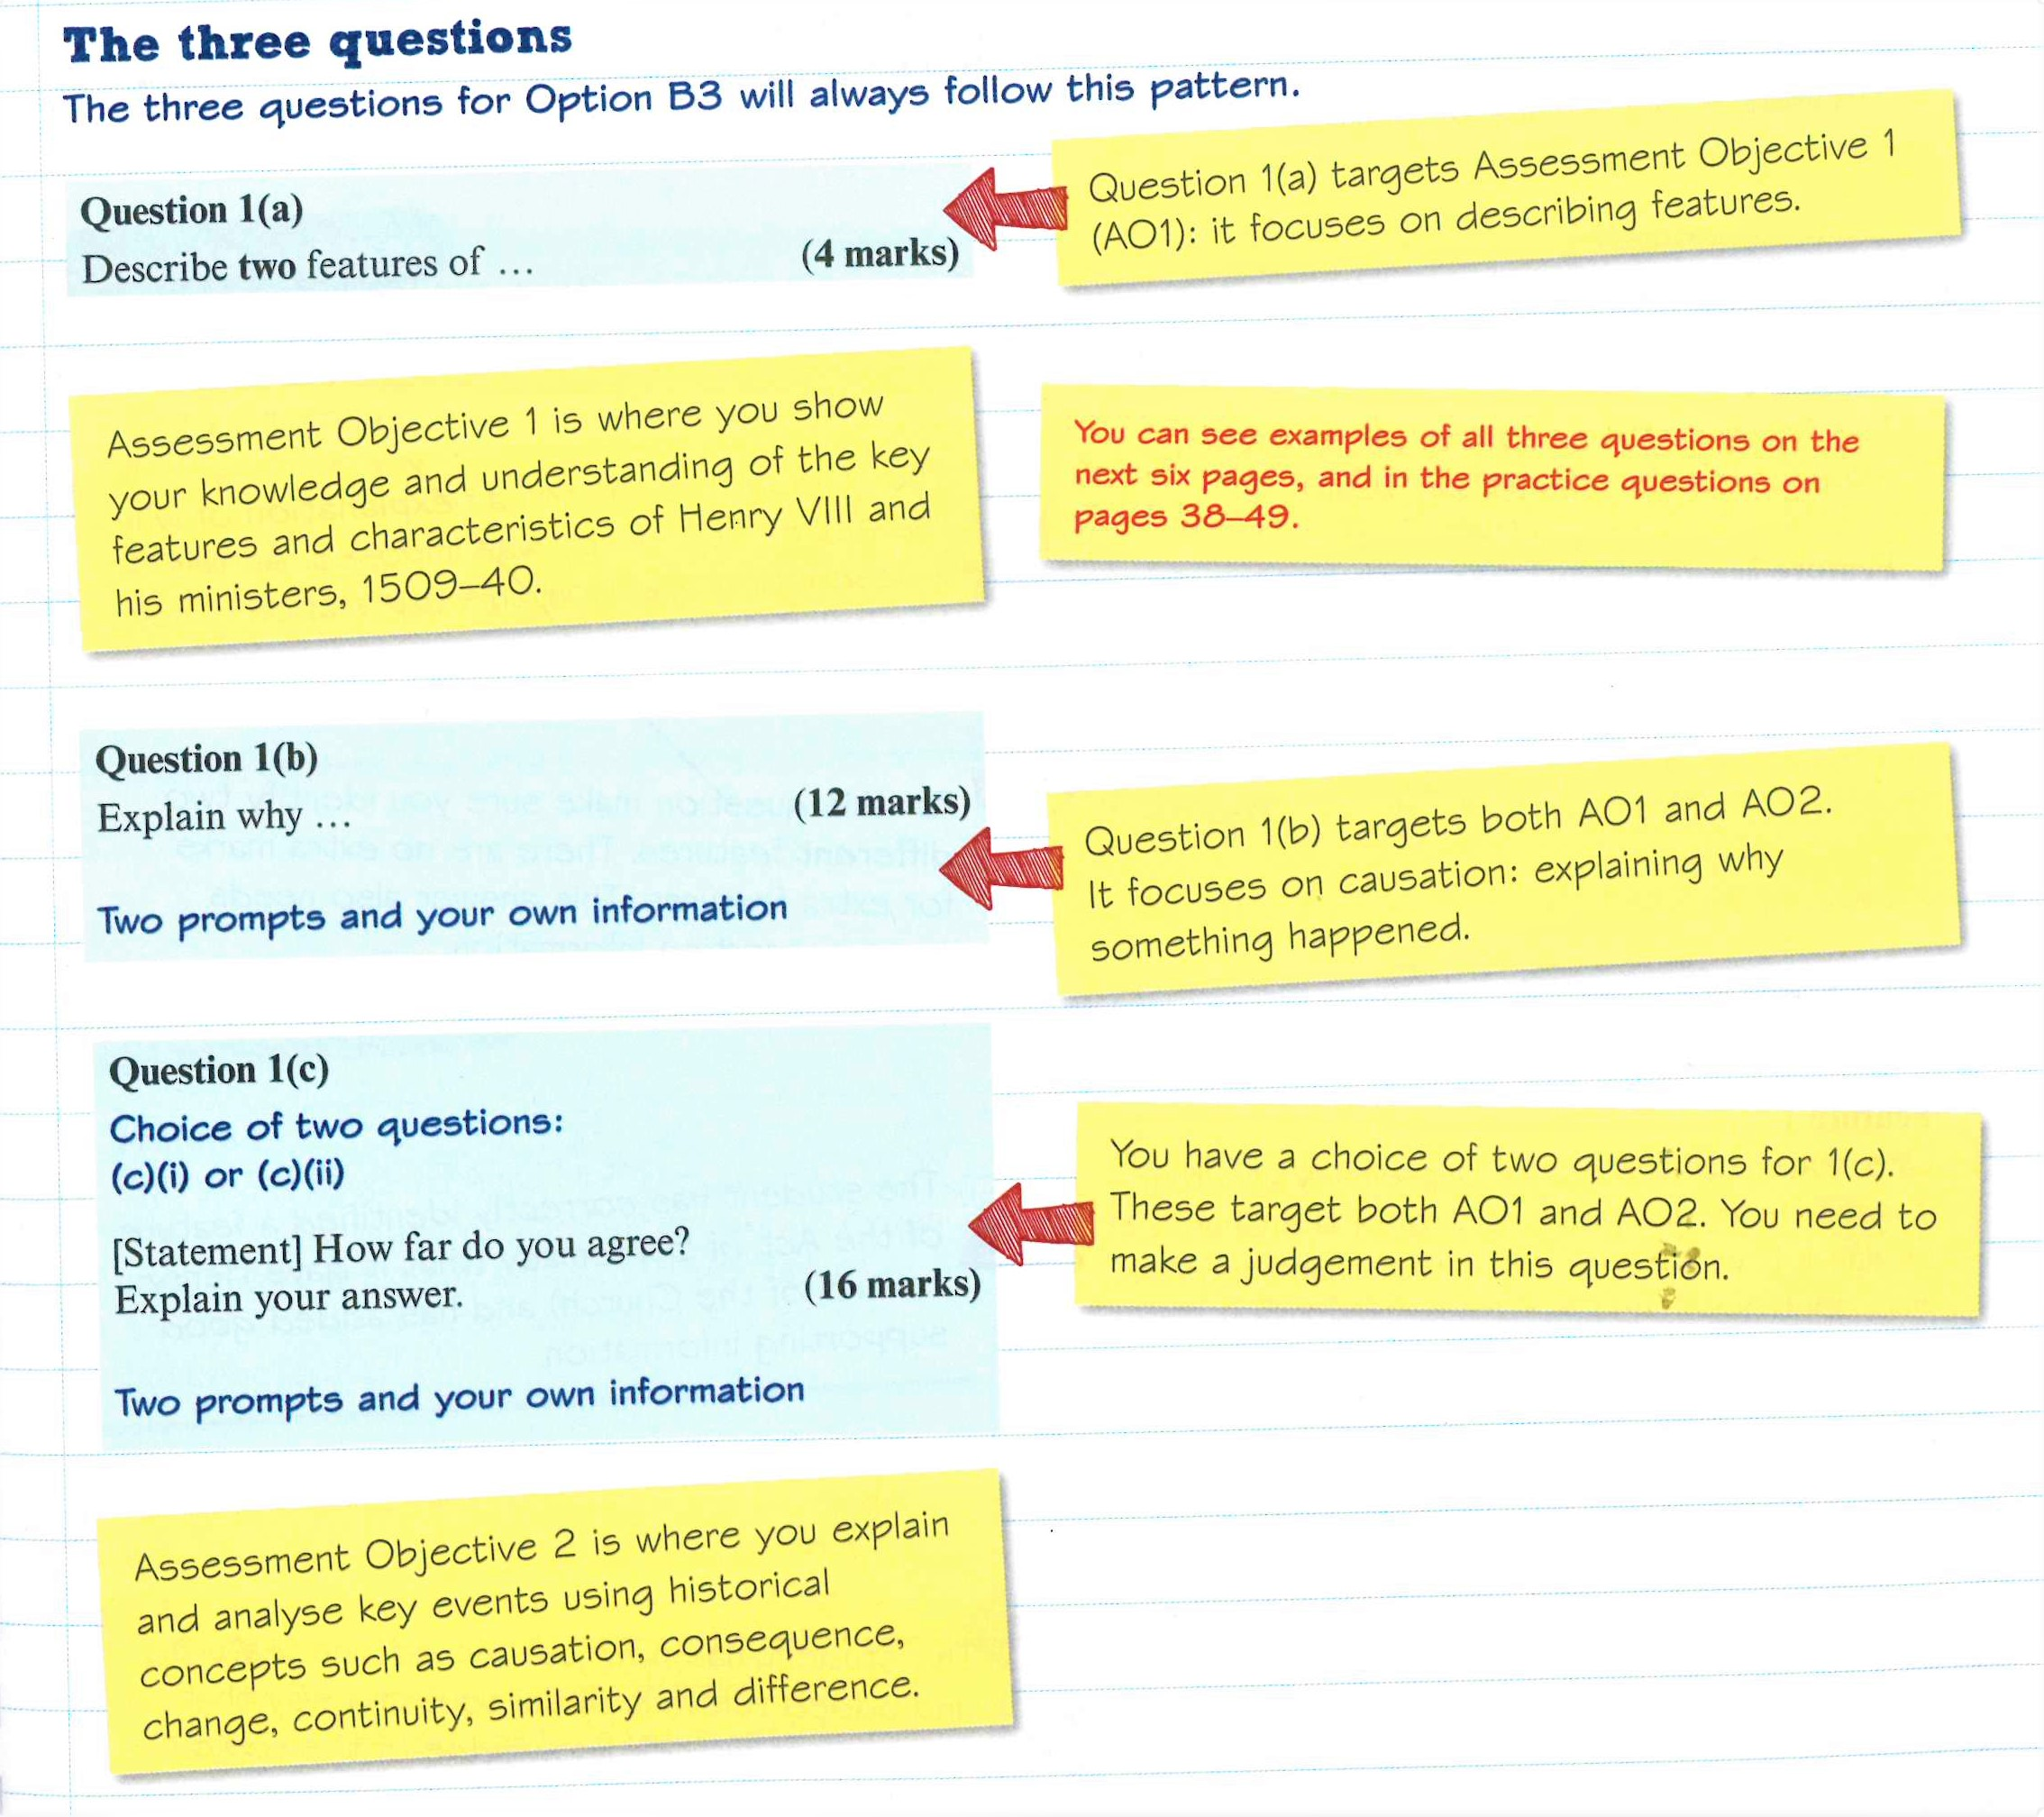
Henry VIII and his ministers 1509 – 1540 Thursday 16th June
5 minutes
15 minutes
30 minutes
A Good 15 minute teacher walk through
https://www.youtube.com/watch?v=KuoQRNicxqk

Slide 22
The Cold War and the Superpowers 1941 – 1991 Tuesday 21st June
12 minutes
13 minutes
25 minutes
A Good 15 minute teacher walk through
https://heathenhistory.co.uk/paper-two-superpower-relations-and-the-cold-war-1941-1991/

